Slide 1
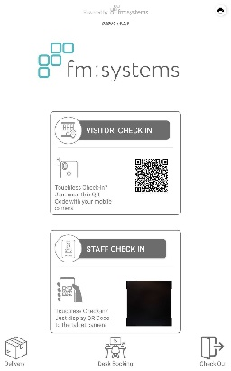
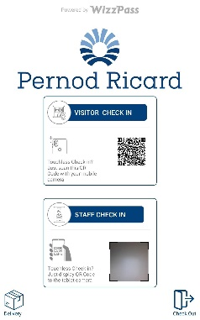
1) USING YOUR VISITOR
MANAGEMENT EMPLOYEE
DASHBOARD
Easier |
Simpler |
Smarter

Slide 2
how the FM:SYSTEMs visitor management works
Hosts pre-book their visitors via their calendar invite or via the Employee online portal.
The visitor automatically receives a pre-arrival email with visitor instructions and directions, as well as a link to do their online pre-registration prior to their arrival.
On the day of their meeting, the visitor uses the Self-Service kiosk at reception to check-in. If they did not complete the pre-registration before their arrival, then they will have to do so at the reception area.
Once the visitor has checked in, then the host gets an email or SMS notification notifying them that their visitor has arrived.
The receptionist can also immediately see which visitors have checked in and who their host is, and then asks the visitor to wait to be collected by their host.

Slide 3
how the FM SYSTEMS OFFICE RESERVATION SYSTEM WORKS
Prior to arrival, staff members will be required to book their visit to the premises for the day they need to be on site
On arrival, if the reservation is complete, the employee’s name will be picked up on the security scanner/ Kiosk.
The employee’s unique QR code Access Card can also be used to enter the premises when scanned
If the employee has not reserved office space for the day, their name will not appear on the scanner, and the QR code Access Card will not work
Employees will be unable to book on days where the maximum capacity has been reached – this will be indicated on the calendar

Slide 4
How to ACCESS THE HOST DASHBOARD
The staff reservation option is accessible under the “Workspace Reservations” tab
Employees can select which tenant they would like access to, and then select the days on the calendar that they would like to reserve space for
Employees will be able to book a desk and meeting room for specific days
Visitors and colleagues can be added via email to meeting room reservations. This triggers a notification and welcome mail to the visitor or colleague
Reservations can also be cancelled in the menu to the right

Slide 5
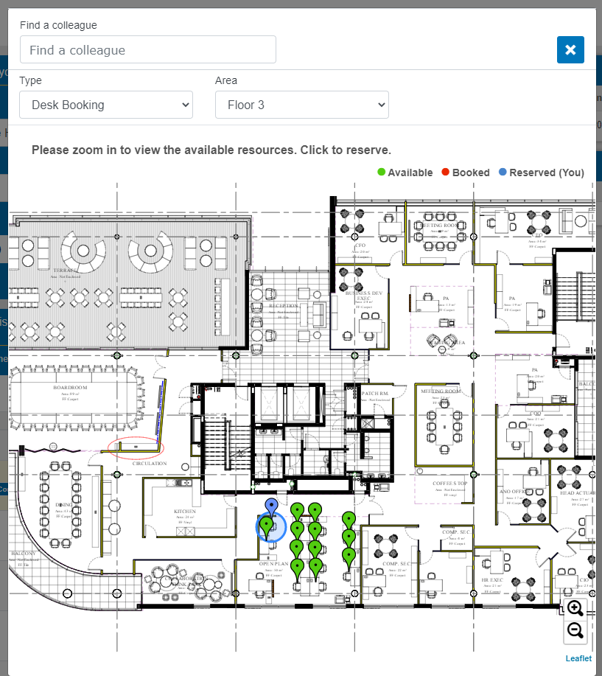
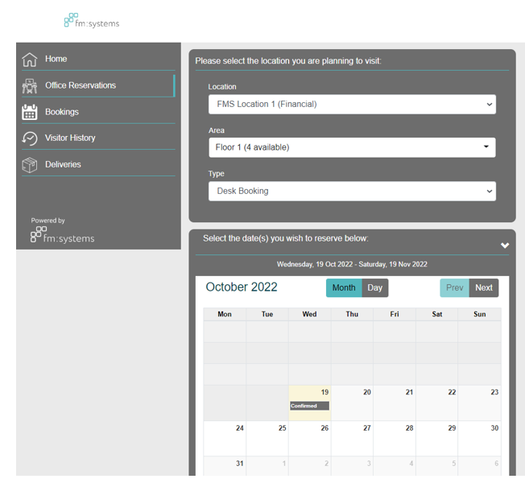
FM:EMPLOYEE DASHBOARD
Desk Booking can be found in the menu of the left hand side
Employees can select which tenant they would like to reserve space at, as well as whether they want to book a desk or meeting room
A pop up with the map layout appears when a date is selected on the calendar
The colour of the pins indicates availability of the desk
Each desk has a description to indicate what’s available (i.e. telephone line)
The selected desk pin turns blue when booked
Booked days will show “Confirmed”

Slide 6
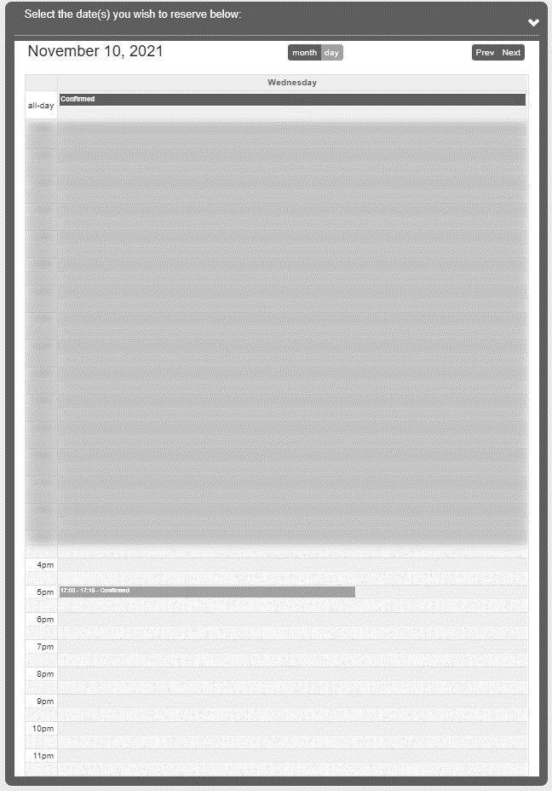
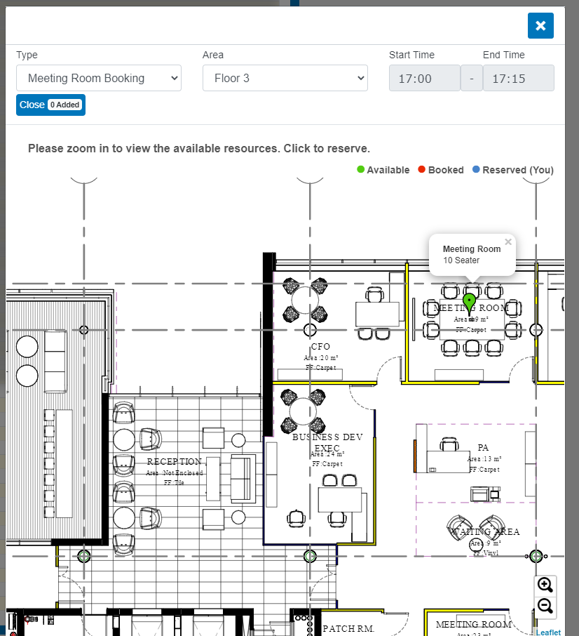
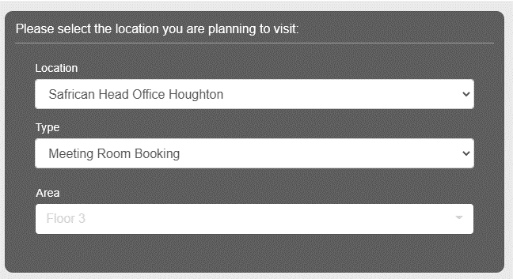
FM: SYSTEMS MEETING ROOM RESERVATIONS – HOST DASHBOARD
Employee selects Meeting Room Booking on the drop down
The meeting times can be updated on the top right of the map pop up
Additional invitees can be added via email to the meeting room
The meeting room pin will change colour when the time its booked is selected
The calendar view can be changed to a day view. Employees can select the time they’d like to book the meeting room for, and the map will open up

Slide 7
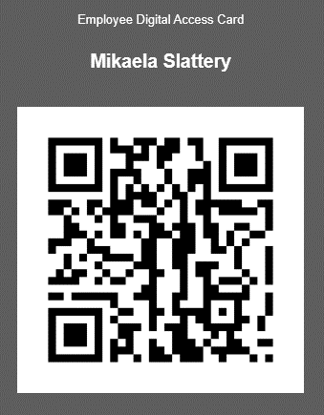
Sanlam OFFICE RESERVATIONS – HOST DASHBOARD
Bookings can be cancelled, with the status indicated
Planned visits are displayed on the right hand side of the screen once booked
The access card becomes active on the days with active office reservations
Upcoming invites to meeting rooms by colleagues are also available on the right hand side

Slide 8
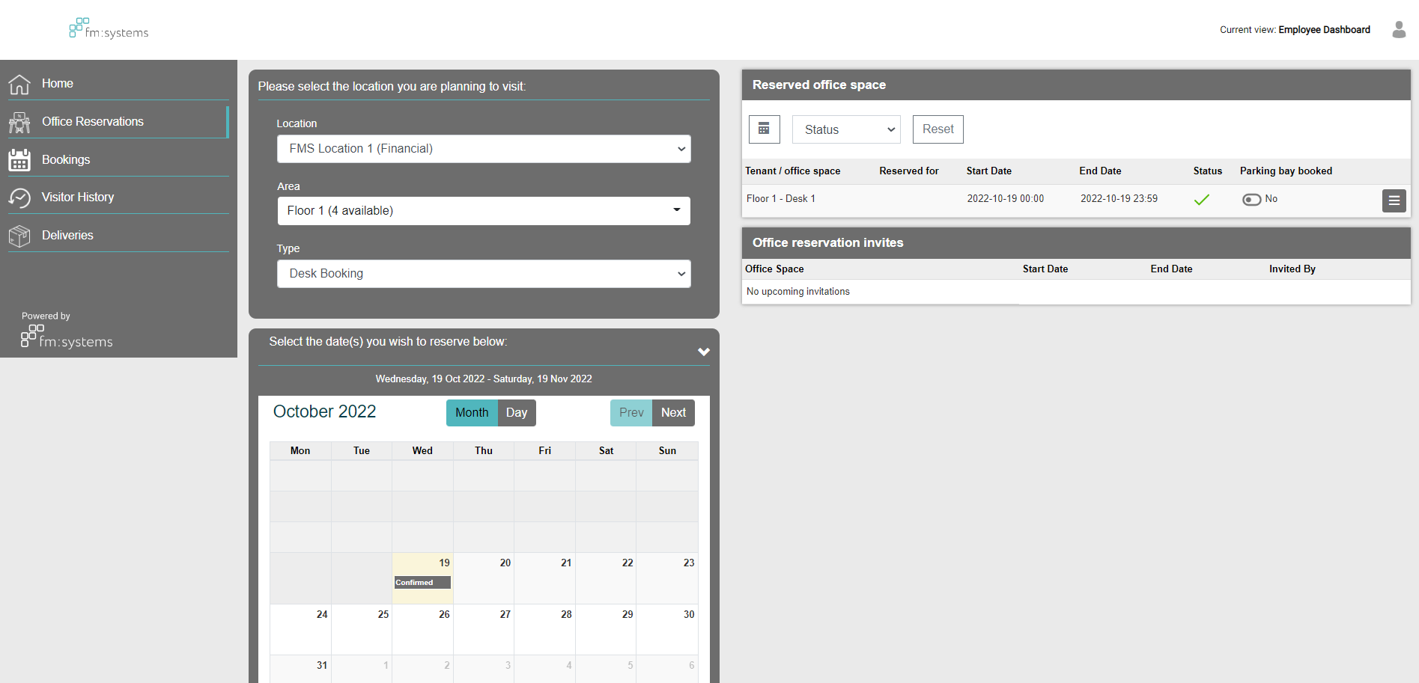
FM:EMPLOYEE DASHBOARD

Slide 9
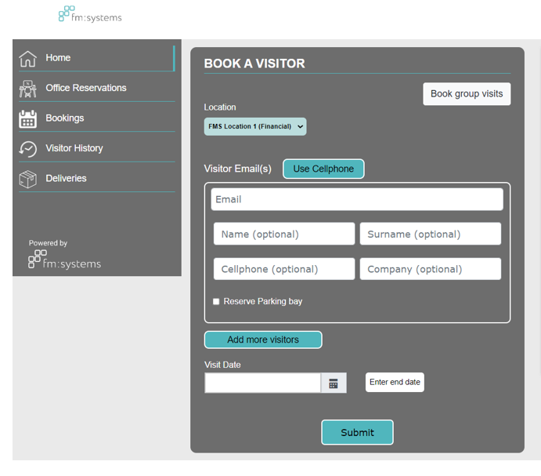
FM:EMPLOYEE DASHBOARD
To book visitors onto site, go to visitor bookings, enter the persons email address or cell phone number, as well as the date of their visit. Thereafter they shall receive a link asking them to pre-register their information prior to their visit.
Enter your guest’s Particulars
Click to add more guests
Add the date of the visit and the end date, if appropriate
Click Submit to add the guest. They will automatically be sent the pre-registration email

Slide 10
FM:EMPLOYEE DASHBOARD
View all currently booked visits you’ve added
Search for a visitor already booked
You can export your visitor bookings to either PDF or CSV
View visit details
Edit visit details
Cancel visit

Slide 11
FM:SYSTEMS EMPLOYEE DASHBOARD
Digital Access card is shown to the kiosk at reception, this allows for a quicker check in process

Slide 12
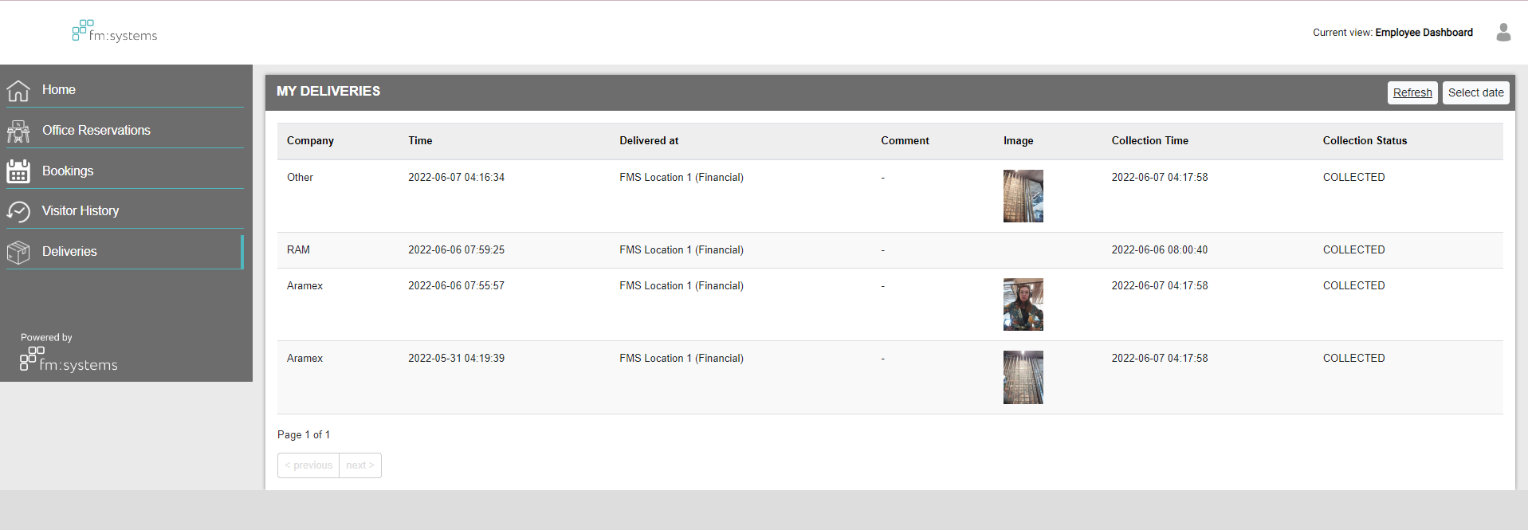
FM:SYSTEMS EMPLOYEE DASHBOARD
Under deliveries, you are able to view all of the deliveries assigned to as well as the status.

Slide 13
USING THE FM:SYSTEMS VACCINATION
CONFIRMATION SYSTEM
Easier |
Simpler |
Smarter

Slide 14
how the FM: SYSTEMS VACCINATION CONFIRMATION SYSTEM WORKS
Employees will be requested to provide proof of vaccination status or negative PCR test to be granted access to the building.
Administrators will be able to approve or deny the proof provided, along with a reason
Employees at specific locations will be redirected to the vaccination page via a pop up reminder
Employees will select their vaccination status from a pre-populated list, and follow the prompts thereafter

Slide 15
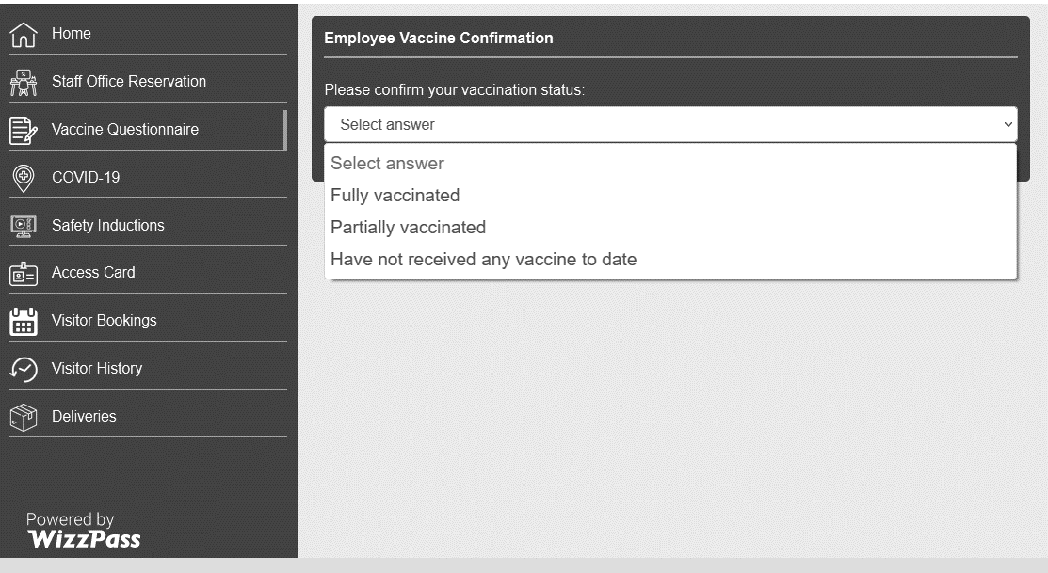
Employee dashboard landing page
Once employees login to their dashboard a pop up will appear requesting they submit their vaccination status answer.
Employees will be able to select their answer rom the drop down available. Additional steps will be required depending on the employee’s selection
Employees will be automatically redirected to the Vaccine Questionnaire tab

Slide 16
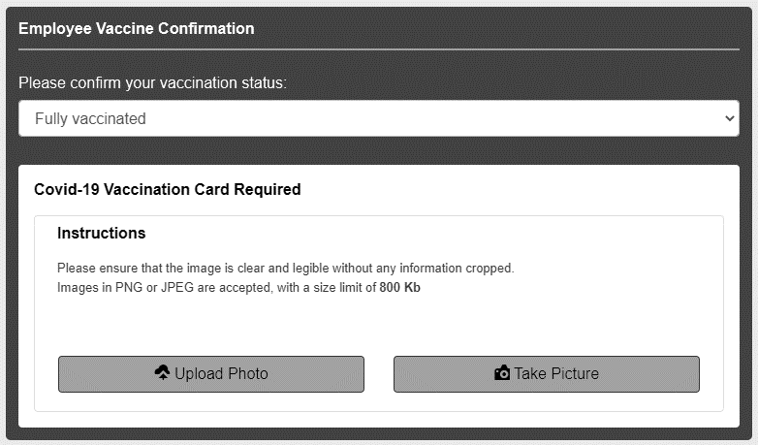
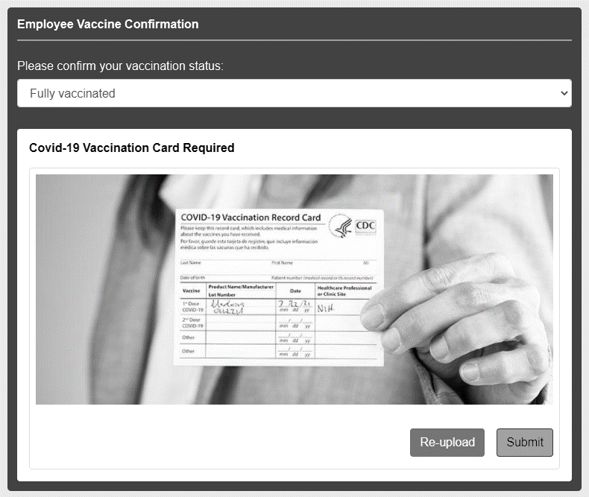
answer selection and upload
If a vaccination card is required as proof, employees will be required to either upload or take a photo
Employees can review their upload or captured photo before recapturing or submitting

Slide 17
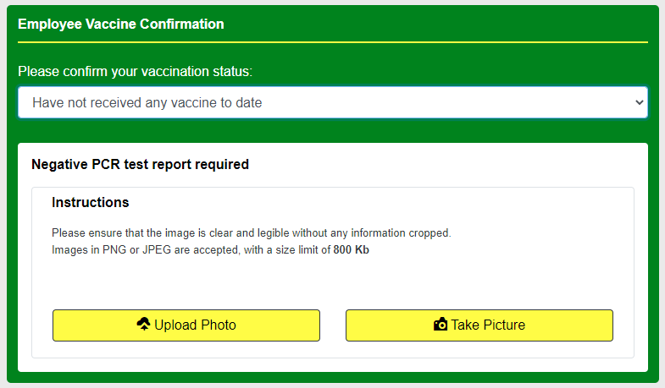
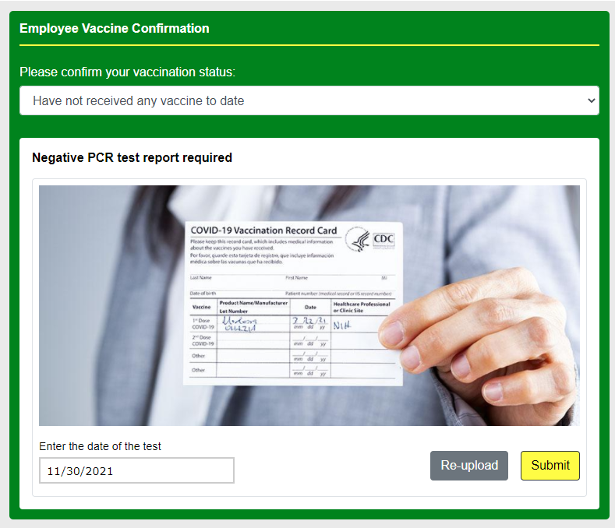
Answer selection and upload
If a negative PCR report is required as proof, employees will be required to either upload or take a photo
Employees can review their upload or captured photo before recapturing or submitting.
For PCR test submissions, the date of the test will need to be selected.
Once the validity of the PCR test has expired, employees will be required to update their answer and proof.

Slide 18
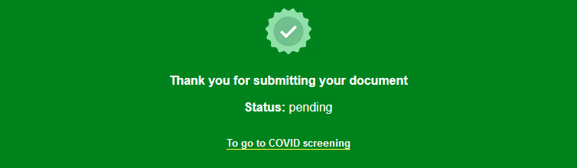
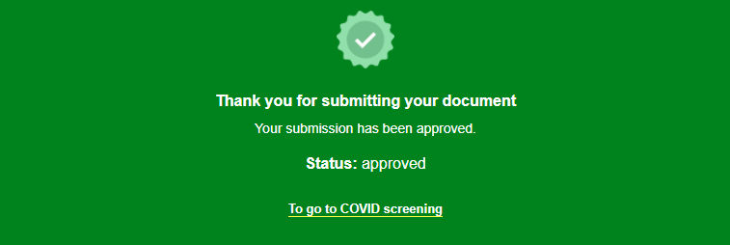
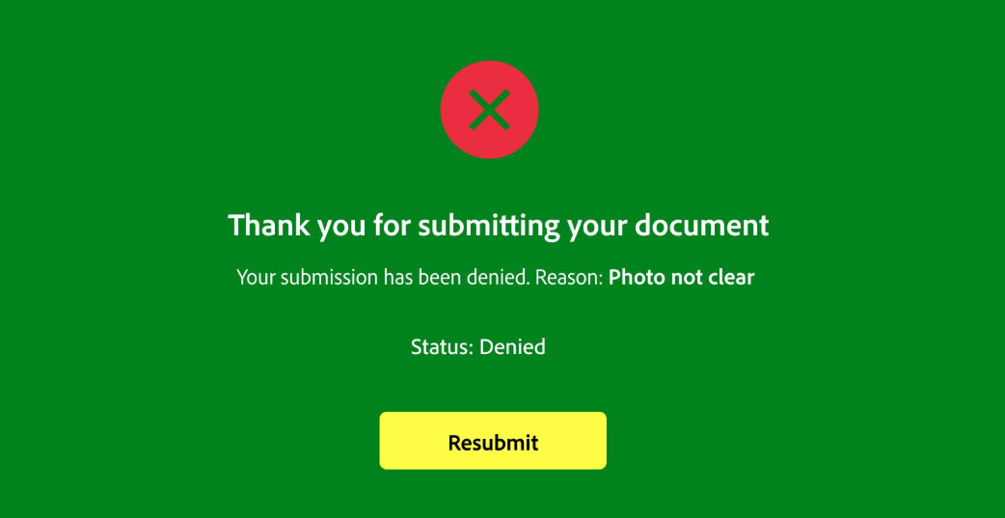
STATUS AND VALIDITY
Once the uploaded document is submitted, employees will proceed with their daily COVID-19 screening questionnaire (If required)
Employees will be able to check the status of their submission on the Vaccination Questionnaire tab
If a submission is denied, the employee will be required to start the process again.
A reason for denial will be provided.

Slide 19
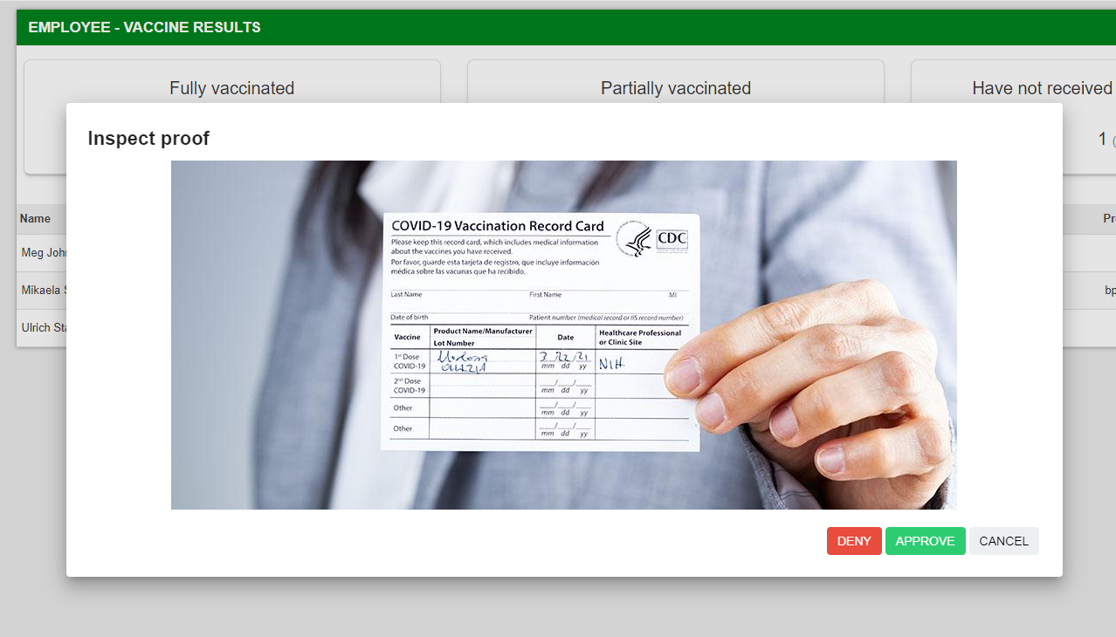
ADMINISTRATION DASHBOARD
Once the proof is inspected, the administrator can approve or deny, and provide a reason
All vaccine and PCR test submissions are listed in the “Vaccine Results” tab
Admins will select “Review” to view the photographic submission

Slide 20
ADMINISTRATION DASHBOARD
Once the proof is inspected, the administrator can approve or deny, and provide a reason
All vaccine and PCR test submissions are listed in the “Vaccine Results” tab
Admins will select “Review” to view the photographic submission

Slide 21
how the FM: SYSTEMS ASSISTANT SETUP WORKS
Assistants can assign themselves to do the following:
Receive visitor arrival notifications on behalf of a colleague
Make online visitors' bookings on behalf of a colleague
To setup these permission options, the assistant should first make sure your companies administrator has enabled them as an assistant.
If your company has enabled the ability to add yourself as an assistant, you shall be able to do this on the employee dashboard.
Once an assistant has been created the nominated colleague shall receive an email confirmation.
The colleague then clicks on the “Manage permissions” link, which will ask them to login, and they can then select “Assistants” and select which permission(s) to give to the assistant:
Receive visitor arrival notifications on their behalf, and/or
Make online visitors' bookings on their behalf.

Slide 22
Creating an assistant- employee dashboard
You shall select the add assistant.
To make yourself an assistant you shall go to “Assistants” under the settings tab.
Enter in your assistants email address, select the rights and submit.

Slide 23
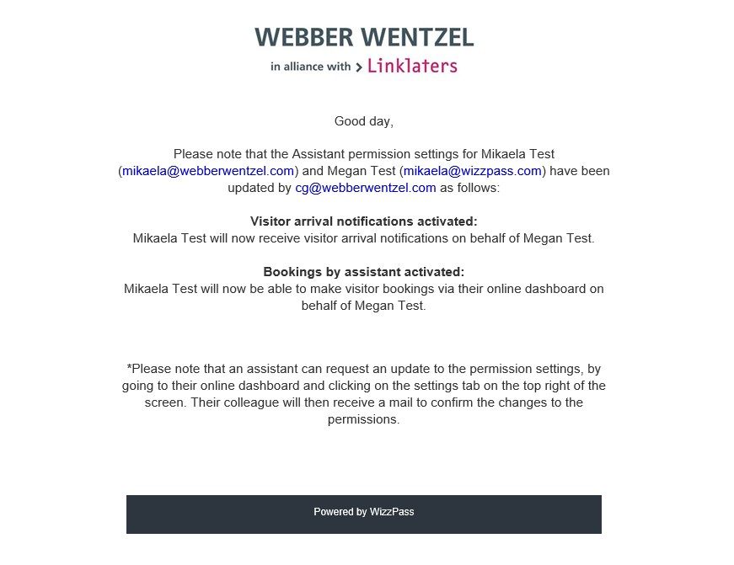
Creating an assistant- employee dashboard
The assistant shall now receive a mail confirming their assistant status.

Slide 24
How assistants can pre-book visitors on behalf of a colleague: OUTLOOK
To pre-book a visitor on behalf of a colleague via a calendar invite, the assistant must use that colleague’s own calendar to send the calendar invite – the calendar invite must come from the colleague’s own email address.
The normal process for booking visitors via a calendar invite is followed – depending on where the meeting is taking place, employees can add either emailsetupbyfmsystems@fmsystems.com or emailsetupbyfmsystems@fmsystems.com in the “To” field of their calendar invite to automatically book all the external visitors included in that calendar invite.
If new attendees are added, or the meeting details are updated after the initial invite has already been sent out – if asked, please select the option to “send update to all invitees”.
After booking a visitor, the host (from whom the calendar invite was sent) will receive a confirmation email showing which visitors have been added to the system and have been successfully booked.
Once a visitor has been booked, the visitor will receive an email confirmation with their visit details, parking instructions, map link to the building and instructions on how they can pre-register their details before their arrival.

Slide 25
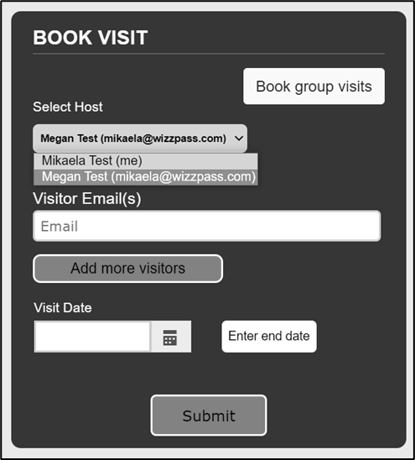
How assistants can pre-book visitors on behalf of a colleague: EMPLOYEE DASH
Assistants will be able to use their Visitor Dashboard to view, make, edit and manage visitor bookings on behalf of a colleague, as well as their own visitors.
Once logged in, the assistant will be able to book visitors by selecting the host, entering their visitor(s) email addresses and the date(s) of the visitors’ upcoming visit.
Assistants will be able to view all upcoming visits that have been booked (and for which host) and also search for individual bookings using the search function. Assistants will also be able to edit or delete any upcoming bookings. If a visit is edited or deleted, an email is sent to the host confirming the changes they have made.
Assistants will also be able to view the history of all their visits from the dashboard. This list can be exported to PDF, specific visitors can be searched for and you can also search the Visit History by date.

Slide 26
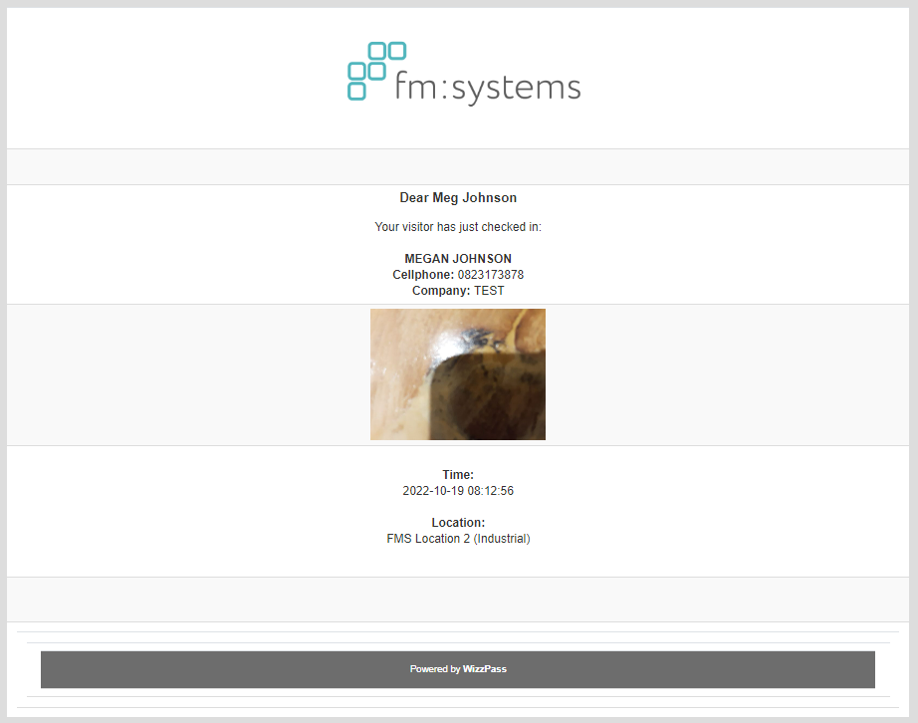
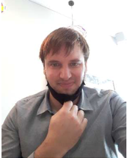
How assistants will receive visitor-arrival notifications on behalf of a colleague
As visitors arrive at Webber Wentzel, the assistant (instead of the host) will receive an email/SMS notification notifying the assistant that the visitor for their colleague has arrived.

Slide 27
2) USING YOUR
VISITOR MANAGEMENT SYSTEM
Easier |
Simpler |
Smarter

Slide 28
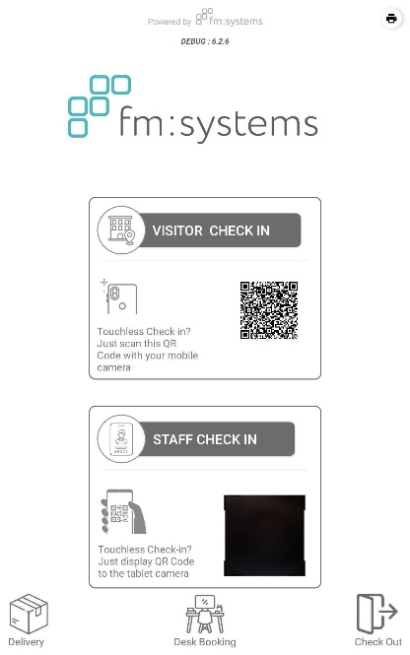
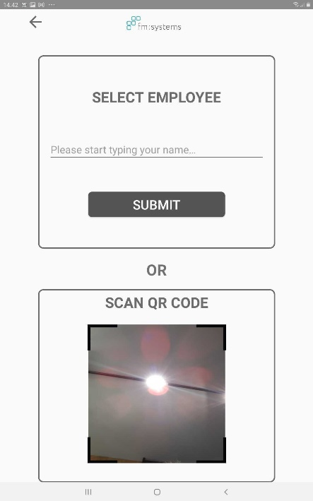
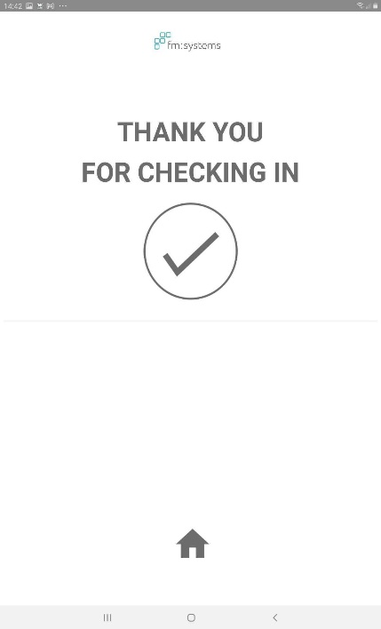
ON SITE CHECK-IN: Employees
You shall select check-in on the FM:Systems Tablet and select Staff Check in.
You can select your preferred way of checking into the building. Either with your Digital Access card or by Typing in your name
Once completed the staff member shall be checked in.

Slide 29
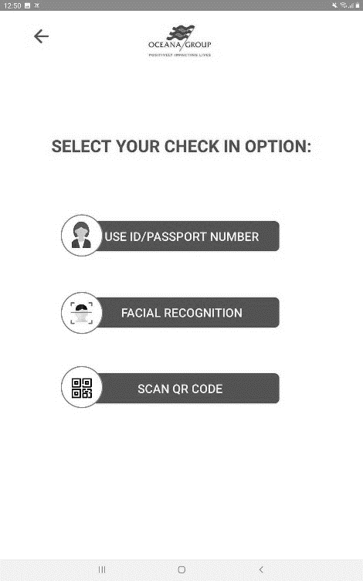
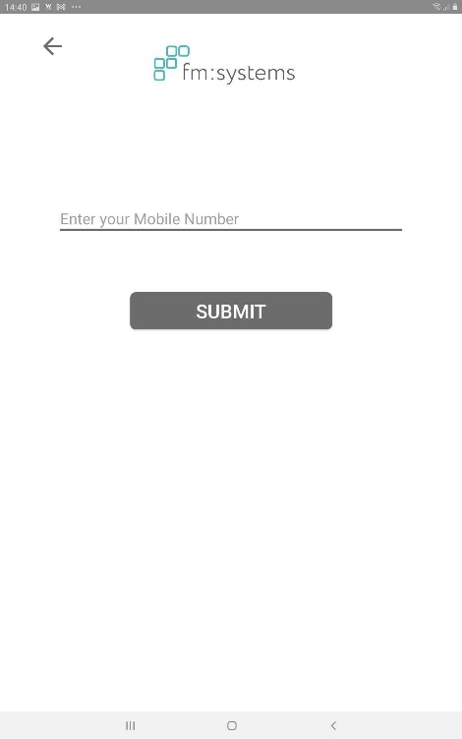
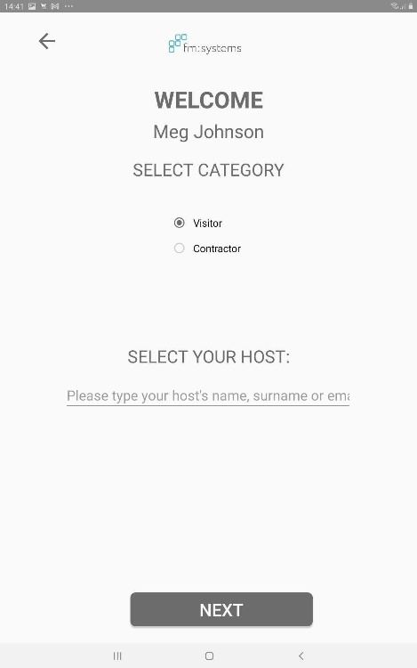
ON SITE CHECK-IN: Visitors
For Visitors, select visitor check in, alternatively ask the Visitor to scan the QR code and check in on their own device.
The Visitor shall select their preferred way of checking in.
The Visitor then needs to enter in either their mobile or identity number (Dependant on your setup).
The Visitor needs to Select their visitor category and then select their host. (If they had been pre-booked they will not be required to complete this step)

Slide 30
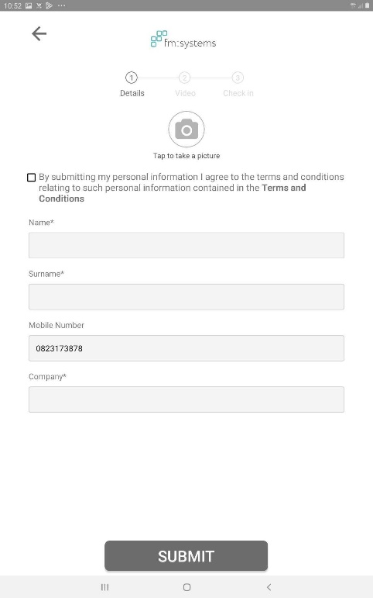
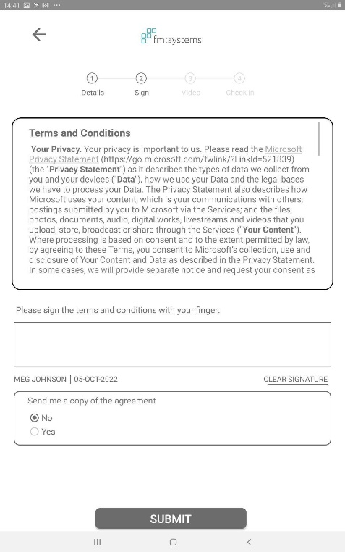
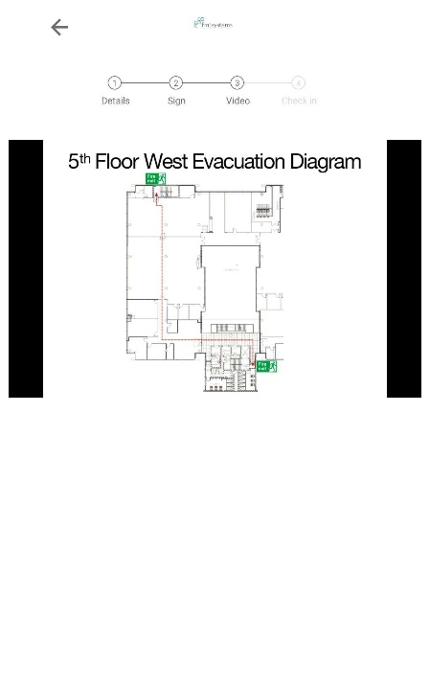
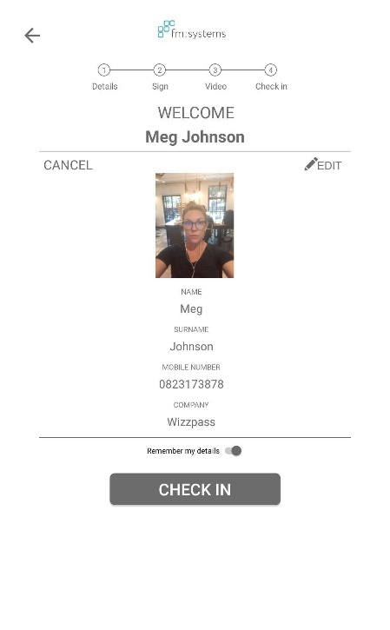
ON SITE CHECK-IN: Visitors CONTINUED
The visitor shall then be asked to enter in their particulars. These fields are fully customizable to your needs. If you have selected to have terms and conditions listed the visitor shall need to acknowledge them prior to proceeding.
If you would like terms and conditions that require a signature and can be mailed to the client, this will be on the next page.
If you require your guests to watch and induction video you are able to do so here, this may be preceded with a questionnaire should you wish. In turn this shall record the date of completion as well as the lapse date on the admin dashboard.
Once all of the relevant fields have been completed the guest has an opportunity to review their information prior to checking in.

Slide 31
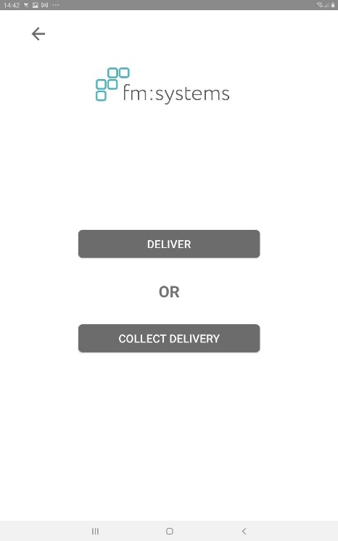
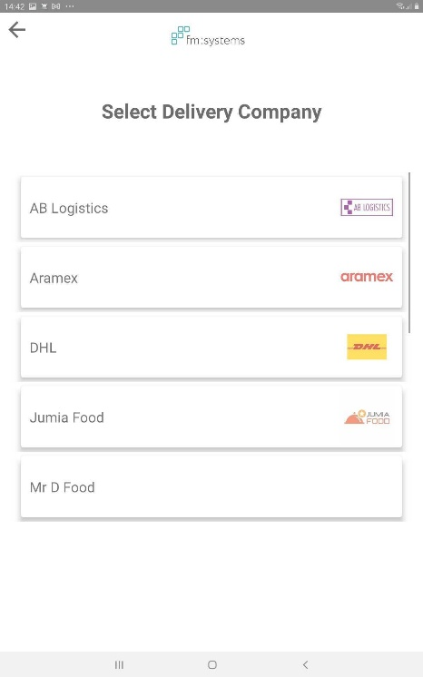
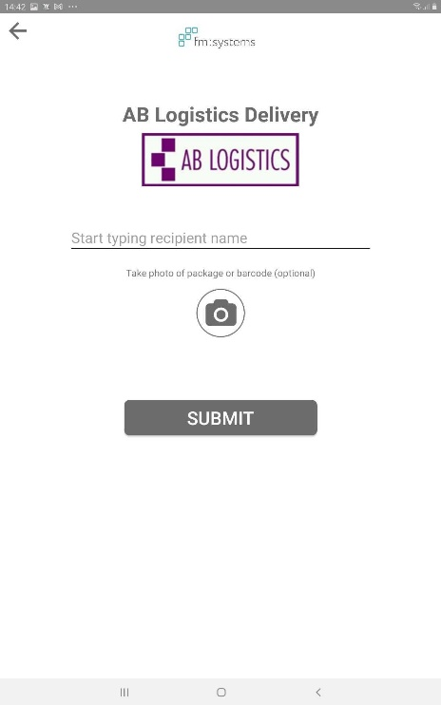
DELIVERIES
For deliveries, select the delivery icon.
Select the deliver tab
Select the delivery company
Select the Host to whom the delivery belongs, take a picture and submit. An email or SMS shall now be sent to the host notifying them of their delivery.

Slide 32
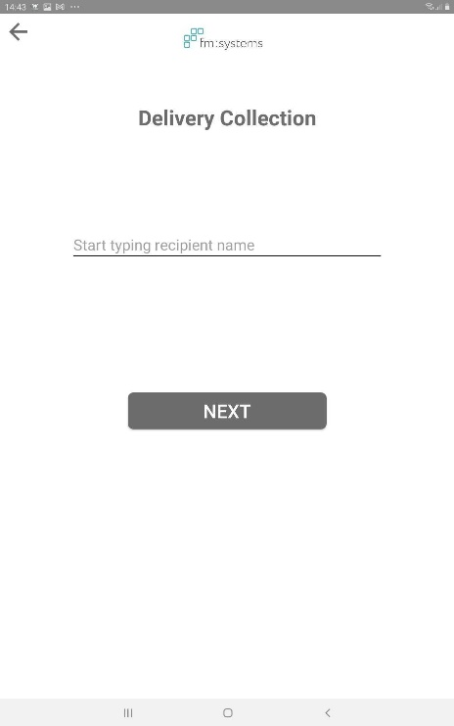
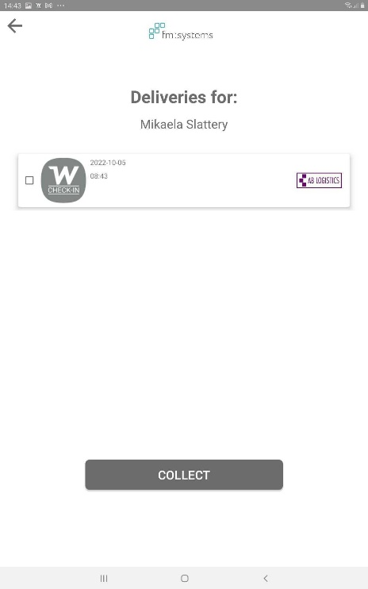
DELIVERIES: Collection
To collect a delivery, select the delivery icon
Select the collect delivery tab.
Type in the name of the recipient.
You will then be presented with all deliveries for the recipient. Click on the parcel and click the collect tab.

Slide 33
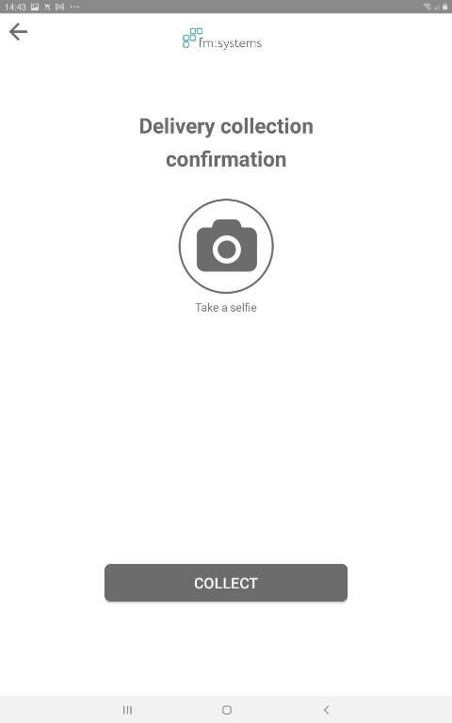
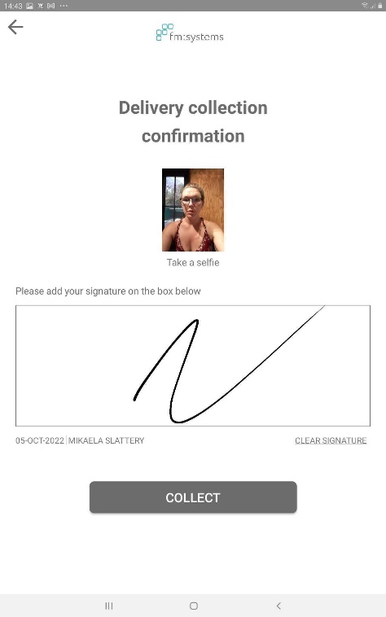
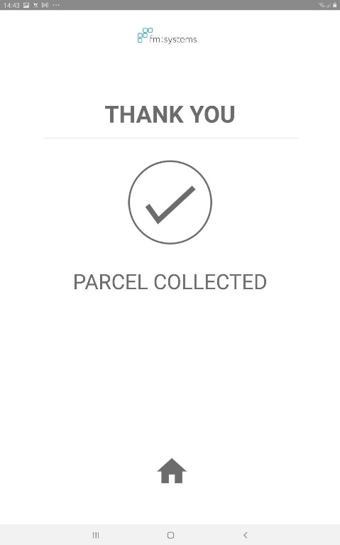
DELIVERIES: Collection continued
The recipient will then be asked to take a picture with the parcel.
Once the image has been captured the recipient is required to sign confirmation.
The recipient has now successfully collected their parcel.

Slide 34
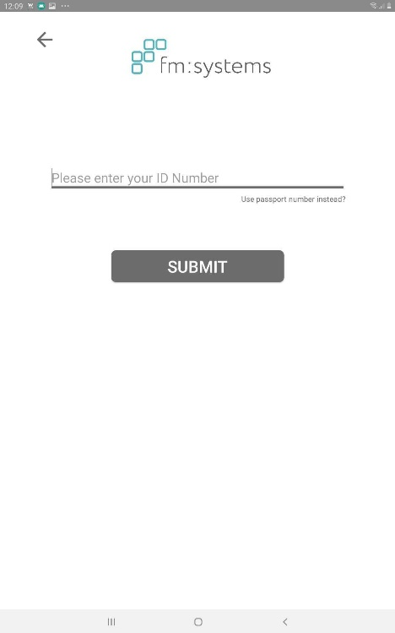
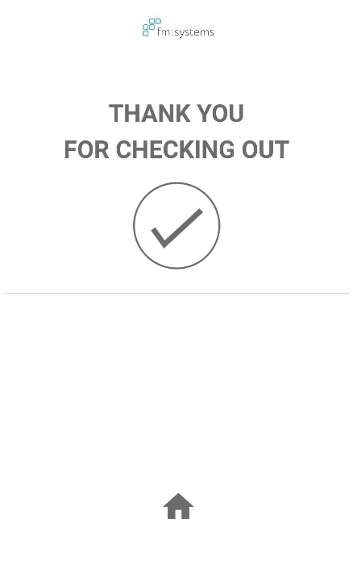
Checking out
To check out staff and visitors select the check out icon
For visitors they shall need to enter their ID number/ Cell hone number. For staff they shall need to enter their name.
Once submitted the individual has successfully checked out.

