Slide 1
Visitor Management Demo
For any questions about the visitor management reach out to uwtower@uw.edu.

Slide 2
What is Visitor Management?
UW Towers new method of visitor check-ins:
- This will notify guest arrivals to the host within the tower
- Will notify tenant when a package has been delivered
- Creates visitor badges for guest of the UW tower

Slide 3
How to Check-In
For general visiting use the
UWTower@uw.edu as the host
*Via Tower Tablets

Slide 4
How to Check-In
For general visiting use the
UWTower@uw.edu as the host
*Via Personal Device

Slide 5
Example of a Printed Badge
Date of Visitation
Photo of Guest
Name of Guest
Tenant they are visiting
Who they work for usually used for Vendors

Slide 6
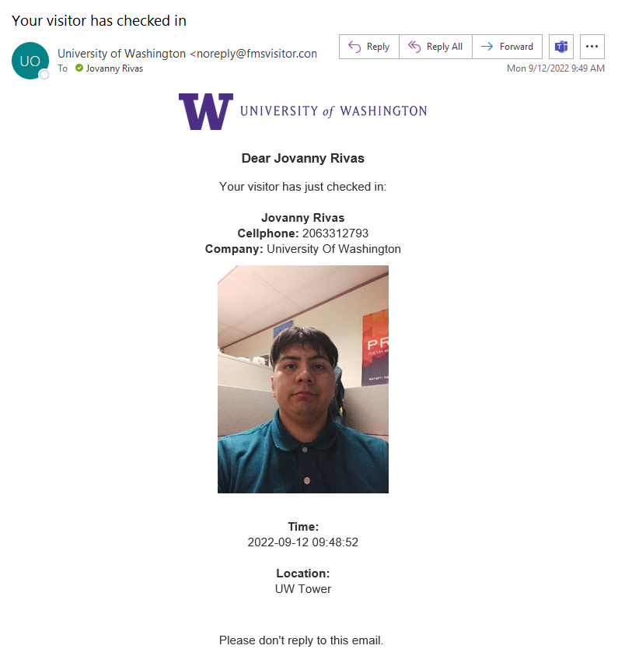
Email Notification
Email will be sent from Noreply@fmsvisitor.com
Contains Visitors Information
No required additional task

Slide 7
Check Out Process
*If guest do not sign out of visitor management
They will be checked out via 11:59PM

Slide 8
Badge Reprinting
*Used if badge doesn’t print first time & if you checked in via cell phone

