Slide 1
Creating Reservations via
Resource Scheduler

Slide 2
Step 1:
On the UW Tower Home page, scroll down until you see the Reservations section.
Click Reservation Information
Home Page: UW Tower | UW Facilities
Click Here

Slide 3
Step 2:
Read the information before proceeding to scroll down, then click Reserve.
You will be sent to Resource Scheduler.
Click Here
<- (Where you can find this guide)

Slide 4
This is the Home Page for Resource Scheduler.
The column on the left will contain all the reservation spaces in the Tower.
The UW Tower only manages the
C building, Mother’s Rooms,
O Building, and rooms on T-22.
The next slide will contain the list of rooms in each section.
column

Slide 5
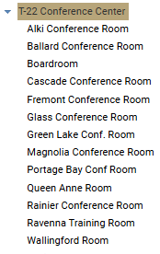
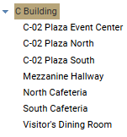
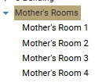
Reservation Locations
T-22 Conference Center
C Building
Mother’s Rooms
O Building
*These are private lactation rooms

Slide 6
Step 3a: Checking Availability
1) Select the location you want to reserve.
*Each space has a number in parathesis to show its capacity. Ex: (200)
2) Click on the calendar icon to specify the date you are wanting to make a reservation.
3) Select the date on the calendar.
2nd Click
1st Click
3rd Click

Slide 7
Step 3b:
On the left you can see the example of someone clicking on their desired date & reservation space.
(ex: Auditorium (200) + Thu 13)
Click on the space where your desired date/time & reservation space meet.
*Click the whitespace
Click Here

Slide 8
Step 4a:
This is the Quick Reserve form.
On the left you can see the questions you will be REQUIRED to fill-in for your reservation to be approved.
Continue to fill out the Quick Reserve form.

Slide 9
Step 4b:
Note that you will NOT be able to create your reservation unless all the fields on the form have been completed.
For one-time reservations
click SUBMIT.
YOU ARE DONE!
Continue to next slide
Reoccurring Reservations on slides 11-13
One-time
Recurring

Slide 10
After creating a reservation, refreshing the page or clicking the HOME tab will display all reservations that you have created under the My Reservations section.
By clicking on a reservation’s title, you can open its Details page which acts like the reservation’s own home page.
Here you can make changes to the reservation’s date/time, add any specific needs in the Description box, or change any other information you submitted before in the Options tab.
Make sure to click SAVE on the top right corner after you make any changes.
HOME
SAVE

Slide 11
Step 5: Reoccurring Reservations
This is the details page of a reservation.
Click Repeat… to proceed.
Click here
Click Here

Slide 12
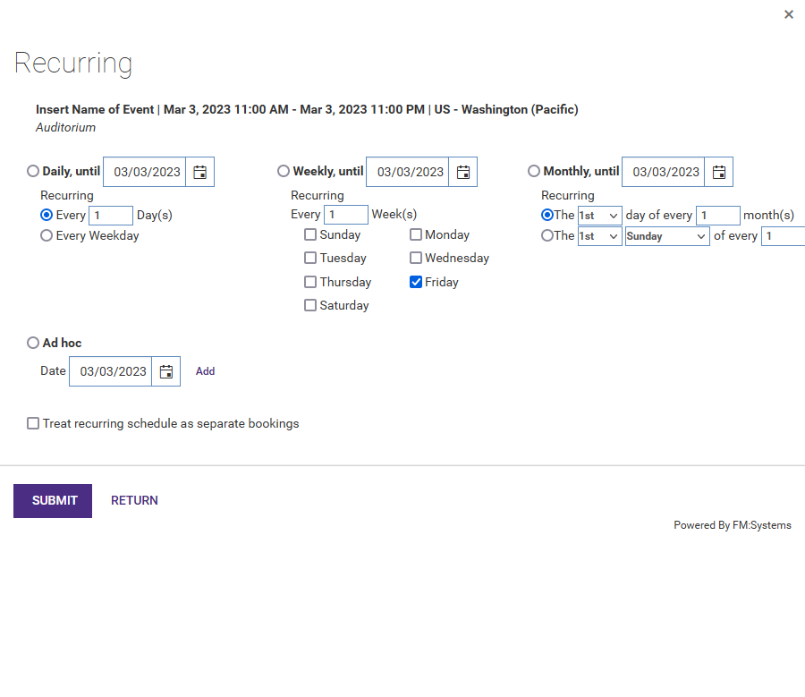
Step 5b:
On the left you can see there is the option to make daily, weekly, monthly, and Ad hoc (specific date) reoccurrences.
*For Ad hoc reoccurrences make sure to click Add after you specify the date(s) you want.
*You can also choose to treat reoccurring reservations the same or as separate bookings so that changes made to each individual reservation don’t affect any others.
Once your selection is complete click SUBMIT.
Click here
Click Here

Slide 13
Step 5c:
You will be sent back to the reservation’s Details page where you must click SAVE to save all changes.
YOU ARE DONE!
Click here
Click Here

