Slide 1
Creating Reservations via Resource Scheduler

Slide 2
Step 1:
On the UW Tower Home page, scroll down until you reach the Quick Links drop-down list.
Click the (+) symbol next to Quick Links to open the drop-down list and find the Reservation Information button.
Click the button to move on to the next step.
https://facilities.uw.edu/buildings/uw-tower
*Reservations not accepted over 1 year in advance*
Click Here

Slide 3
Step 2:
If you are a Tenant at the UW Tower, scroll down and click Reserve A Room
Upon clicking, you will be sent to a new window.
For all Non-Tenants read the information below before proceeding any further.
Click Here

Slide 4
Step 3:
This is the Home page for Resource Scheduler.
The column on the left will contain all the reservation spaces that the Tower has to offer.
The UW Tower only manages C building, Mother’s Rooms, O Building, and rooms on T-22.
The next slide will contain the list of rooms in each section.

Slide 5
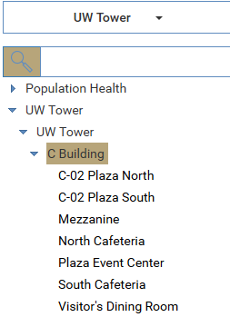
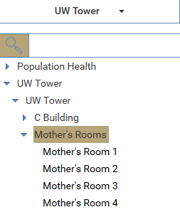
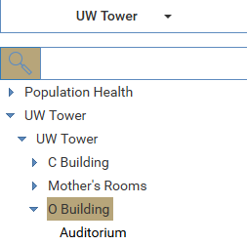
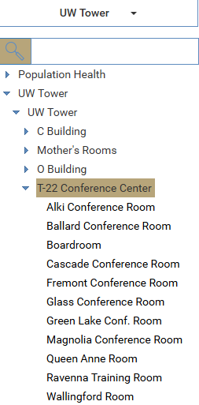
O-Building
Mother’s Rooms
C Building
These are for private lactation rooms
Reservation Spaces
T-22 Conference Center

Slide 6
Step 3a:
1st, select the space you are wanting to reserve.
Each room has a number in parathesis to show its max capacity. Ex: (200)
2nd, click on the Calendar Icon to find the date you are wanting to make a reservation
3rd, select the date on the calendar.
2nd Click
1st Click
3rd Click

Slide 7
Step 3b:
On the left you can see the example of someone clicking on their desired date & event space. (ex: Auditorium (200) + Mon 27)
Click on the box where your desired date/time & reservation space meet.
(Click the open whitespace)
Continue to the next step.
Click Here

Slide 8
Step 4a:
This is the quick reserve form.
On the left you can see the questions you will be REQUIRED to fill-in for your reservation to be approved.
Continue to the next slide to see the remaining questions you will be asked.

Slide 9
Step 4b:
These are the remaining questions.
Note that you will not be able to create your reservation unless all the fields on the form have been completed.
If you don’t have any additional information, please put N/A, x, or none.
For one-time events click the SUBMIT button to be done.
To learn how to create recurring scheduling go to the next slide
One-time
Recurring

Slide 10
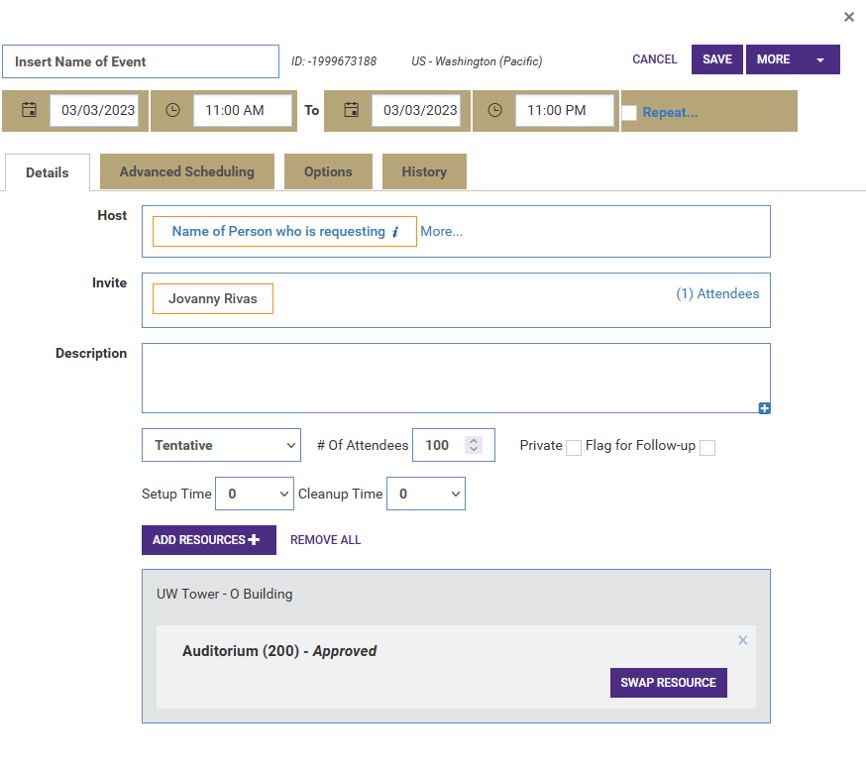
Step 5a:
This is the Home page of a reservation.
Click the Repeat button to proceed.
This will send you to 1 last section to complete reoccurring events.
Click Here
Click Here

Slide 11
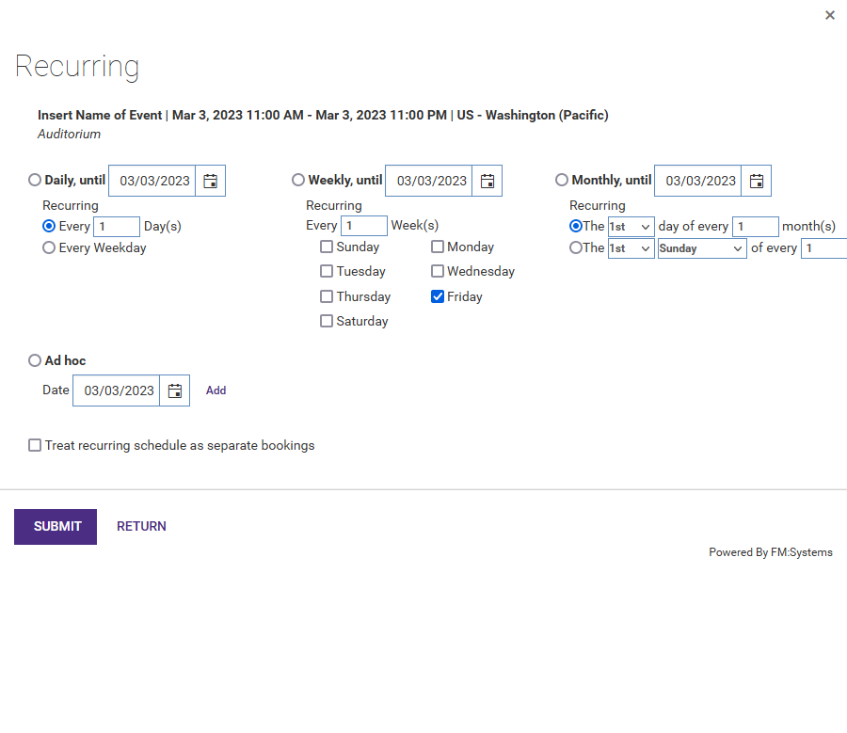
Step 5b:
Here you can make specific requests on your recurring events.
On the left you can see we have the option to make daily, weekly, and monthly reoccurrences.
Once your selection is completed you can Click the SUBMIT button.
Click Here
Click Here

Slide 12
Step 5c:
You will be sent back to the event Home page where you will click SAVE one more time to complete all changes.
Click Here
Click Here

Slide 13
Step 6:
After creating a reservations refreshing the page or clicking the HOME button will display all reservations that you have created under the My Reservations section.
Click Here

