Slide 1
College of Engineering Interdisciplinary Engineering Building

Slide 2
Goals & Objectives
Provide an educational experience that prepares undergraduate students to be leaders.
Increase diversity and access to foster excellence.
Accommodate the almost 200% growth of undergraduate students over the last 12 years.
Build interdisciplinary collaborations that inspire innovation.
Create industry partnerships to increase impact.
Focus on key global challenges where they achieve greatest impact and excellence.

Slide 3
Project Overview
75,000 GSF interdisciplinary engineering facility
$75,070,000 project cost
83% degree production growth since 2009

Slide 4
Project Program
Alleviate existing space deficits within the College of Engineering
Provide student services and serve as a “home base” for freshman & sophomore students
Provide space for collaborative, project-based learning, balanced with research and faculty offices
Example program: senior capstone projects, which are designed to holistically combine theory, practice, and design while pairing students with local companies, opening doors for employment and strengthening connections between the UW and industry.

Slide 5
Timeline
Pre-Planning January 2019 – May 2020
DB Team Selection July 2020 – December 2020
Project Definition December 2020 – May 2021
Design & Preconstruction May 2021 – April 2022
Construction August 2021 – January 2024
Occupancy April 2024

Slide 6
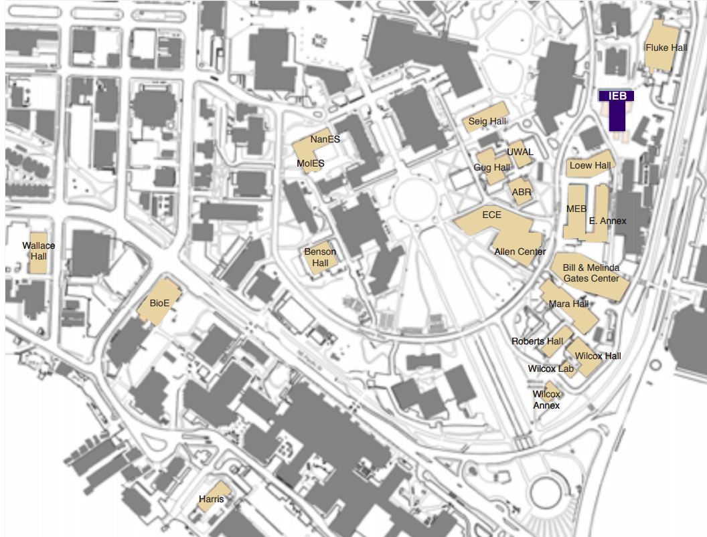
Engineering Presence on Campus

Slide 7
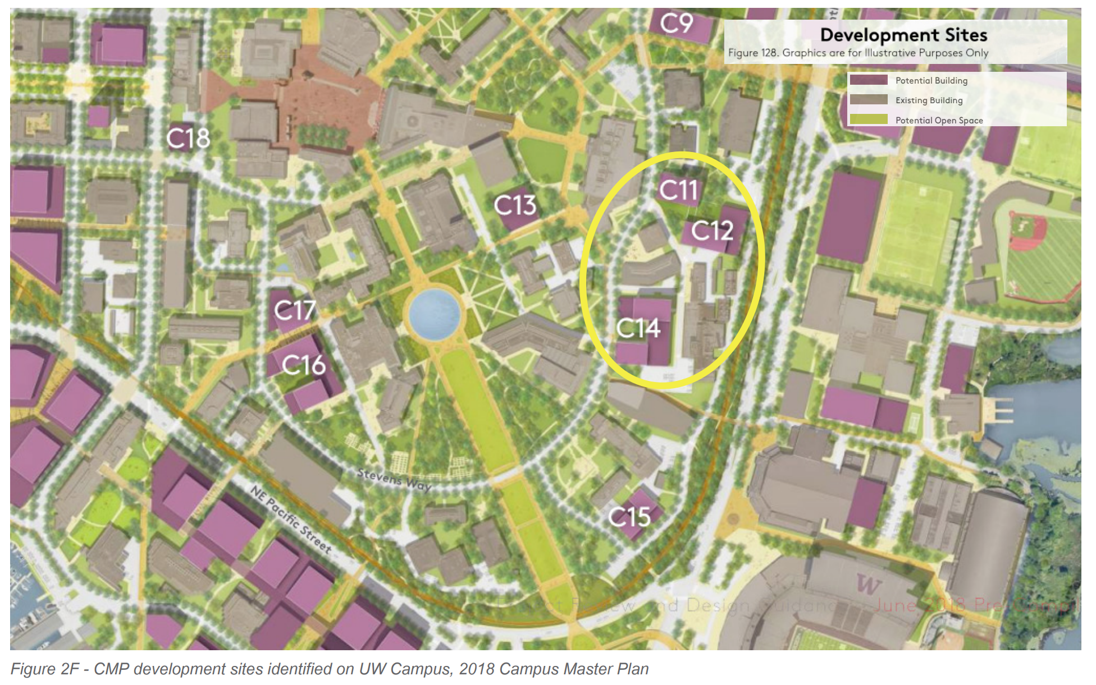
Site Selected – C11

Slide 8
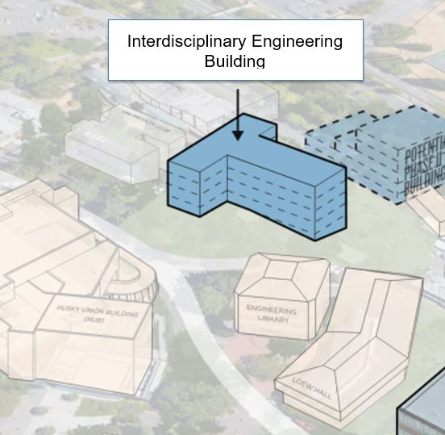
Preferred Site – C11 on Stevens Way
Close proximity to core college facilities and undergraduate life in the heart of the College of Engineering precinct
Accommodates up to 85k gsf
Links disparate CoE campus district activities with accessible pedestrian connections and outdoor gathering areas
Challenges include significant topographic change and constrained site

Slide 9
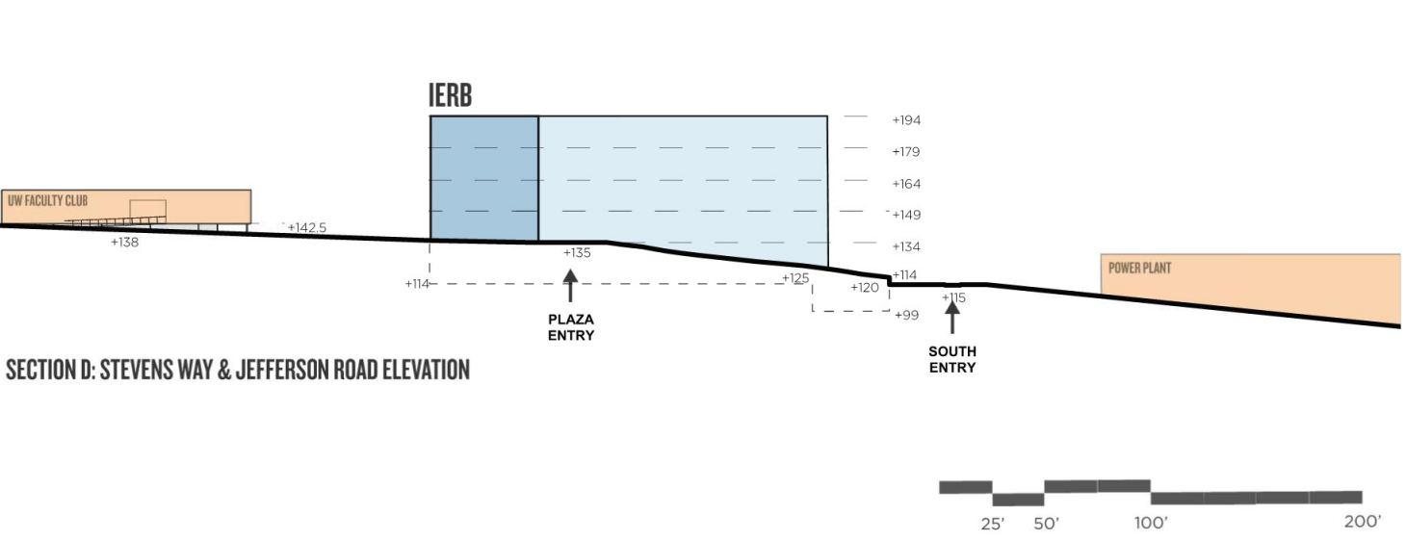
Site Topography

Slide 10
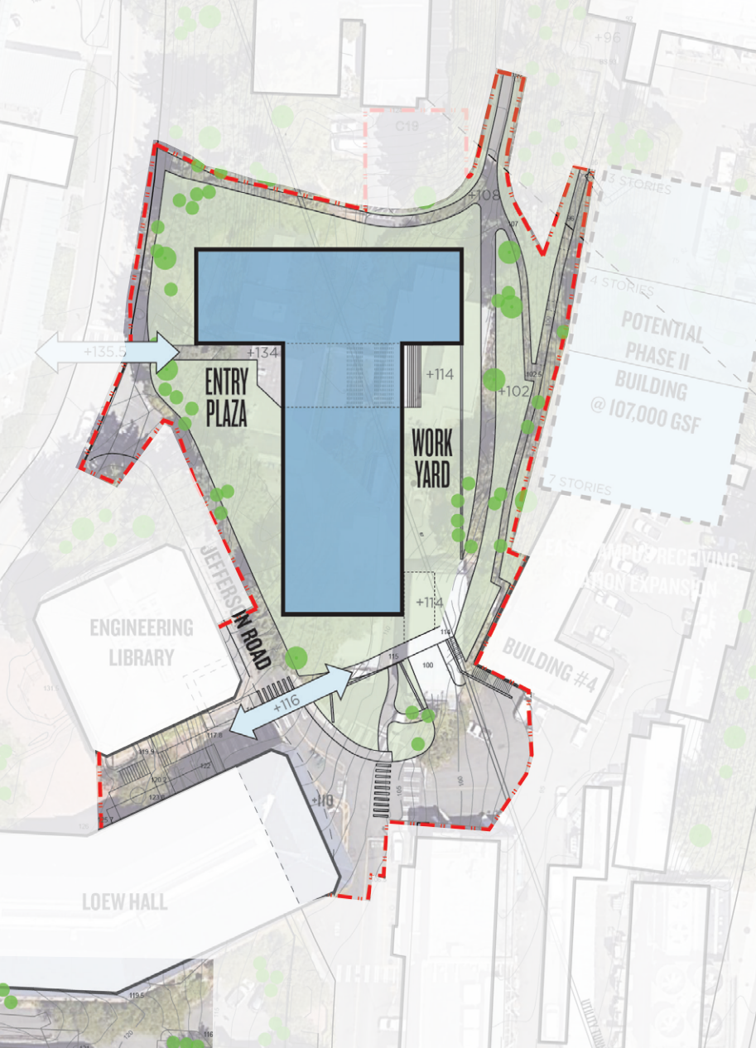
Site Fit

Slide 11
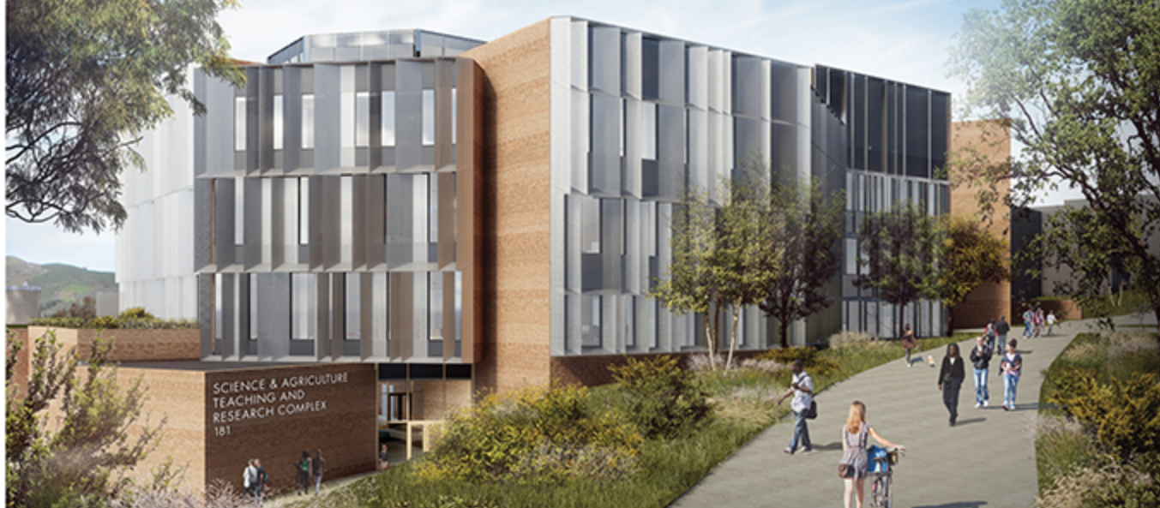
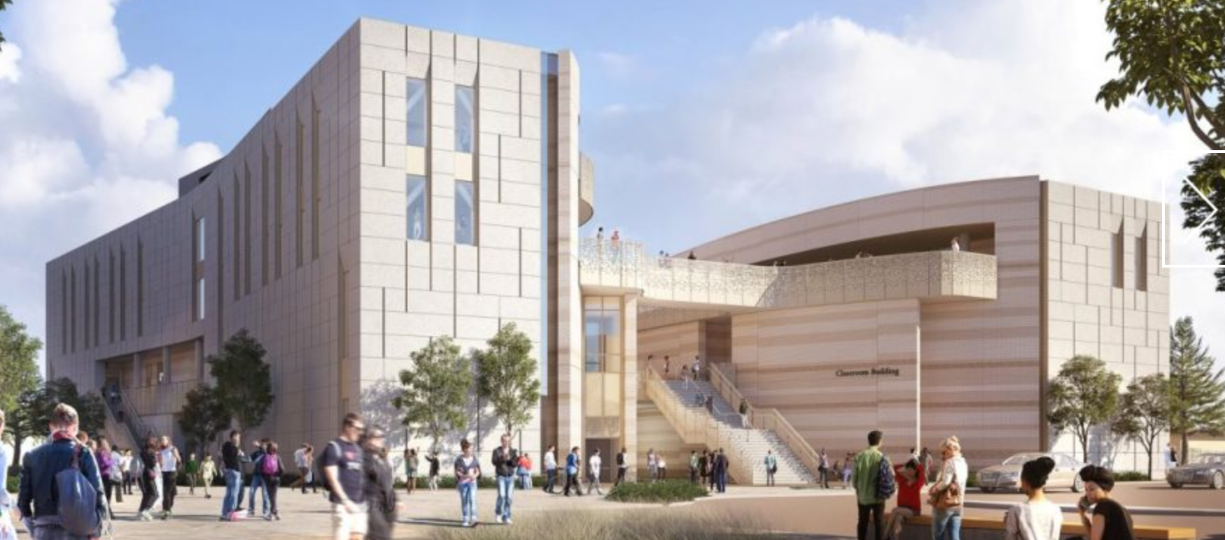
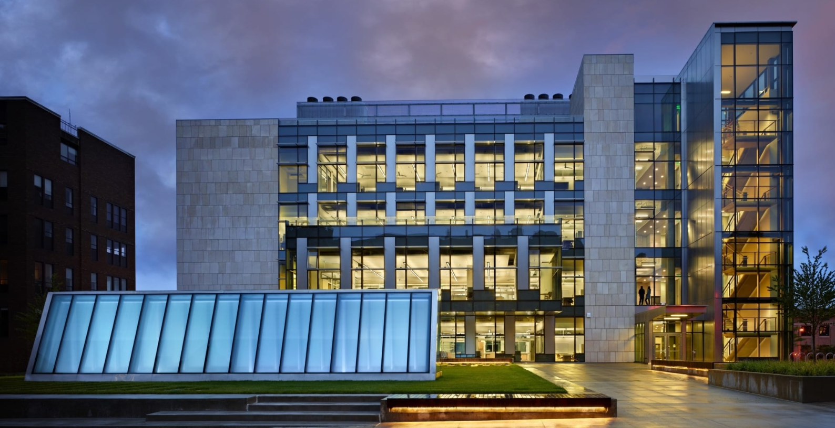
Budget $75,070,000 ($1000/GSF)
BENCHMARK 1 – Cal Poly Science & Ag Teaching/Research
100,000 gsf
Projected Completed in Fall 2021
Total Project Cost: $125 million
Cost/GSF: $1250
BENCHMARK 2 – UC Santa Barbara Classroom Building
95,000 gsf
Projectedd Completion in 2023
Total Project Cost: $97 million
Cost/GSF: $1022
BENCHMARK 3 – UW Molecular Engineering Building
90,300 gsf
Completed in 2012
Total Project Cost: $95 million
Cost/GSF: $1053

Slide 12
Next Steps
Design Builder Selection – in progress
Architect Selection – refine invite list
Project Definition – once team is on board

