Slide 1
University of Washington Architectural Commission
August 10, 2020

Slide 2
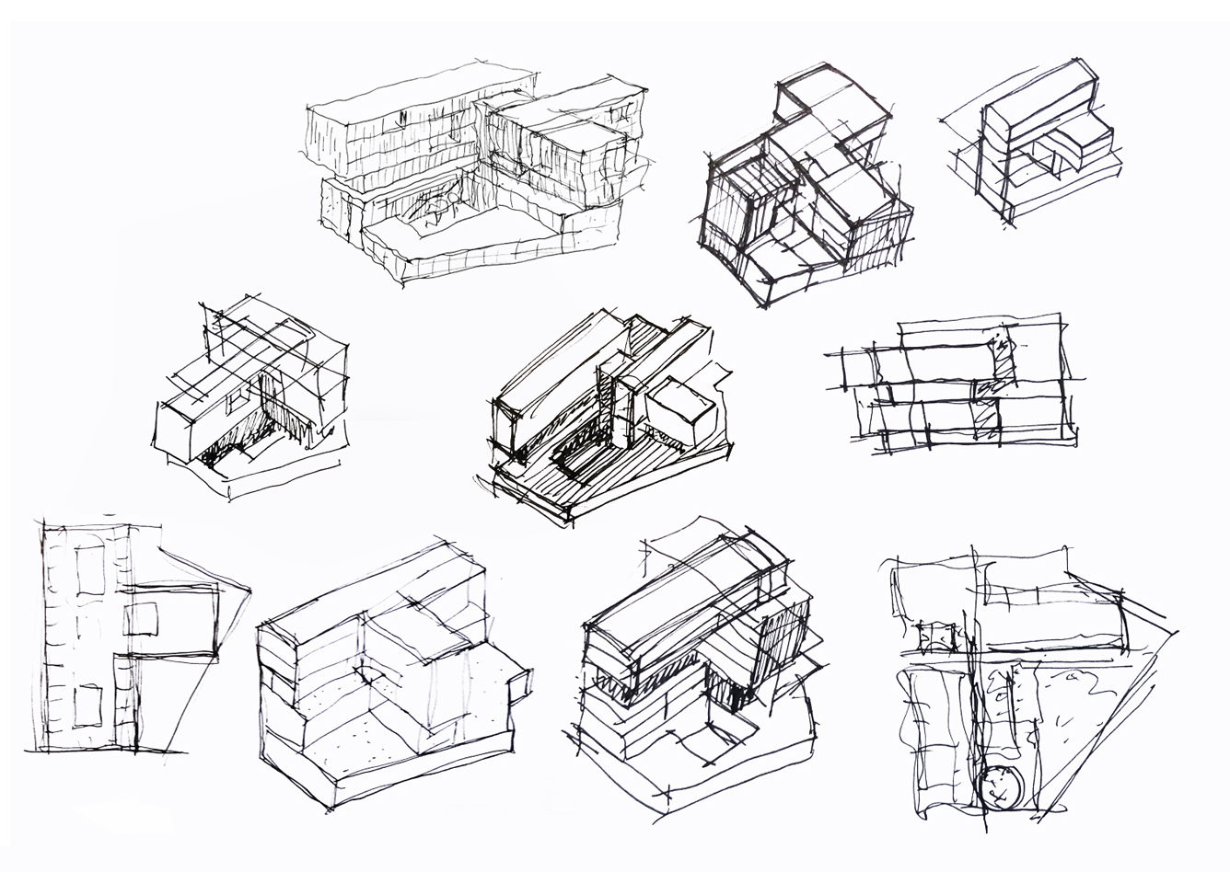
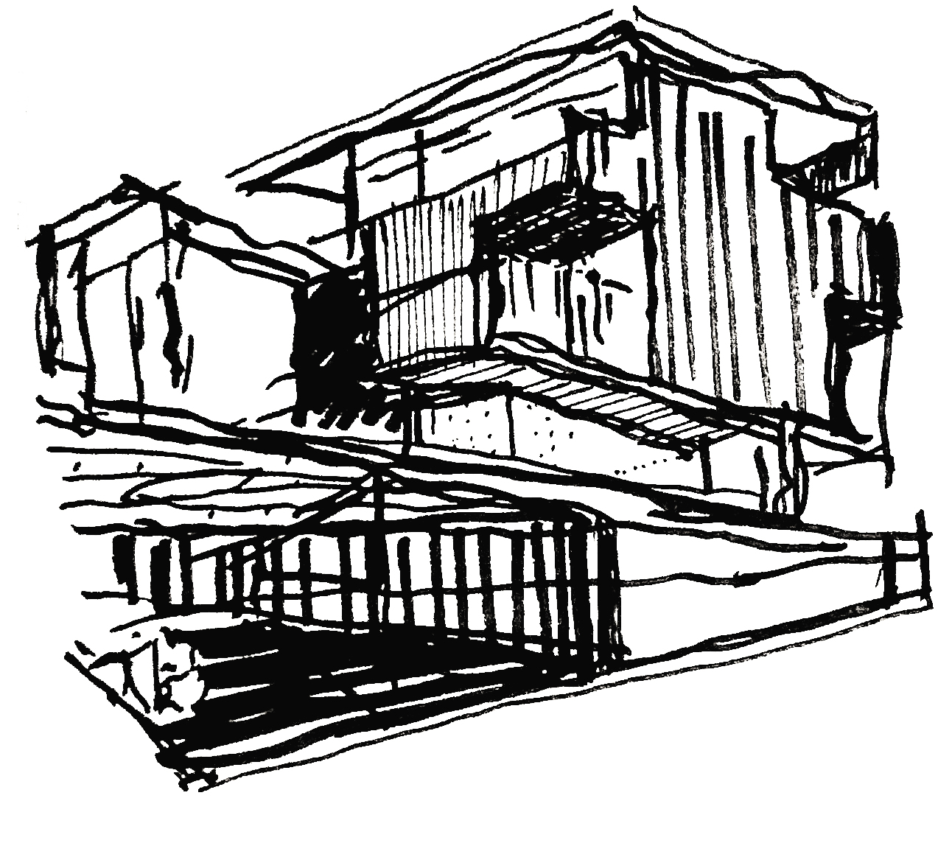
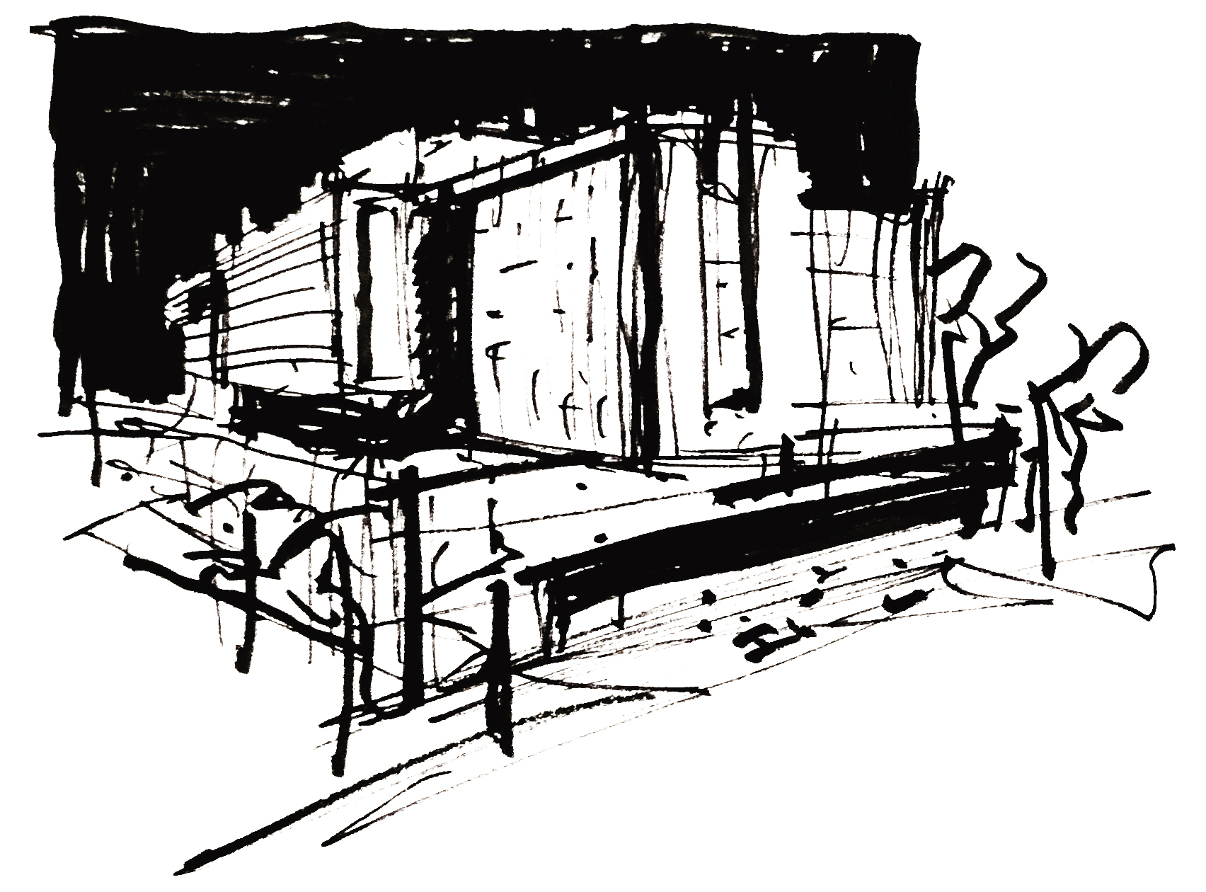
University of Washington Architectural Commission
UW Behavioral Health Teaching Facility
Project Definition Design Progress

Slide 3
University of Washington Architectural Commission
UW Behavioral Health Teaching Facility
Project Definition Design Progress
Goals of Presentation
Review design progress to date during the Project Definition Phase
Building Massing and Organization
Site and Landscape Design Approach
Project Definition
Identify Target Program
Identify Design Criteria for Project
Identify Design Options
Utilize “Choosing by Advantages” approach to identify appropriate Siting Strategies, Building Systems ( Structural and MEP), Connections, and Construction Logistics.
Identify Sustainability Objectives
Feedback
Overall Site Approach
Building Organization and Massing

Slide 4
Project Goals and Guiding Principles

Slide 5
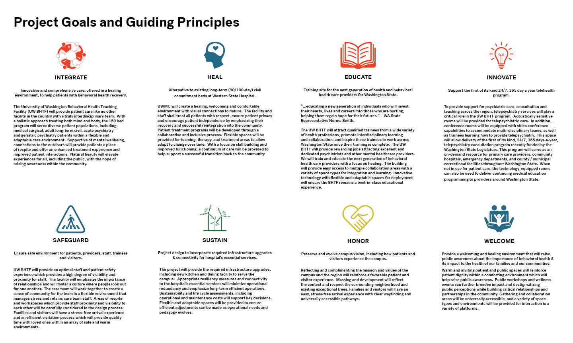
Guiding Principles

Slide 6
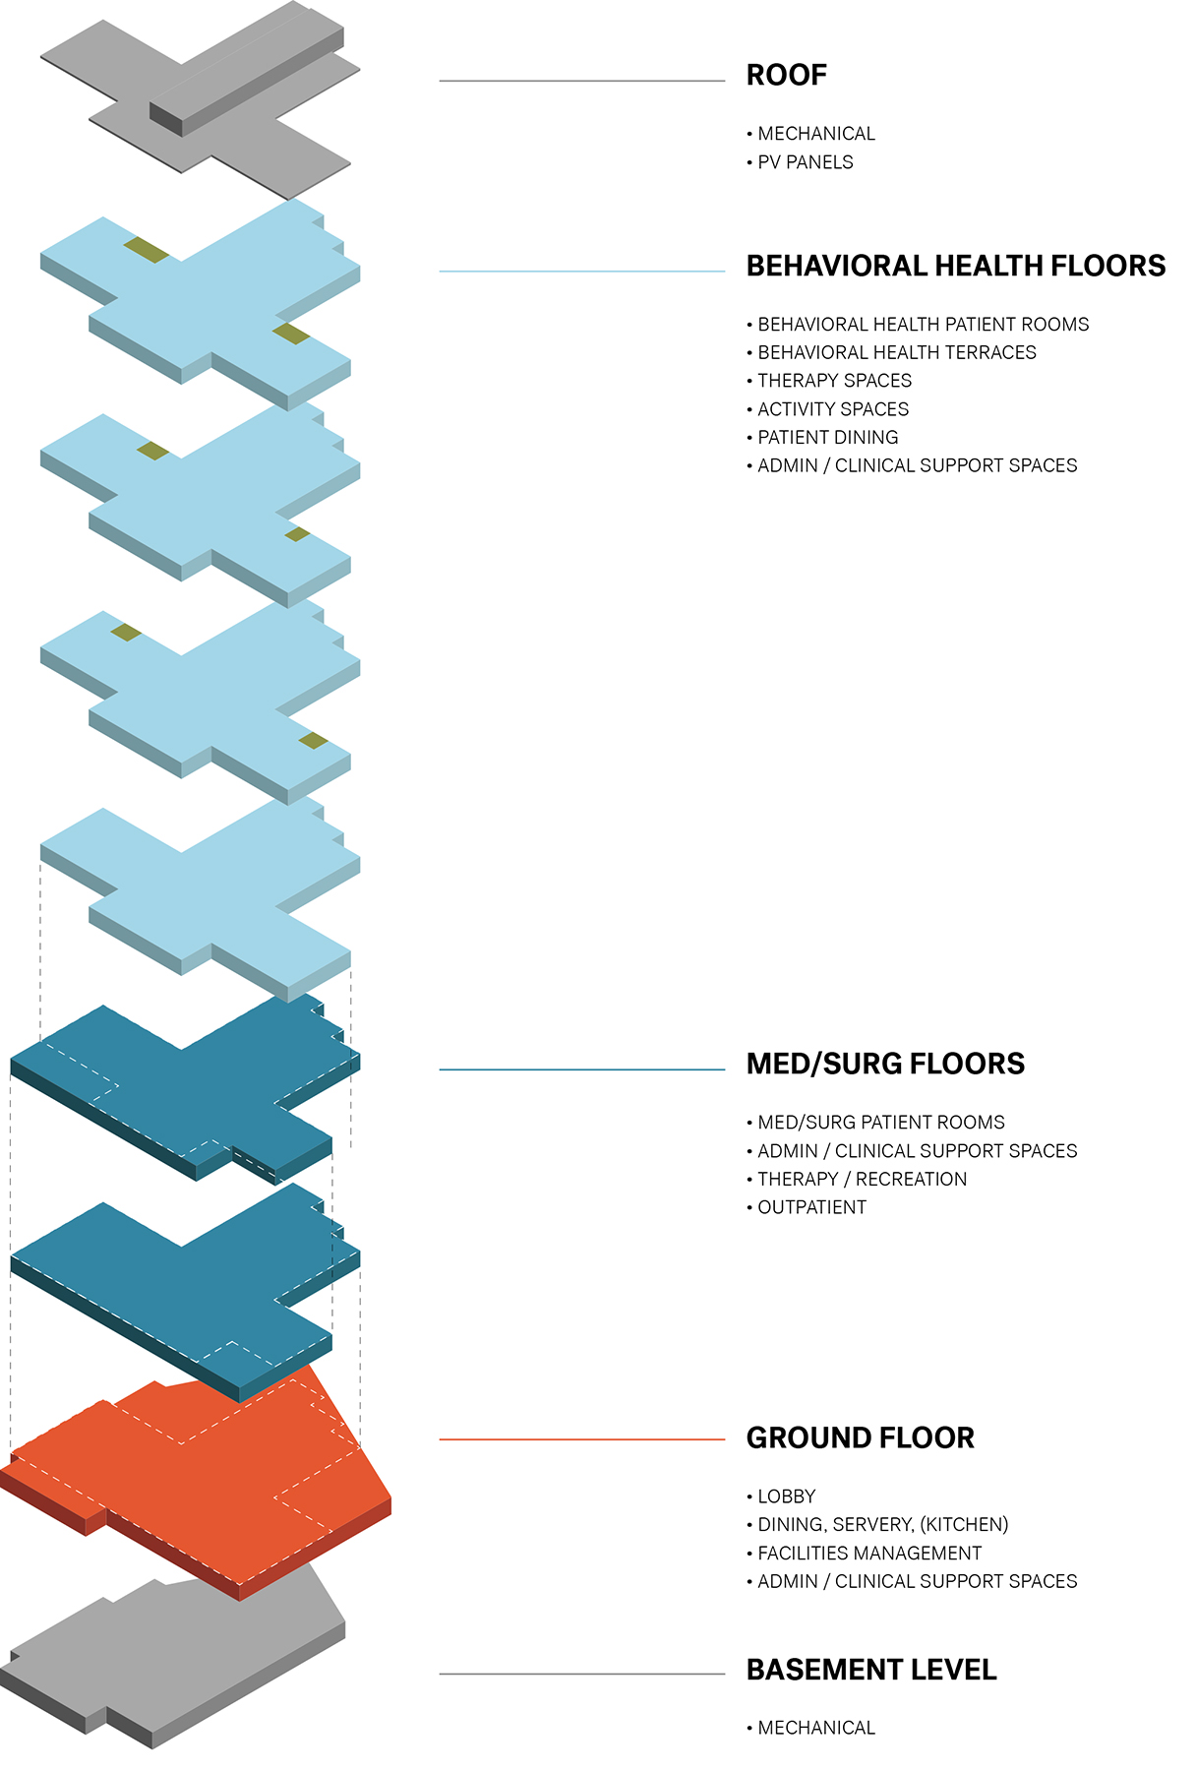
Program
50 Med/Surg Beds to serve patients with both
Physical and Mental Health Conditions
100 Behavioral Health Beds
Gero-Psych
Acute
Long-term Civil
Outpatient Specialty Services
New Kitchen and Dining to serve campus
Clinical Admin and Telepsychiatry
Trainingg and Education Spaces
Building Support

Slide 7
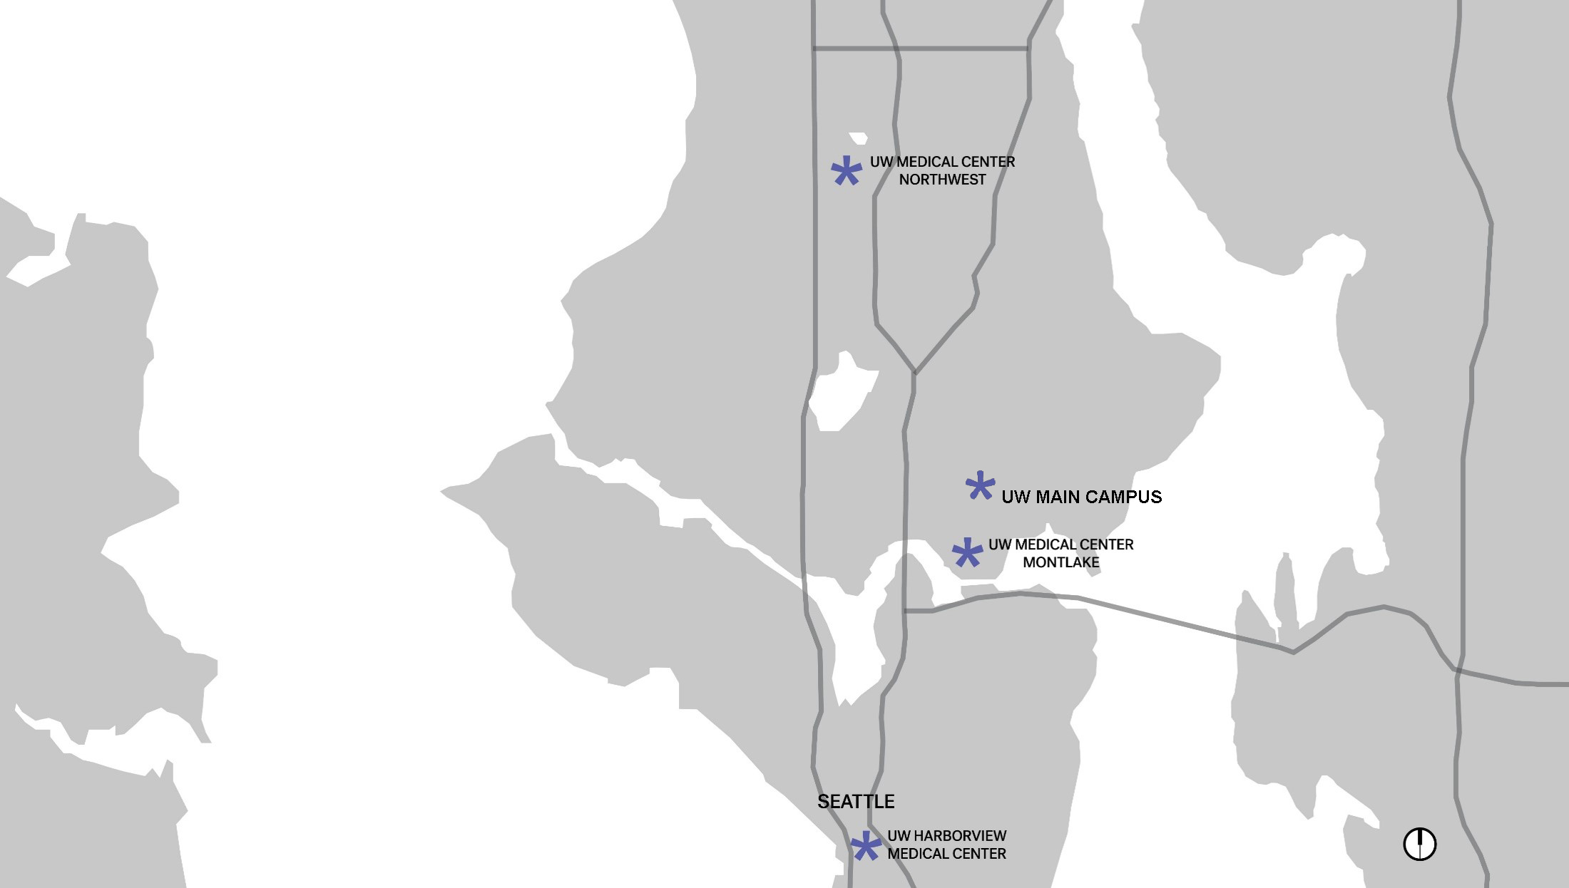
Vicinity Map

Slide 8
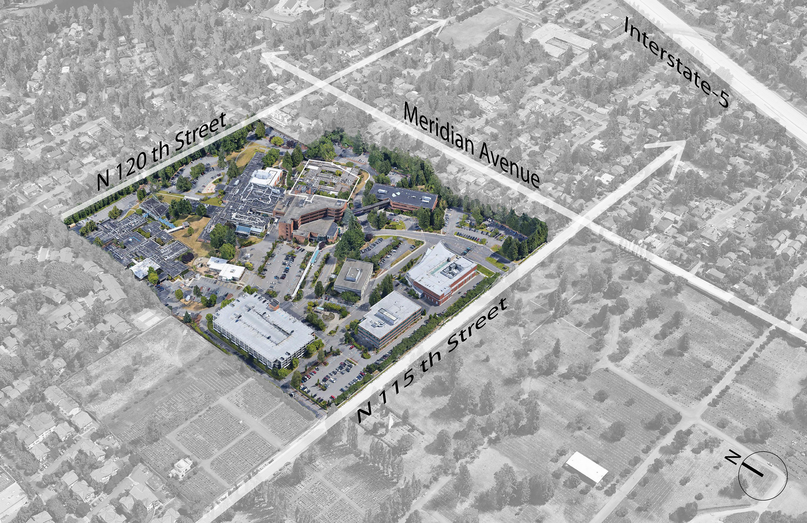
Campus Overview

Slide 9
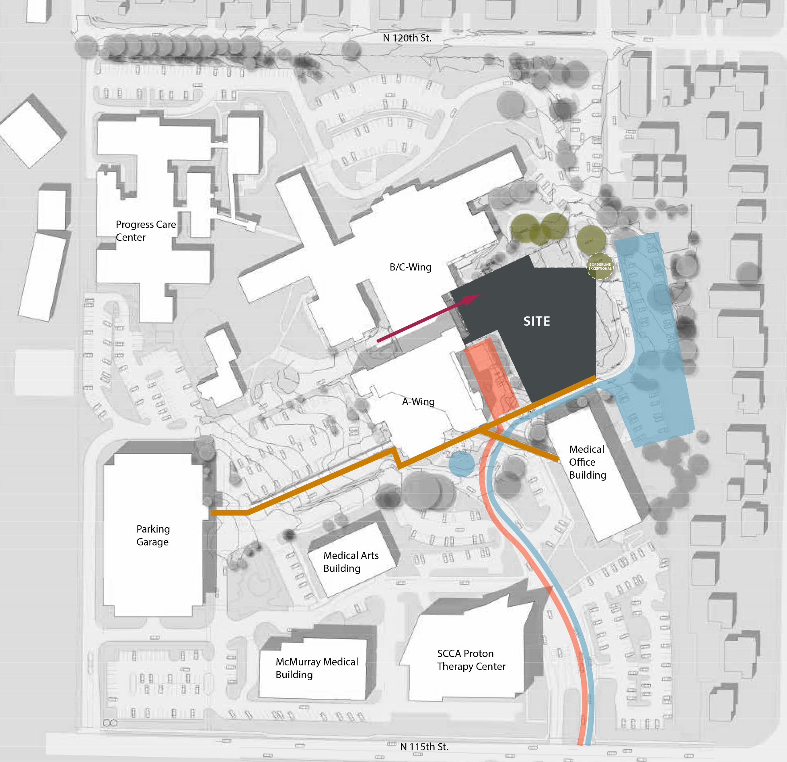
Campus Design Drivers
Northwest Hospital & Medical Center became
part of the UW Medicine system in 2010
Bed Hospital
Outpatient Services
2,000 + Employees
44 Acres
Original Buildings: 1960
Medical Tower: 1983

Slide 10
Campus Design Drivers
Height Limit 105’
Setbacks

Slide 11
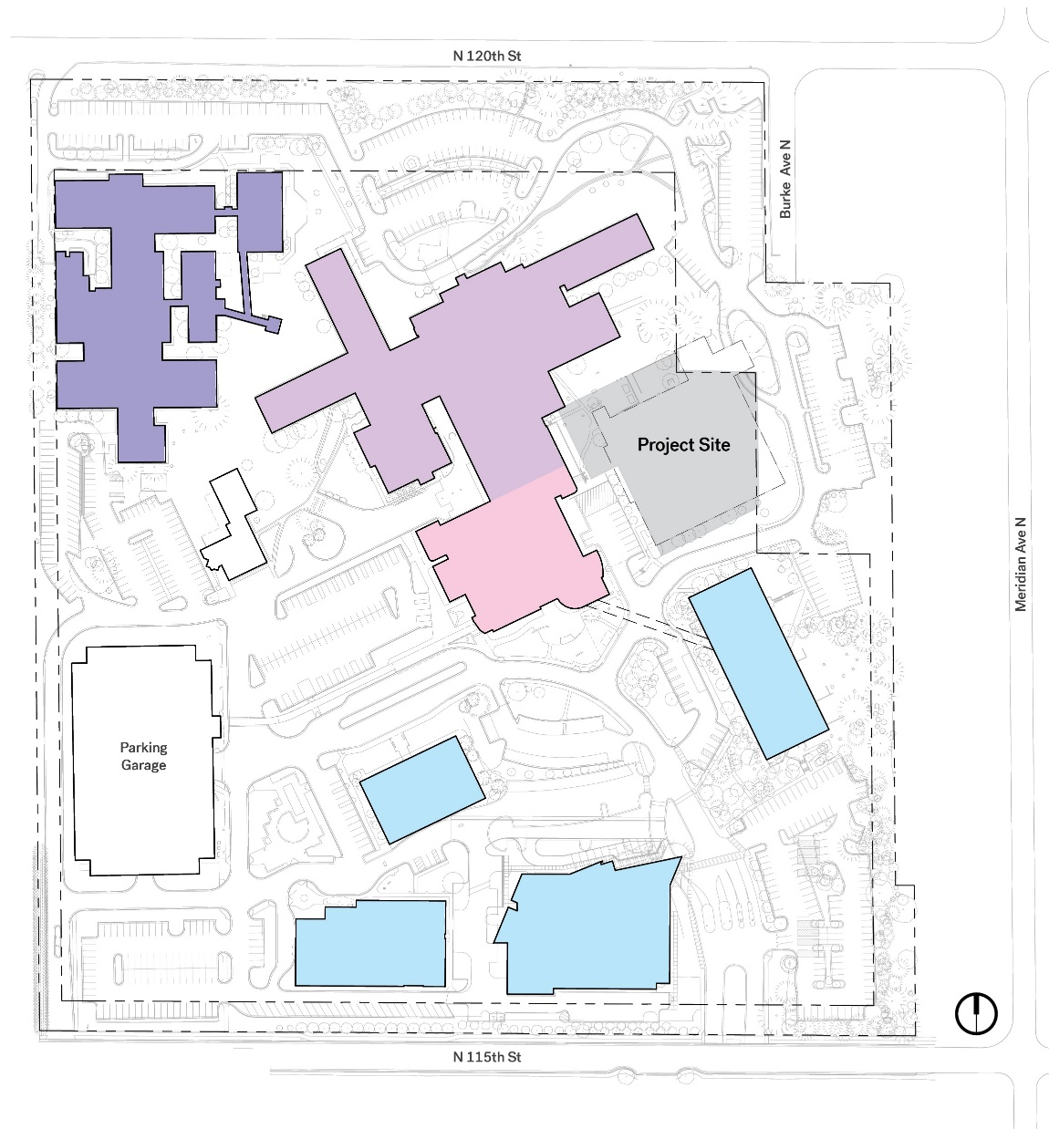
Campus Design Drivers
Masterplan Objectives
Preserve Openness And Greenery
Operational Efficiency
Campus Zoning
Sensitivity to Surrounding
Community
Flexibility

Slide 12
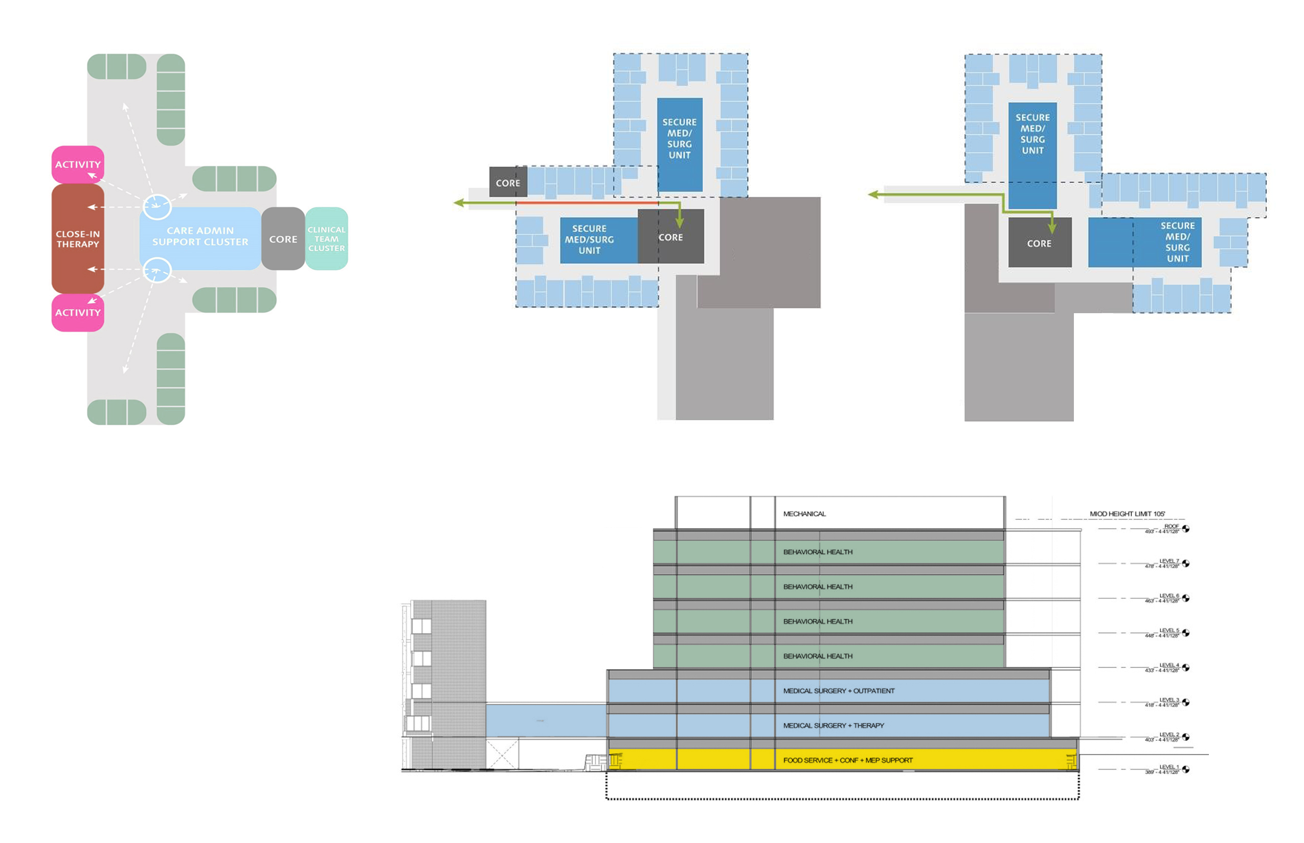
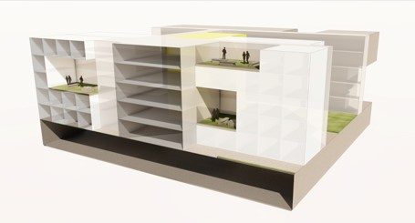
Program Design Drivers
Behavioral Health Unit Model of Care Patient Privacy, Views, Public/Patient/ Service Circulation
Patient Access to Outdoors on Upper Floors Program Building Connections and Stacking

Slide 13
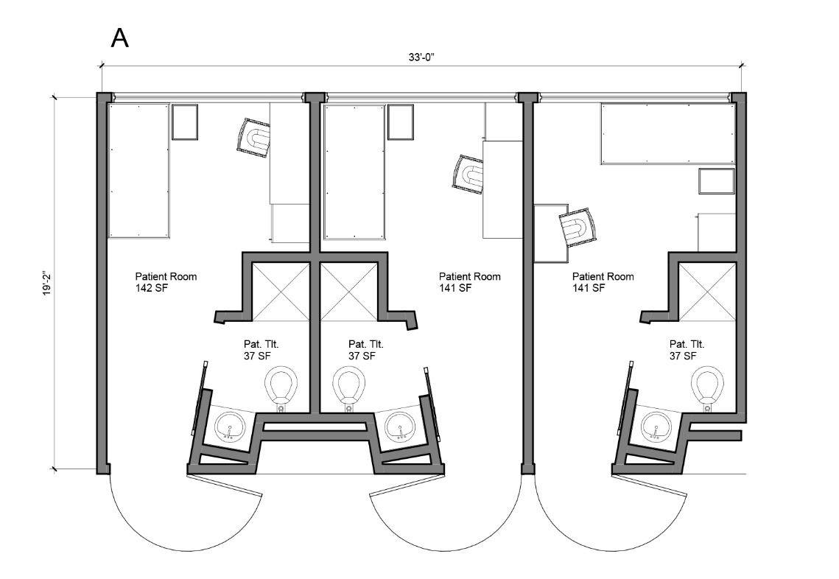
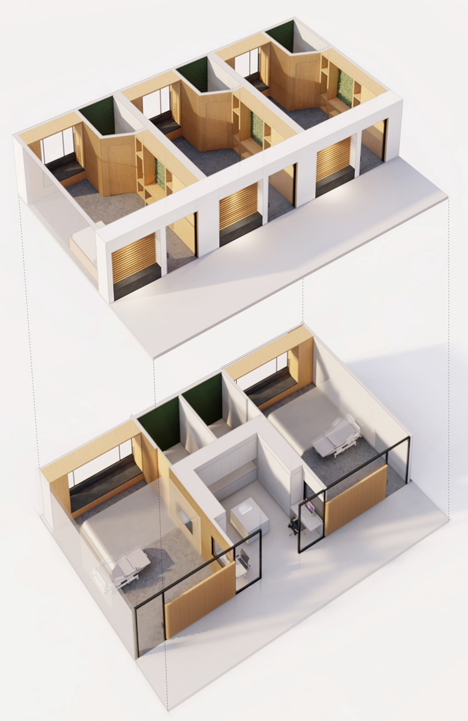
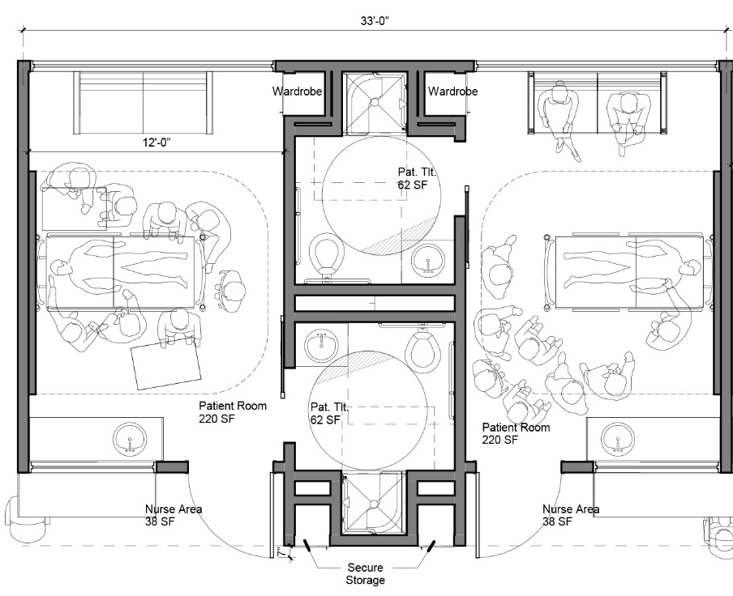
Program Design Drivers

Slide 14
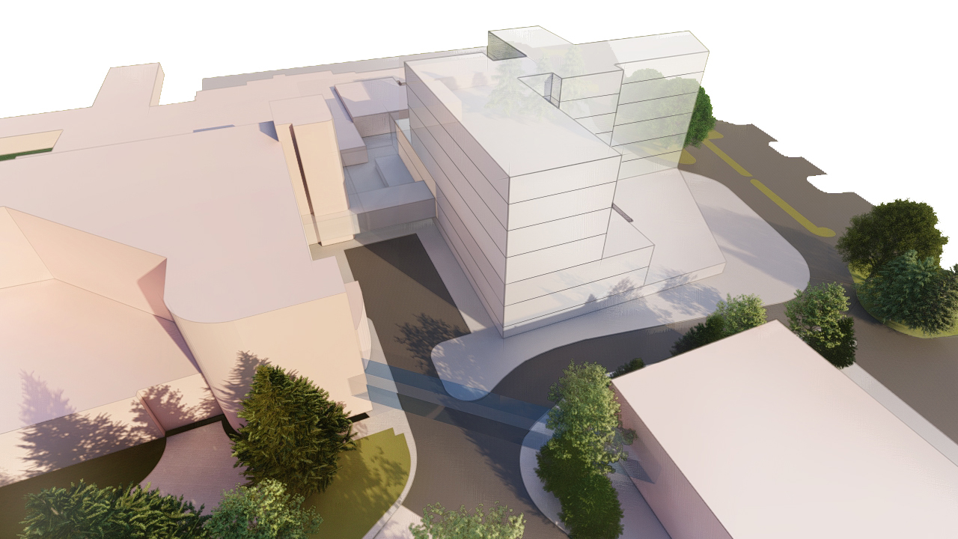
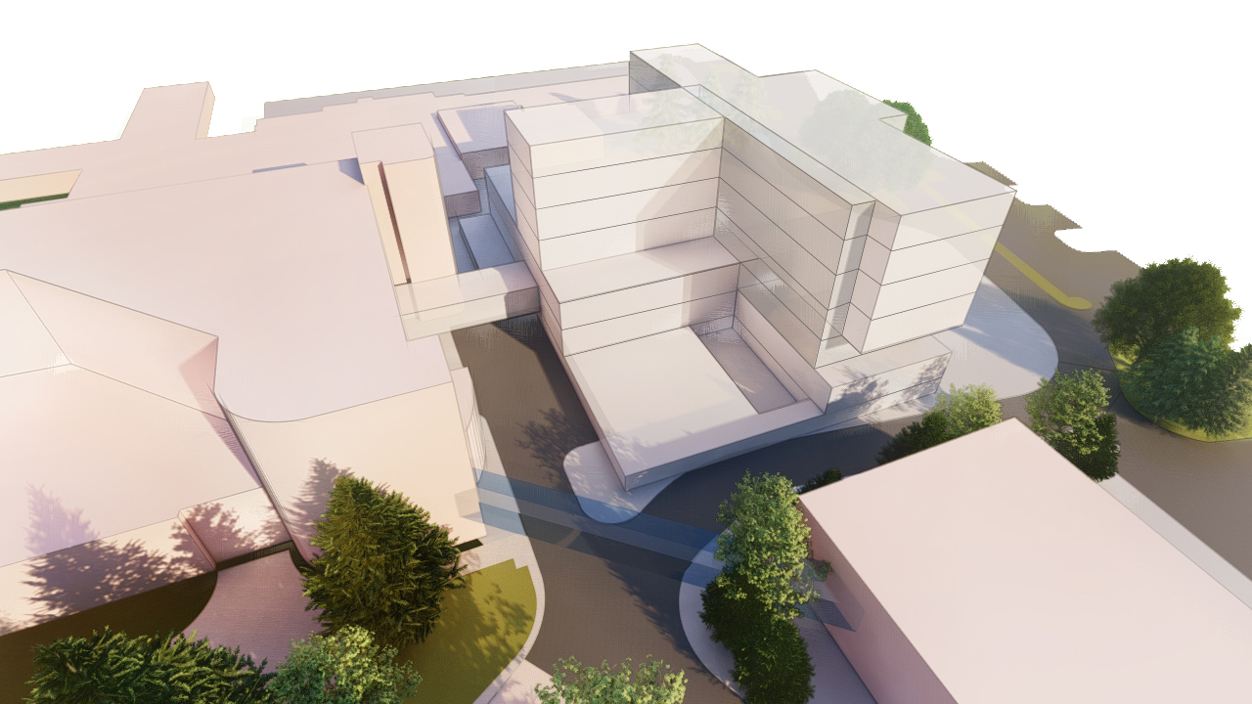
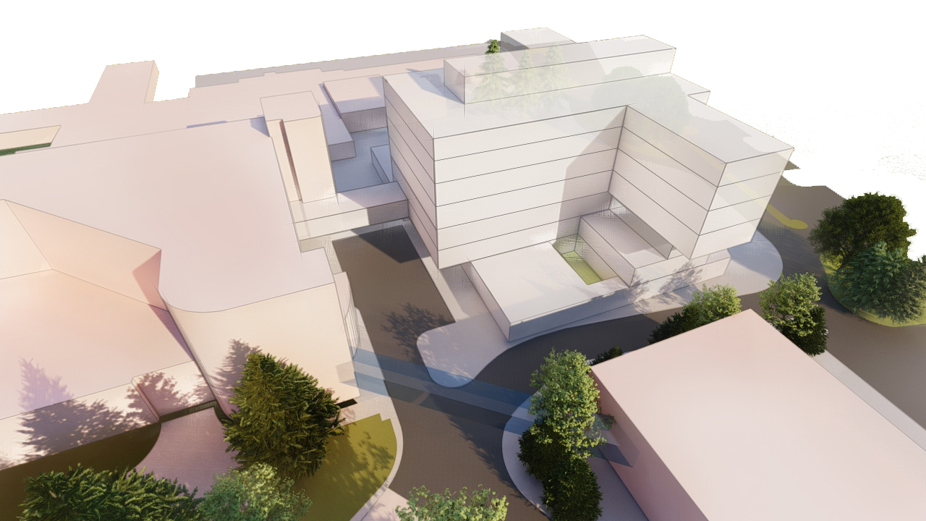
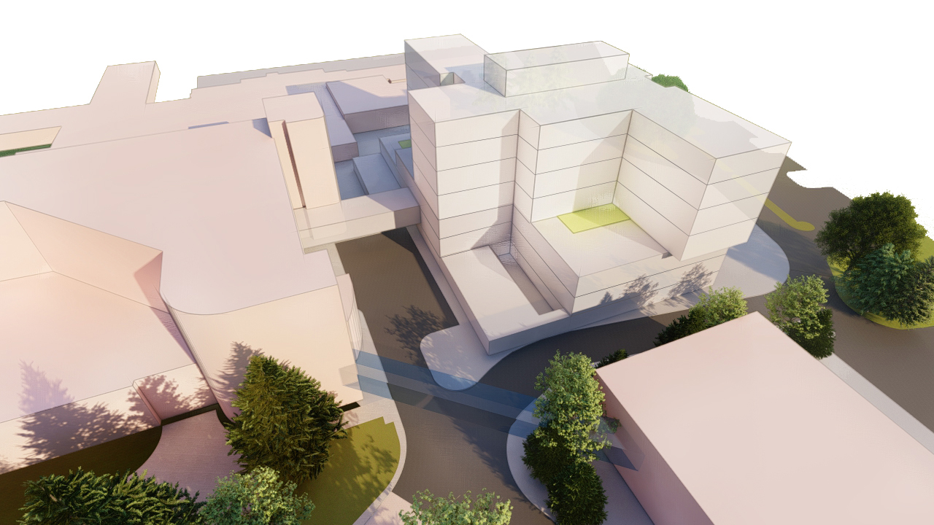
Massing Studies

Slide 15
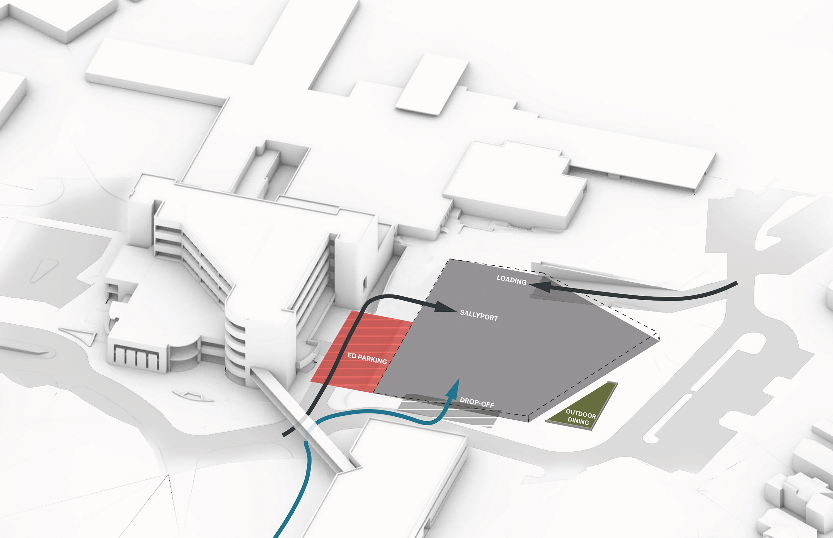
Site Design Drivers

Slide 16
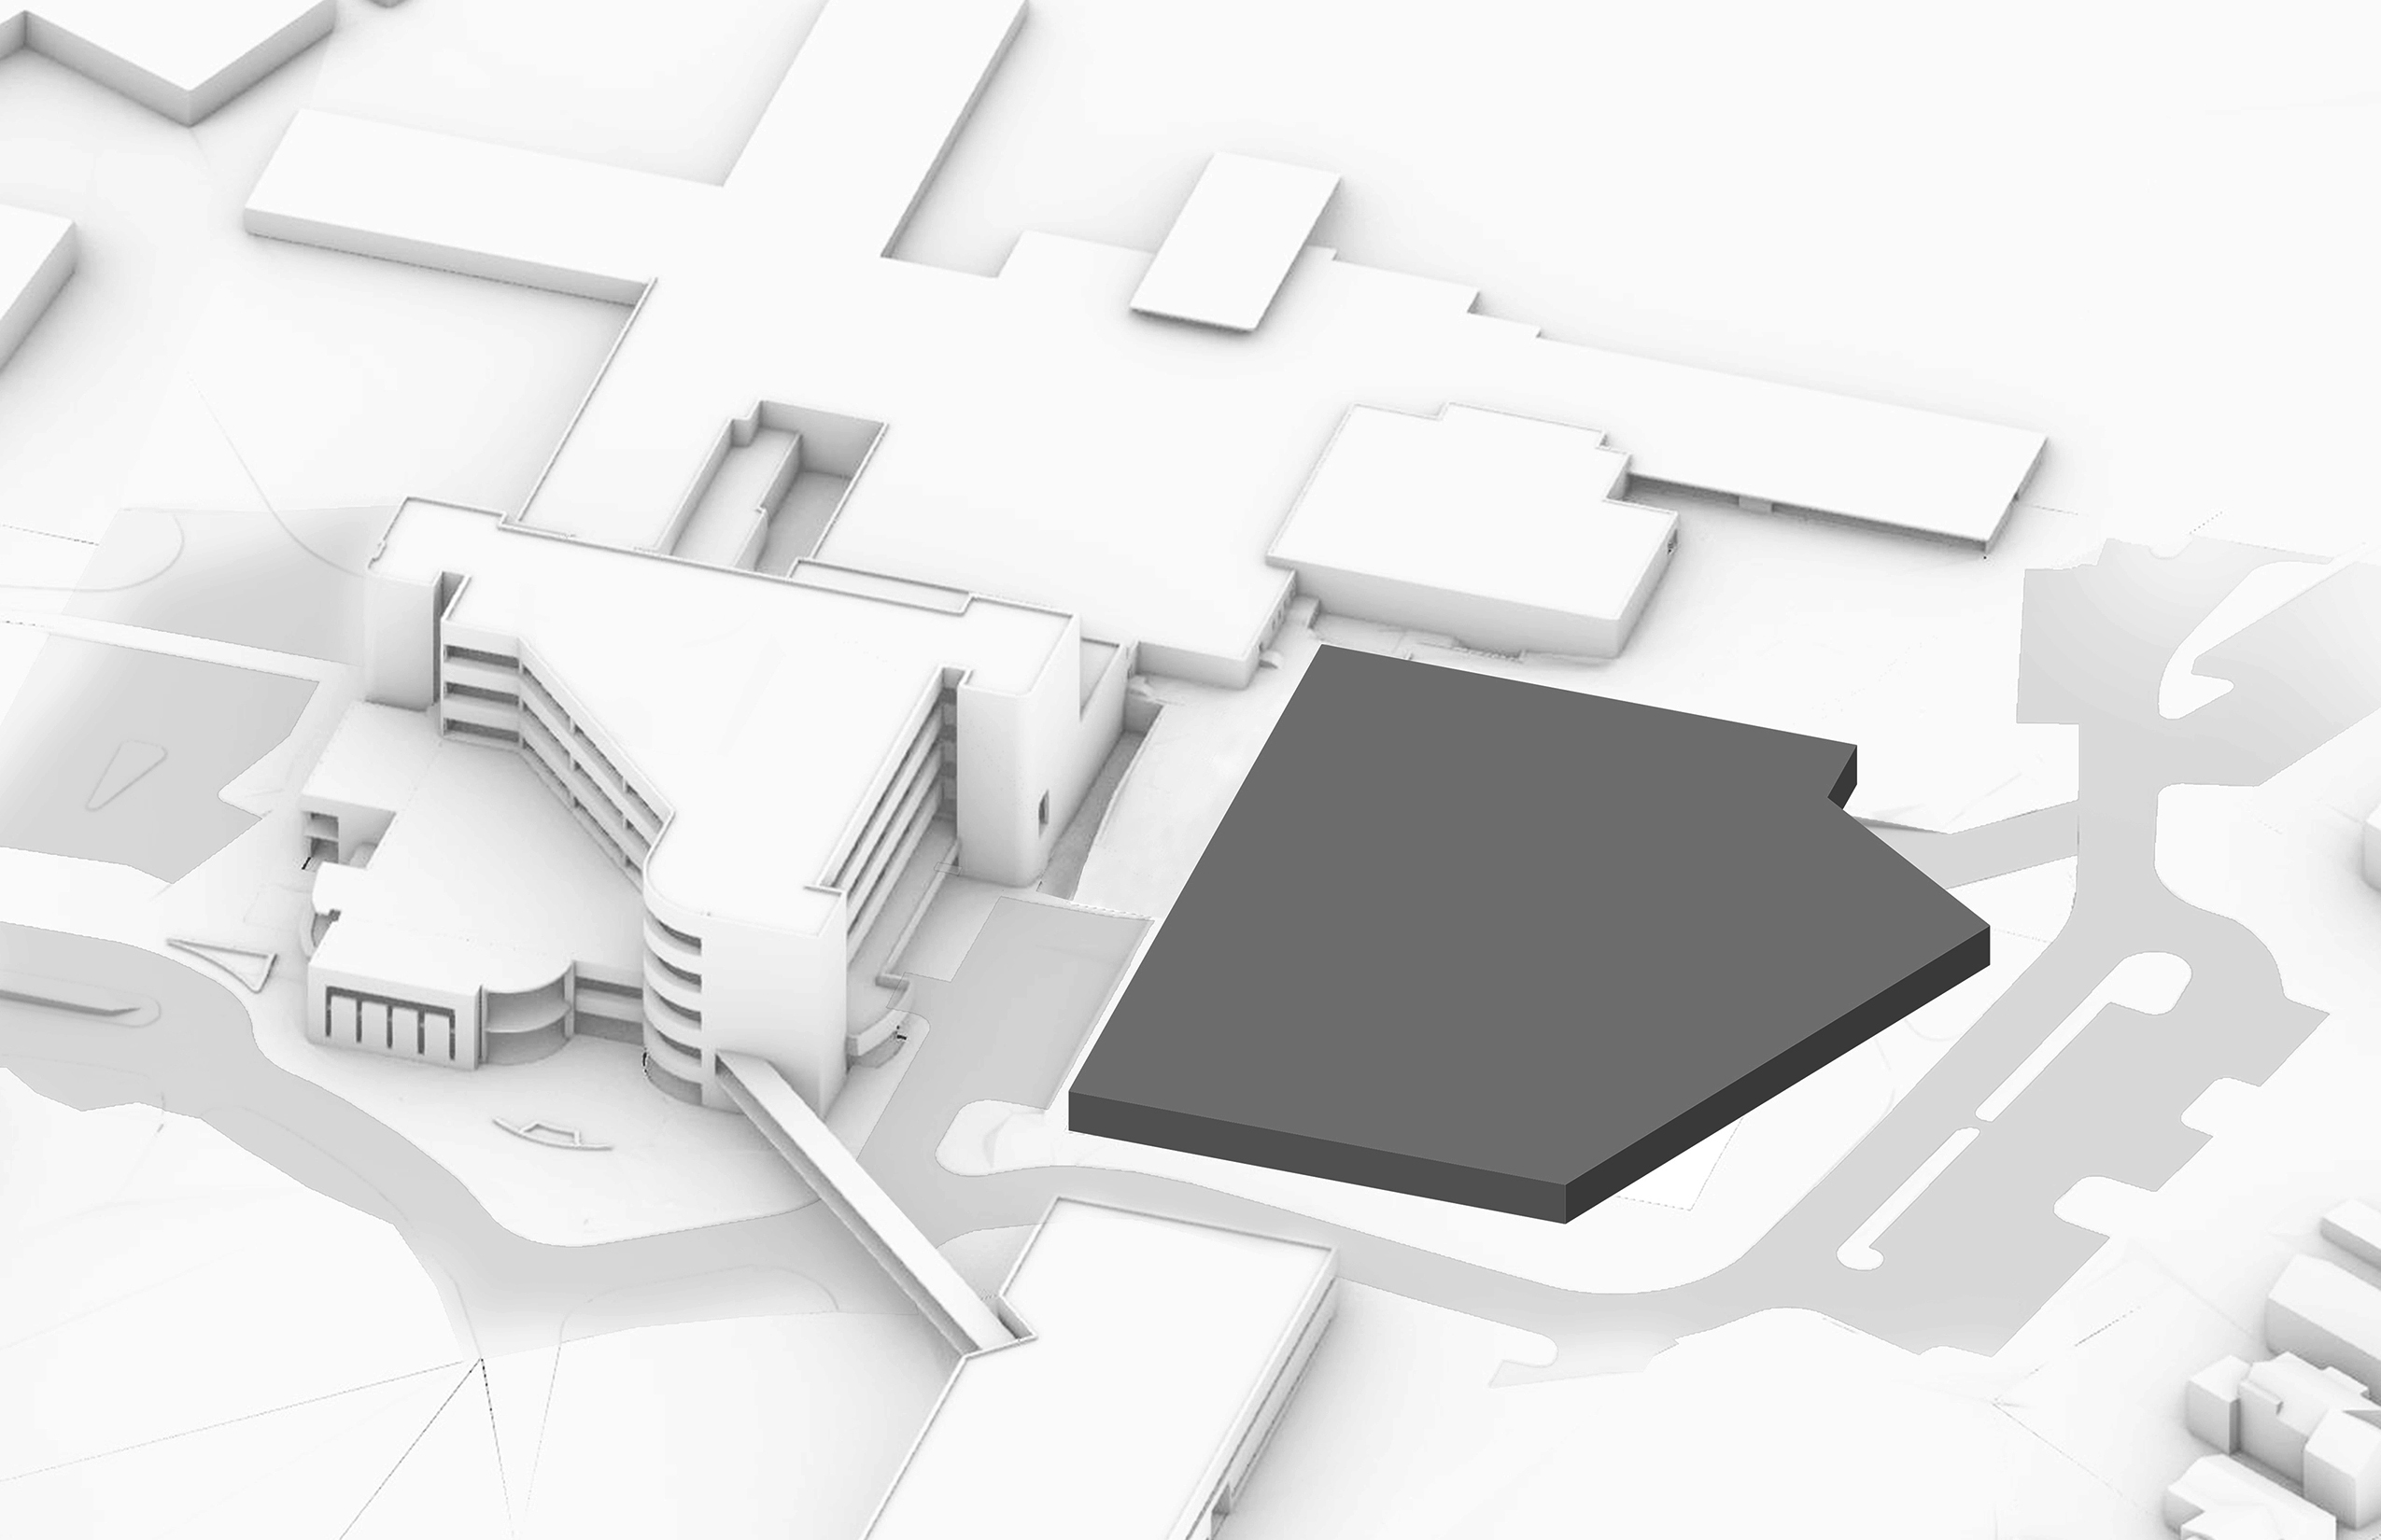
Maximize Level 1 Footprint

Slide 17
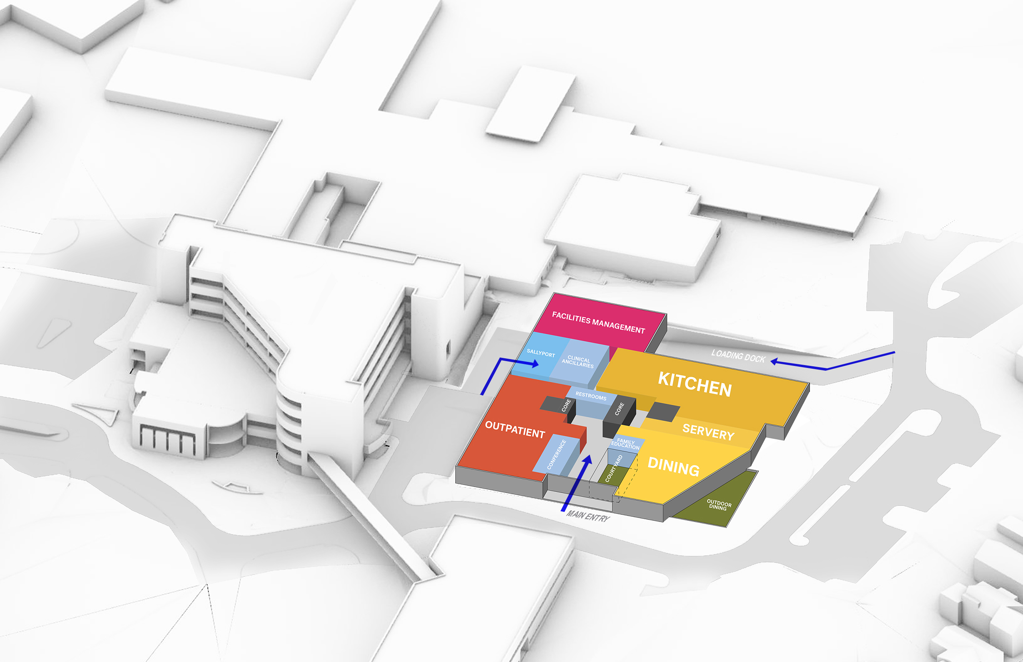
Level 1 Diagram

Slide 18
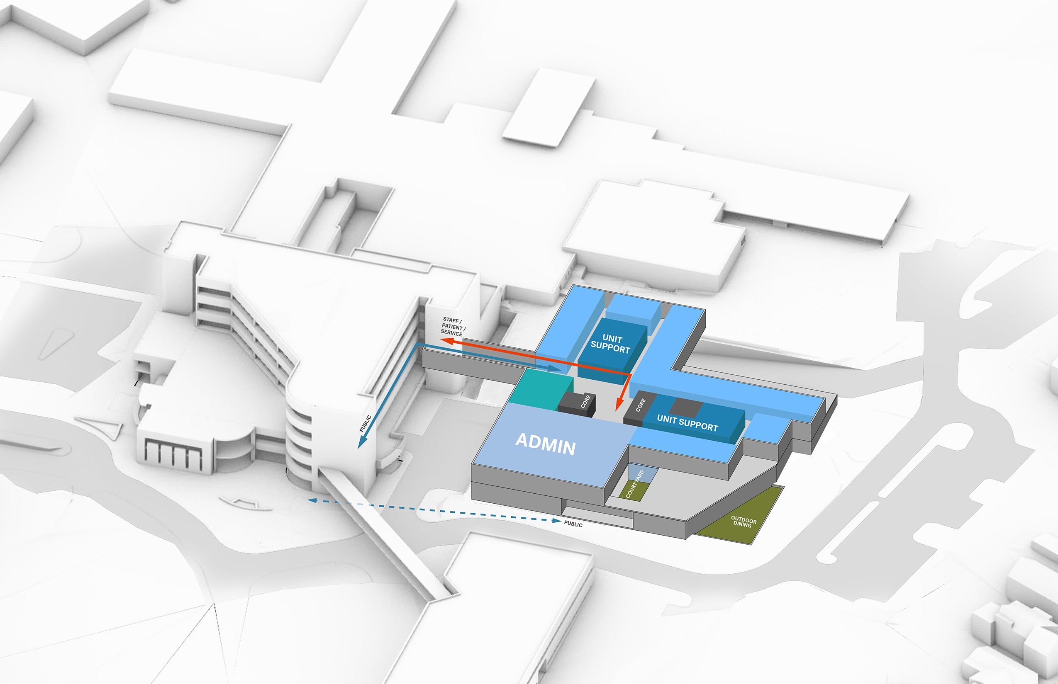
Level 2 Diagram
Med/Surg Patient Unit and Connections to Main Hospital

Slide 19
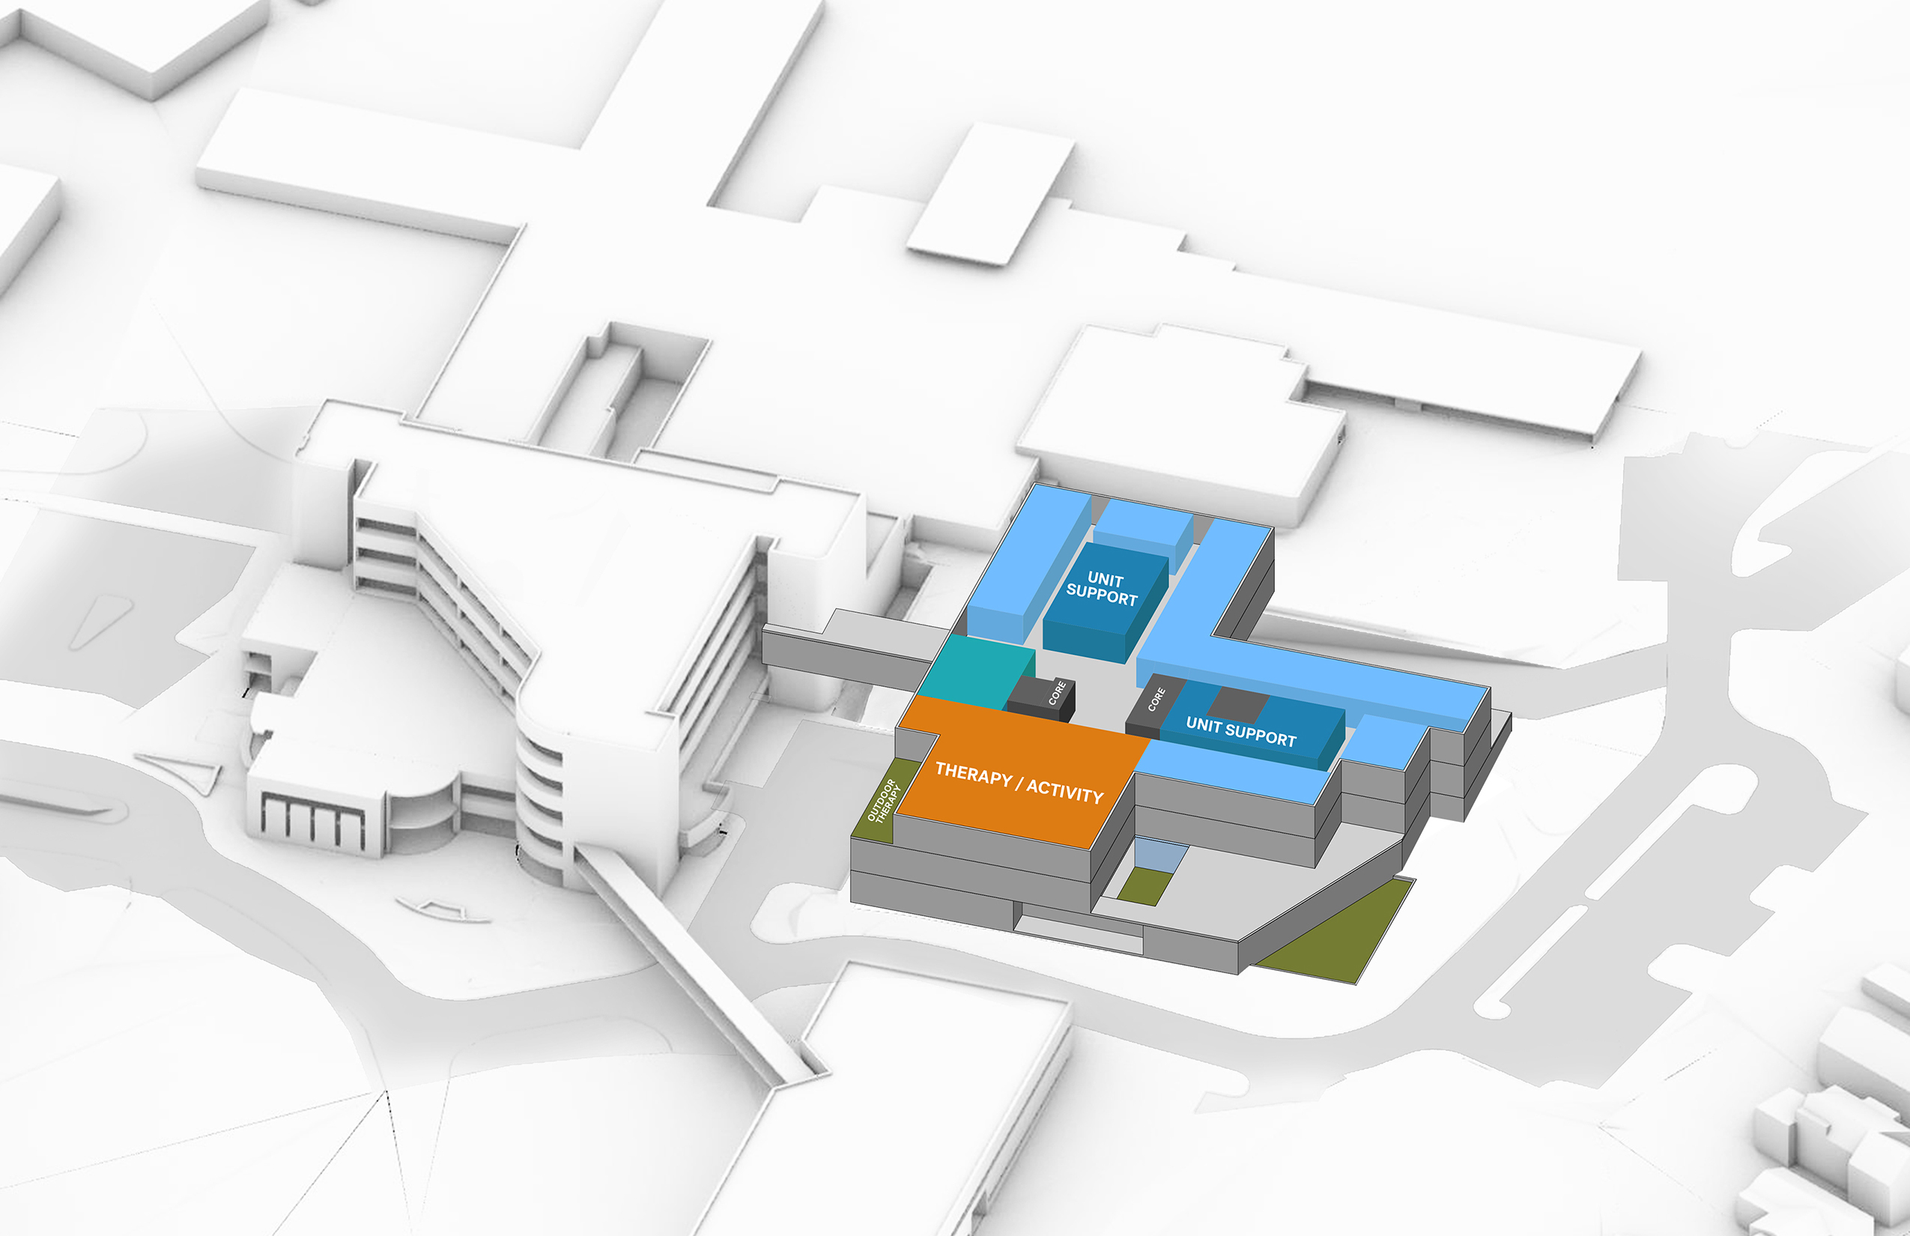
Level 3 Diagram
Med/Surg Patient Unit

Slide 20
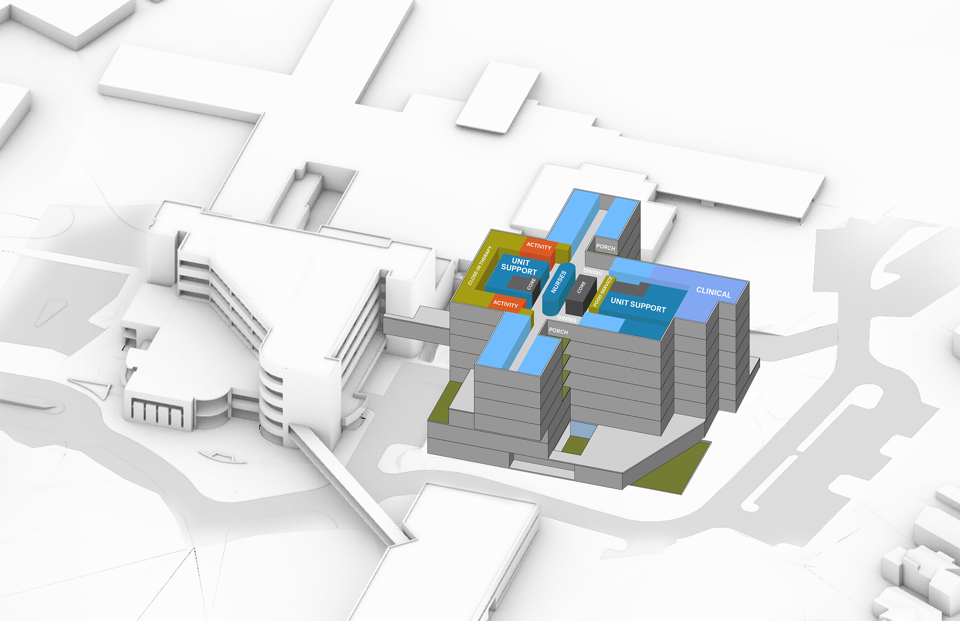
Level 4-7 Diagram
Behavioral Health Patient Units

Slide 21
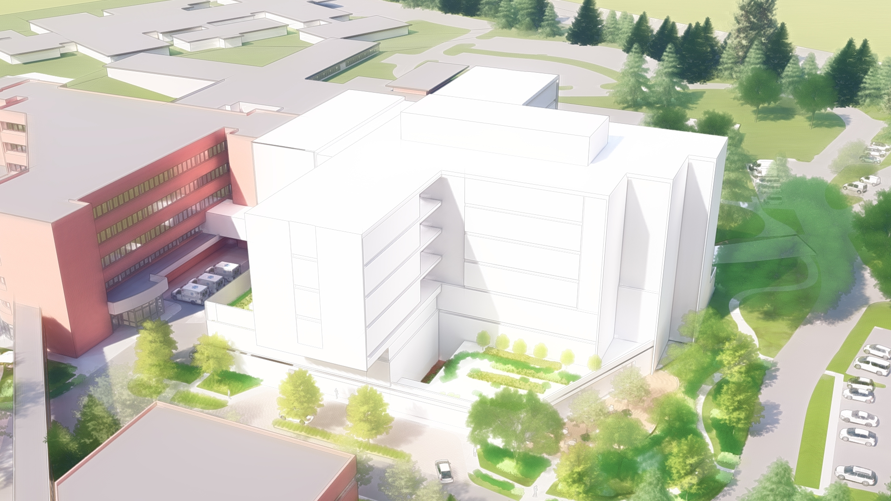
Building Massing

Slide 22
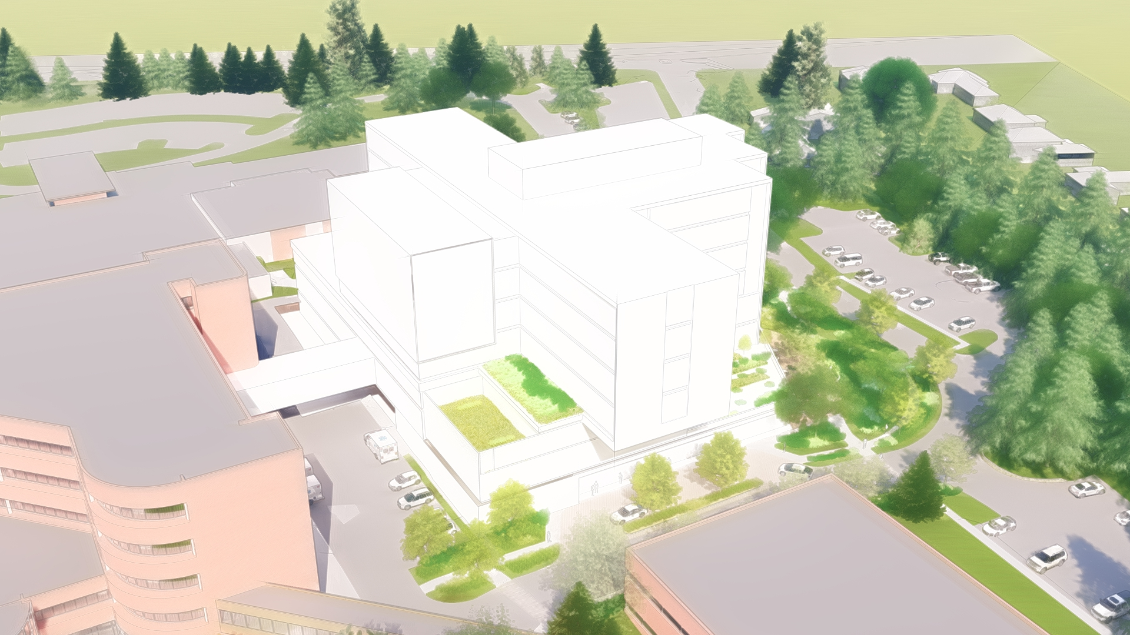
Building Massing

Slide 23
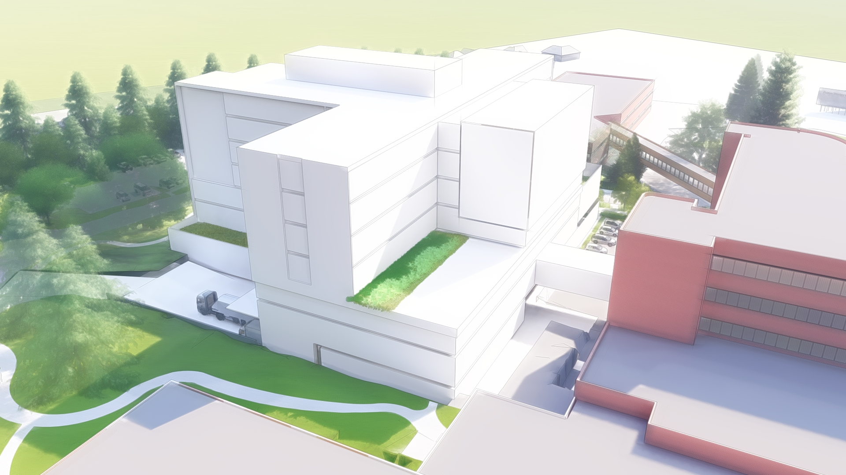
Building Massing

Slide 24
Landscape Design Objectives
Fit the building into the Campus
Respect and preserve the exceptional trees and tree groves
Provide proximate parking for the visitors to reinforce “welcoming” a Guiding Principle
Create safe pedestrian and vehicular movement
Provide adequate ADA parking and access to the building
Create an inviting entry sequence for vehicles and pedestrians
Work within the budget
Connect the patients, visitors and staff to the outdoors

Slide 25
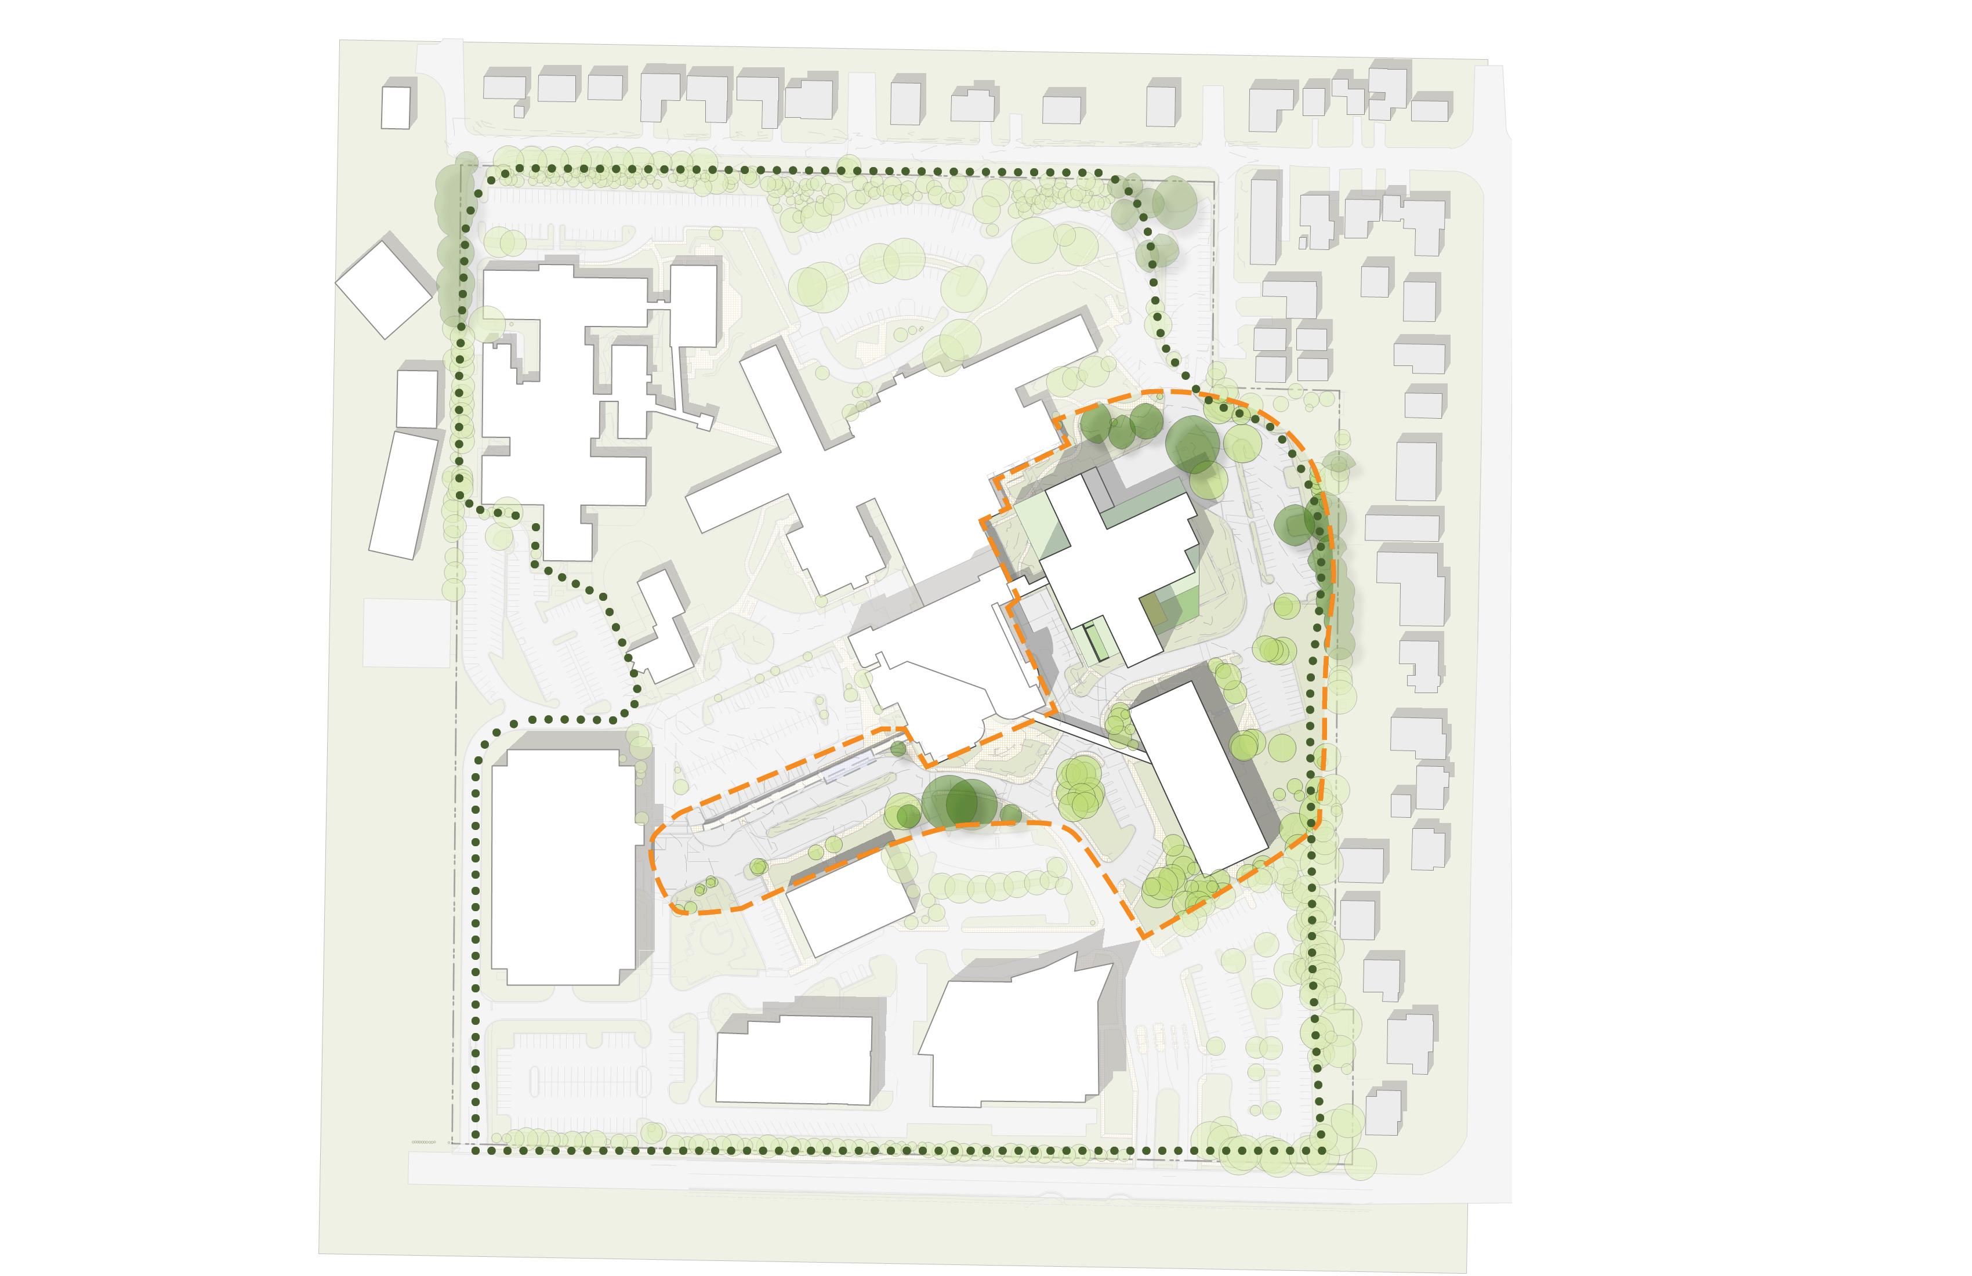
Campus Plan
N 120th St.
Progressive
Care Center
B/C-Wing
Behavioral Health Teaching Facility
Lot D
Childcare
A-Wing
Lot C
Green Heart
Medical Office
Building
Green Spine
Lot B
Parking
Garage
Medical Arts
Building
Limit of Work
Campus Loop Trail
McMurray Medical
Building
SCCA Proton
Therapy Center
N 115th St.
N

Slide 26
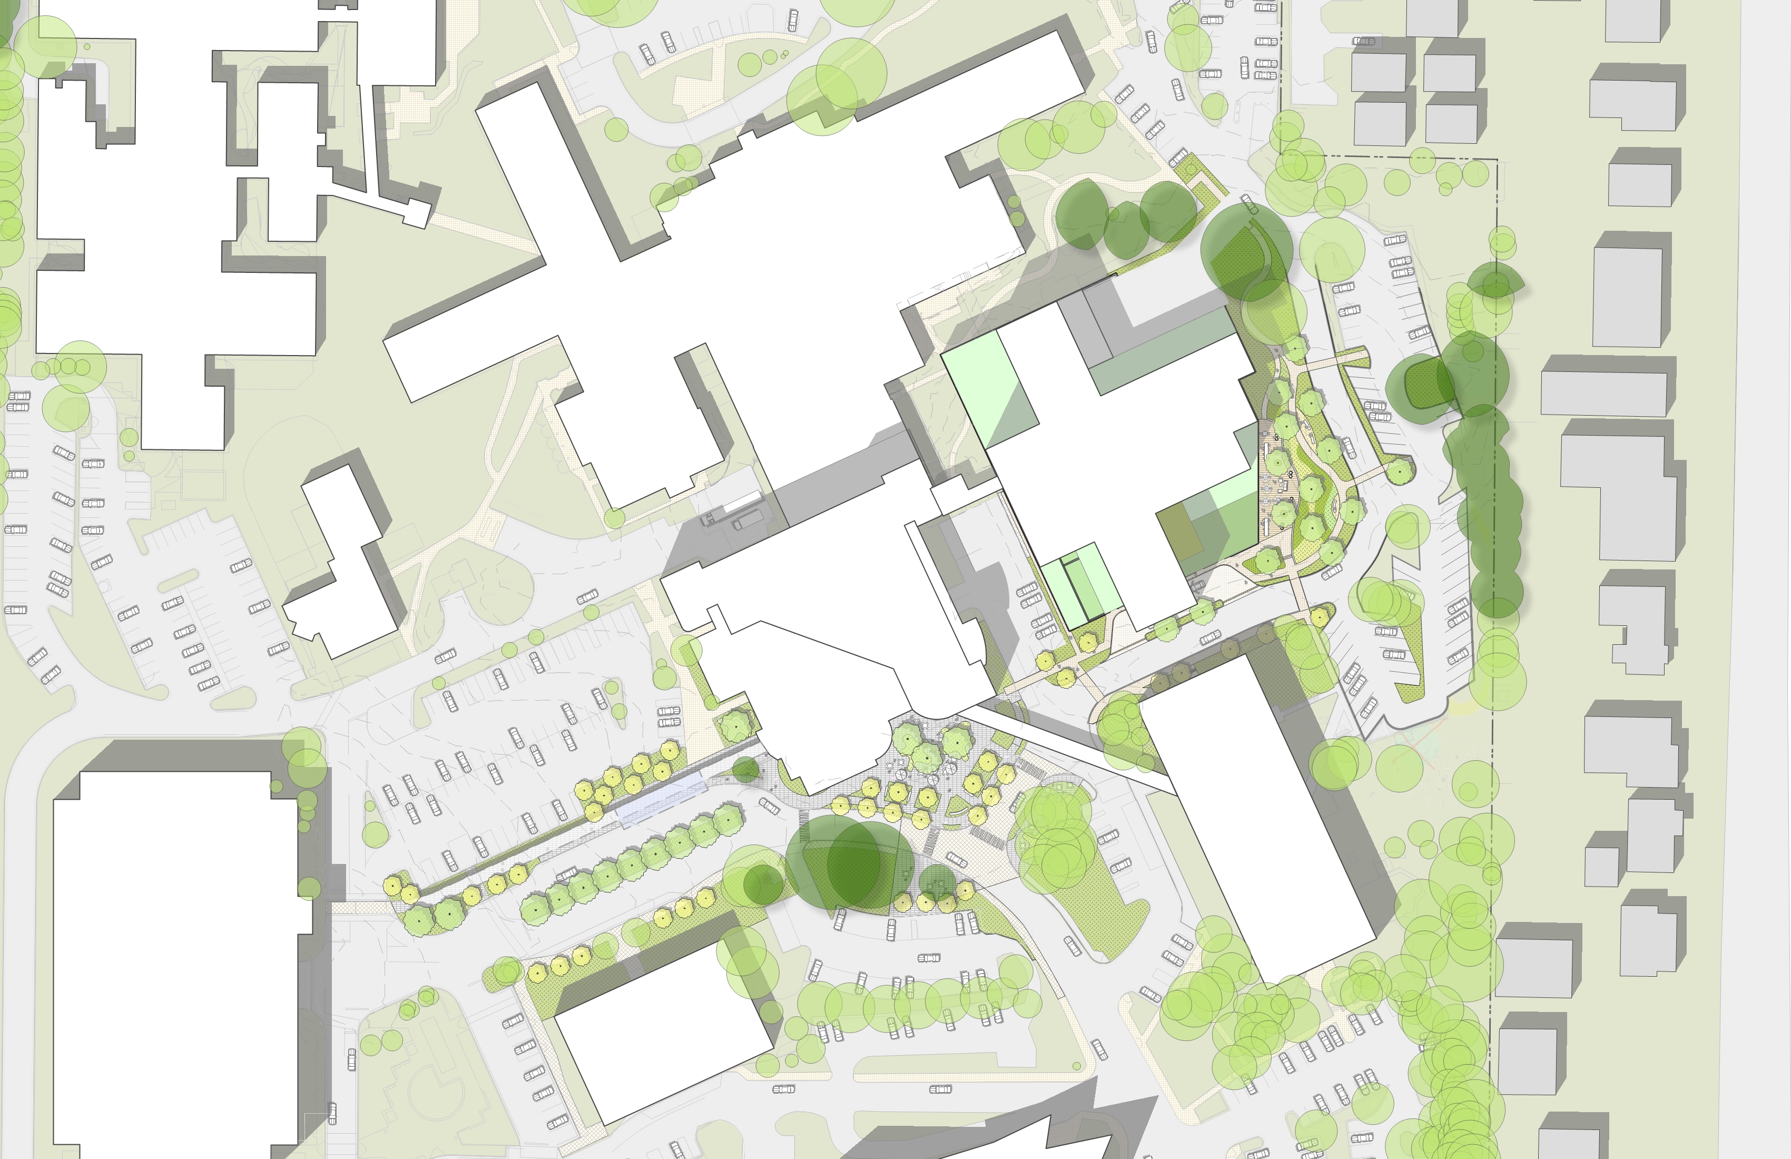
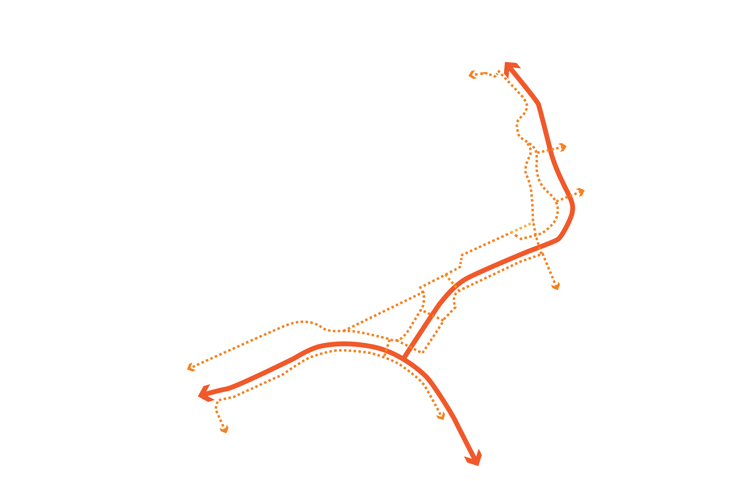
Primary Vehicular and Pedestrian Movement
Progressive
Care Center
B/C-Wing
BHTF
Childcare
A-Wing
Medical Office
Building
Parking
Garage
Medical Arts
Building

Slide 27
Project Adjacent Parking
B/C-Wing
26 Parking Stalls
BHTF
A-Wing
33 Parking Stalls
Medical Office
Building

Slide 28
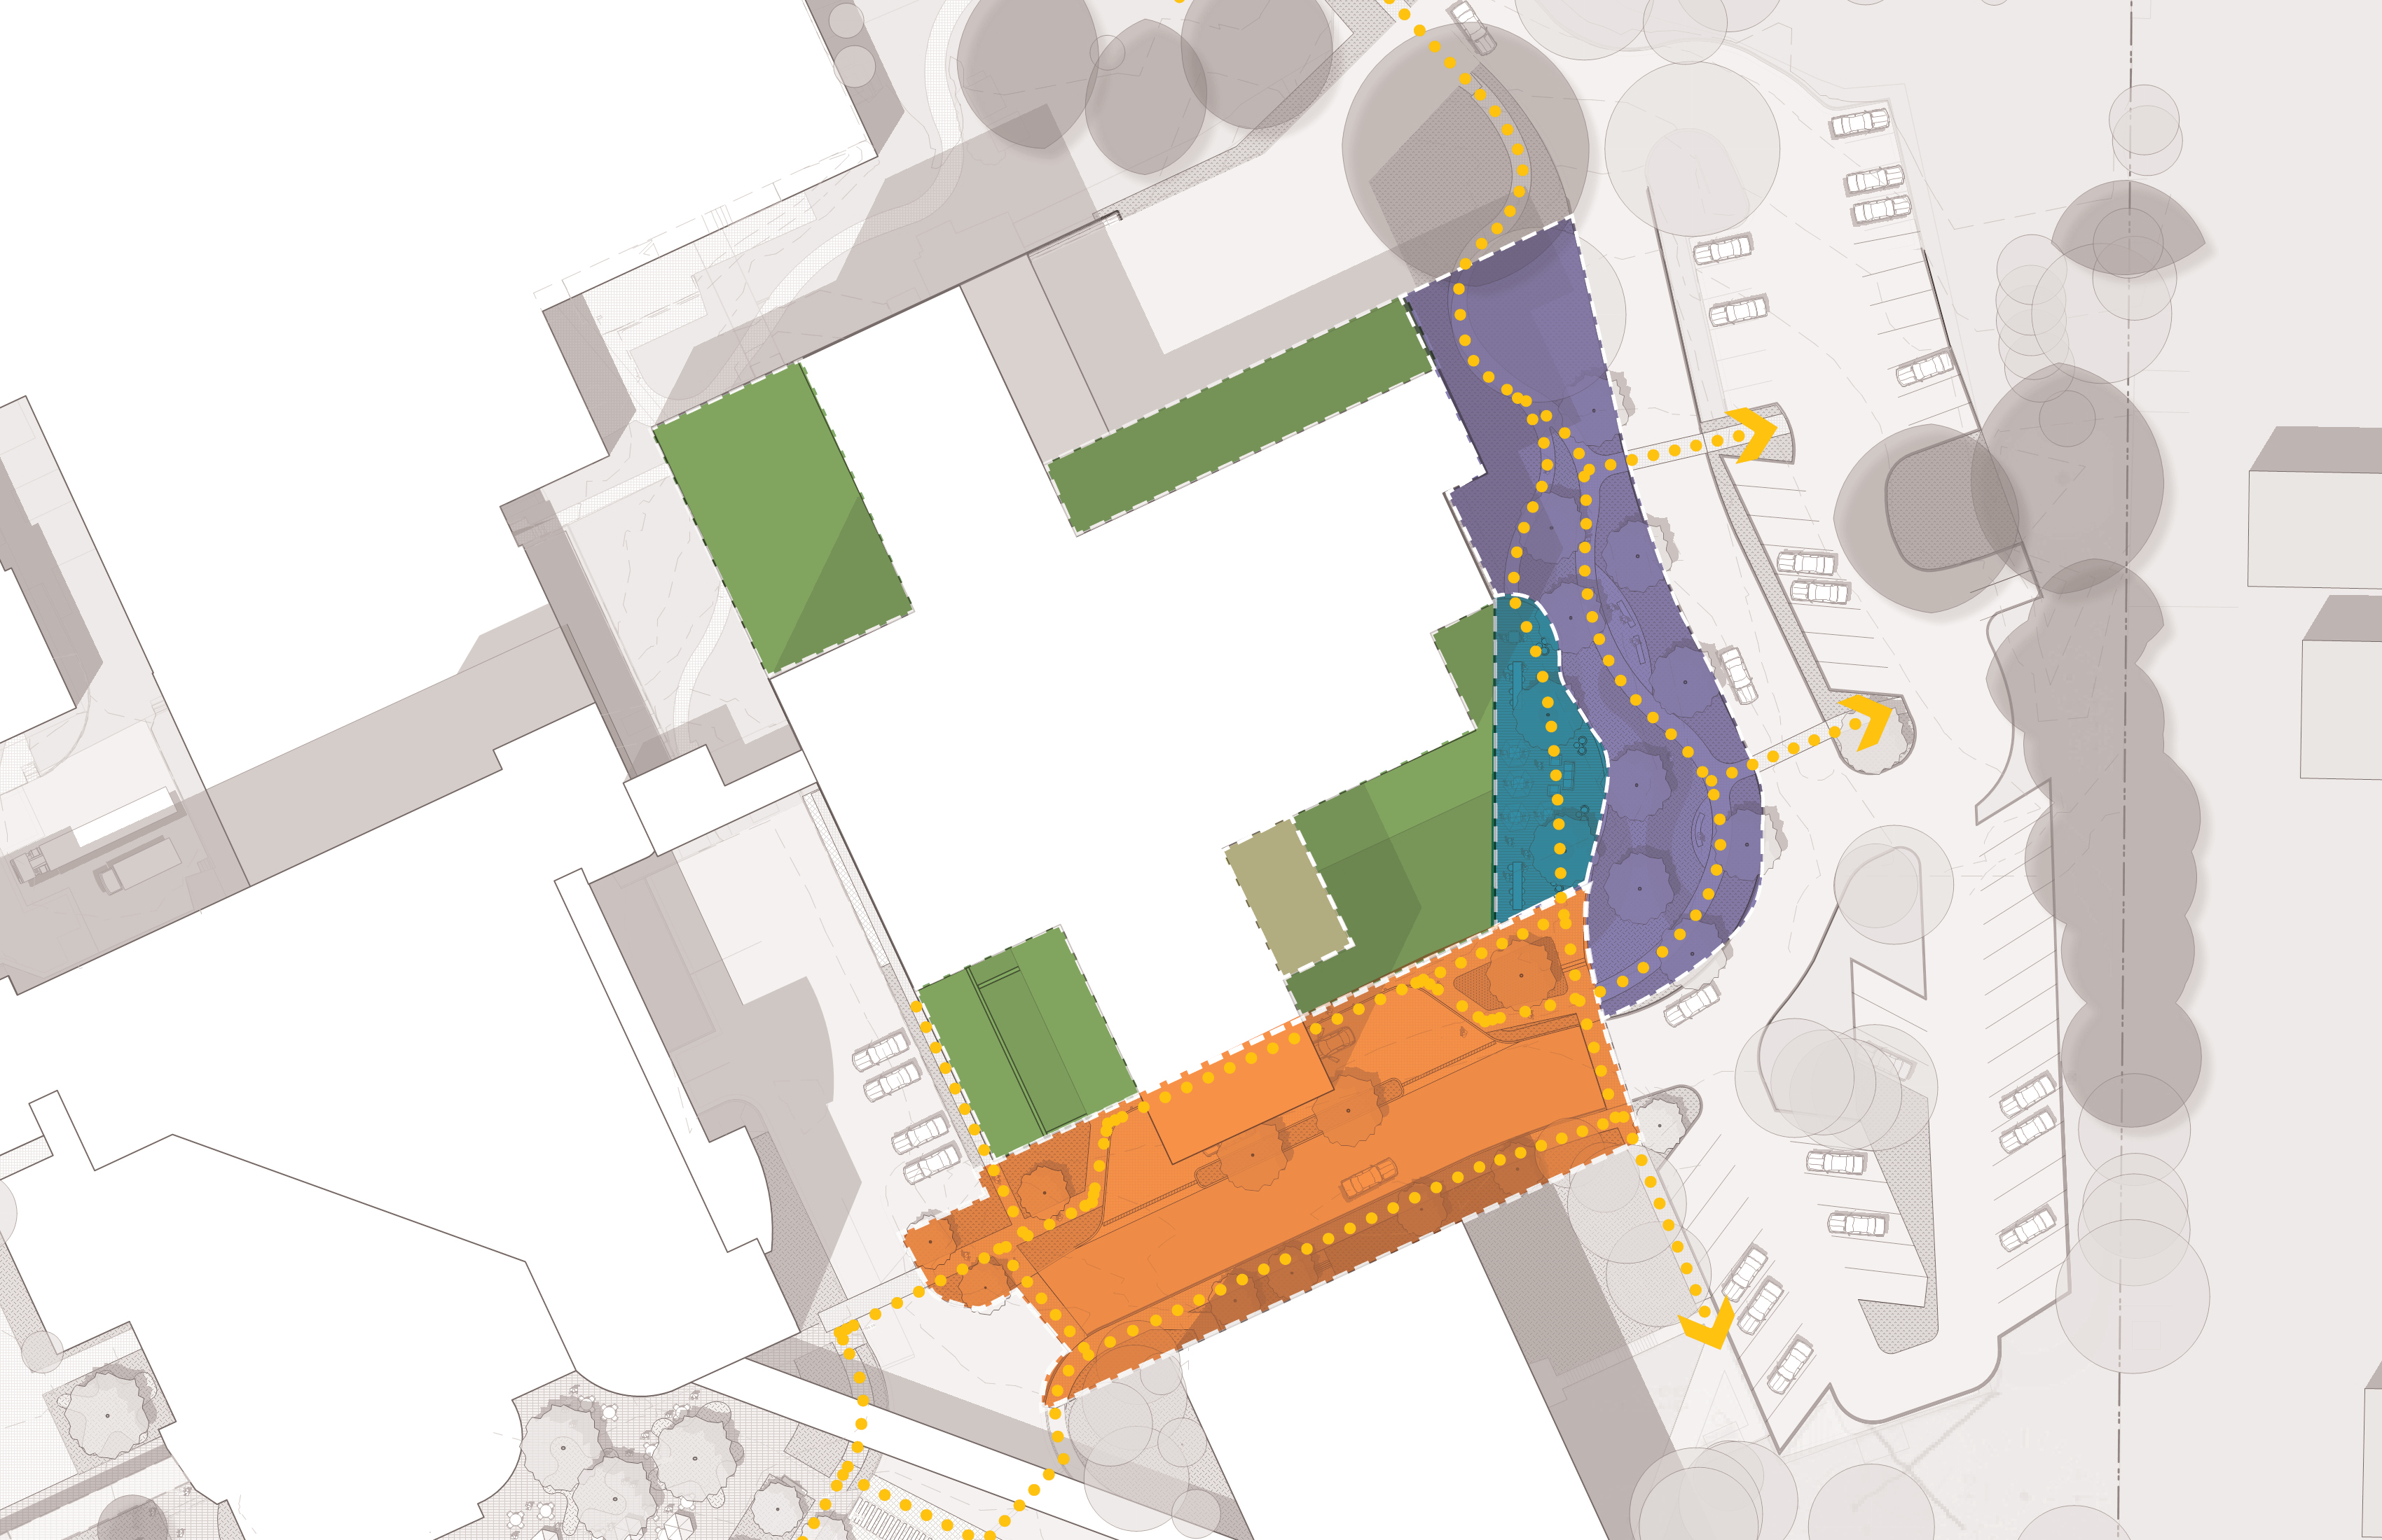
Landscape Opportunities
B/C-Wing
Roof Terrace
Level 2
Roof Terrace
Level 4
Dining Terrace
Roof Terrace
Level 2
Garden Walk
Entry
Courtyard
Roof Terrace
Levels 3 & 4
A-Wing
Arrival / Drop Off
Medical Office
Building
N

Slide 29
Site Plan
Exceptional Trees
Progressive
Care Center
B/C-Wing
Behavioral Health Teaching Facility
Childcare
A-Wing
Medical Office
Building
Parking
Garage
Medical Arts
Building
N

Slide 30
Exceptional Trees and Tree Groves
Progressive
Care Center
B/C-Wing
Exceptional Trees
Existing Tree to be Transplanted
BHTF
Childcare
A-Wing
Medical Office
Building
Parking
Garage
Medical Arts
Building
Existing Canopy Trees

Slide 31
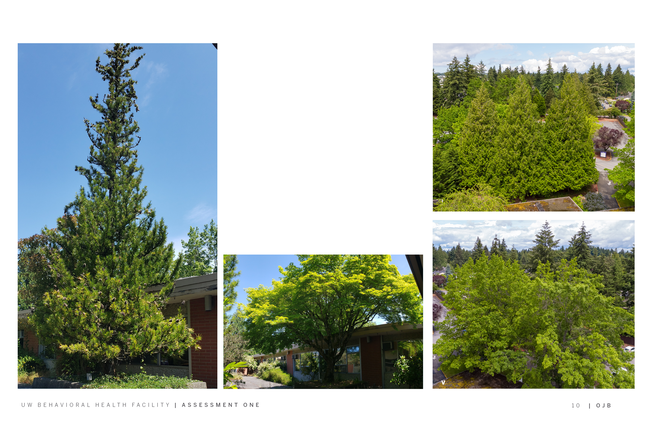
Significant & Exceptional Trees
B/C-Wing
A-Wing
Exceptional Trees - Western Red Cedar
MOB
Japanese Umbrella Pine
(Potential Transplant)
Japanese Maple
(Potential Transplant)
Exceptional Tree - Scarlet Oak

Slide 32
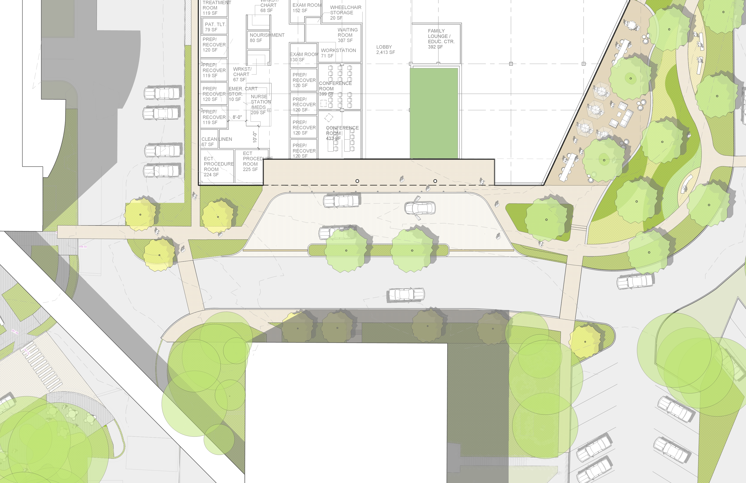
Arrival / Drop-Off
Interior Courtyard
Dining Terrace
Entry
p
Bollards
Garden Walk
Steps
Arrival / Drop off
Ornamental
Planting
Pedestrian Walk
Drain
Planted Median
Sloped Walk
Crosswalk
Loop Road
Crosswalk
Pedestrian Walk
Steps
Parking
MOB
Area: 15,200 sf
N

Slide 33
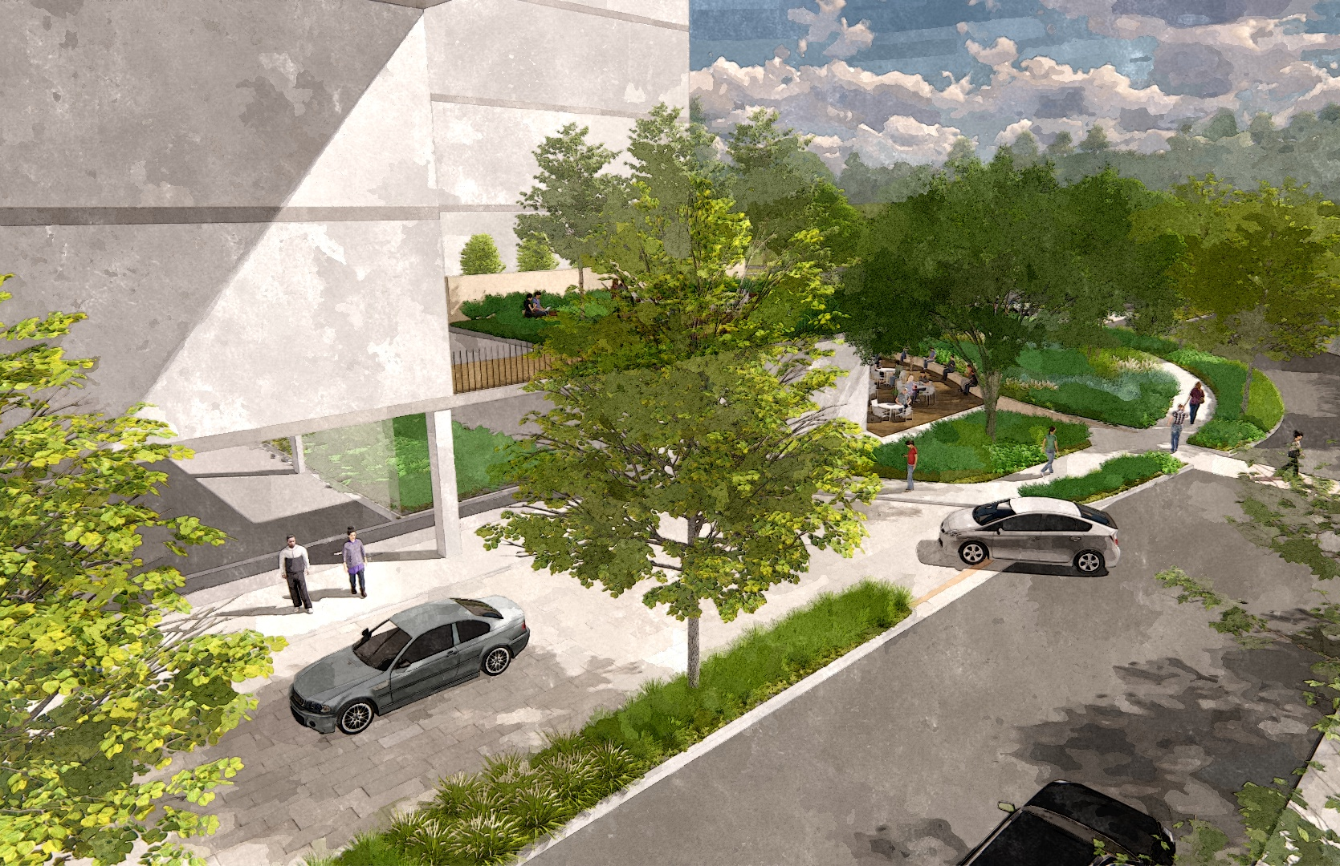
Arrival / Drop-Off
Roof Terrace
Interior
Courtyard
Ornamental
Planting
Pedestrian Crosswalk
Re-Aligned Road
Arrival / Drop Off
Planted Median

Slide 34
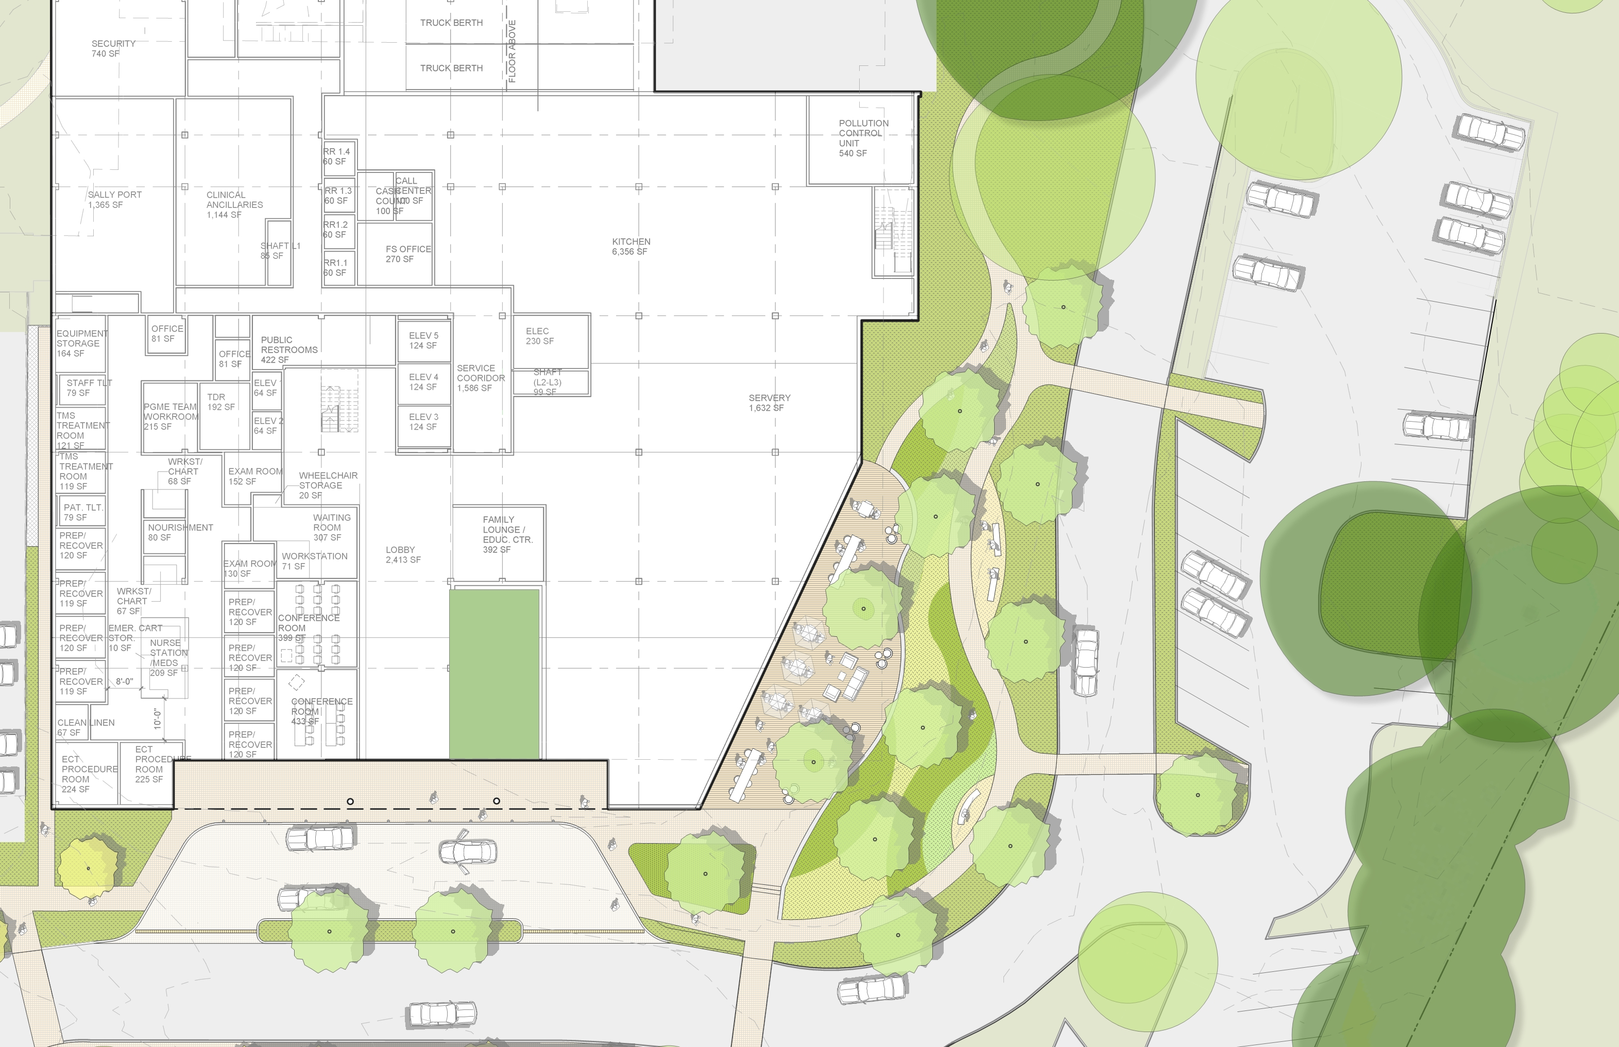
Dining Terrace + Garden Walk
l
Parking
Crosswalk
Interior Courtyard
Dining Terrace
(2,250 sf)
Seating
Exceptional Tree
Garden Walk
(9,750 sf)
Seat Wall
Entry
Crosswalk
Seating
Exceptional
Tree Grove
Total Area: 12,000 sf
N

Slide 35
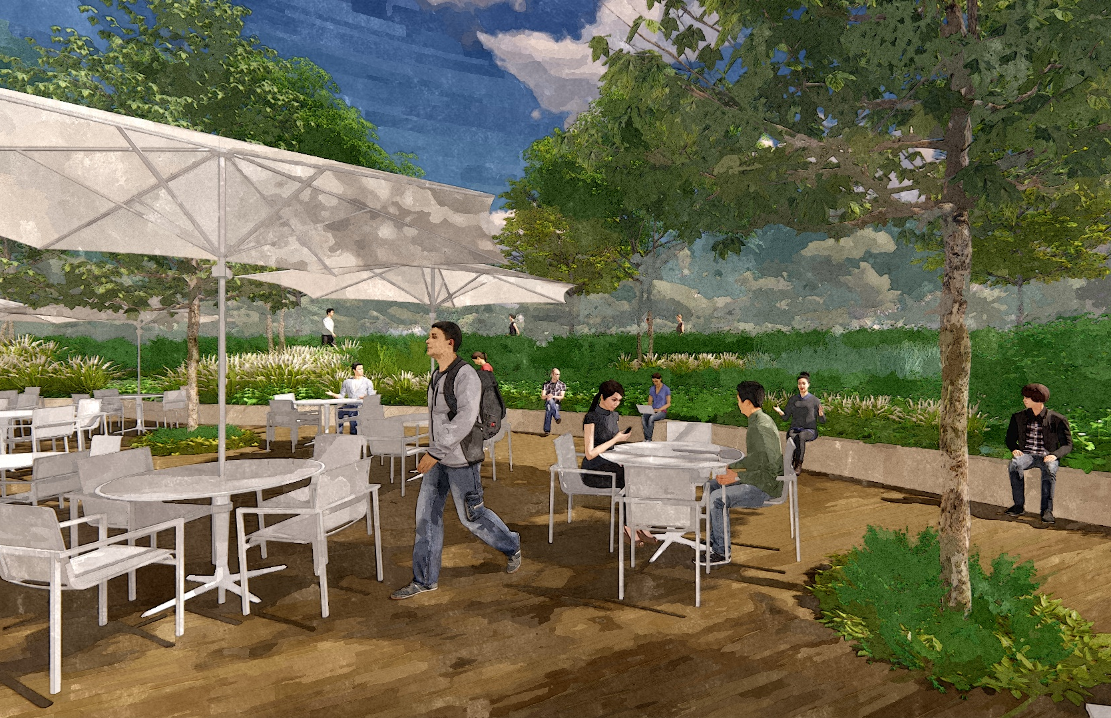
Dining Terrace
Canopy Trees
Garden Walk
Garden Walk
Ornamental Planting
Flexible Seating
Seat Wall
Decorative Paving

Slide 36
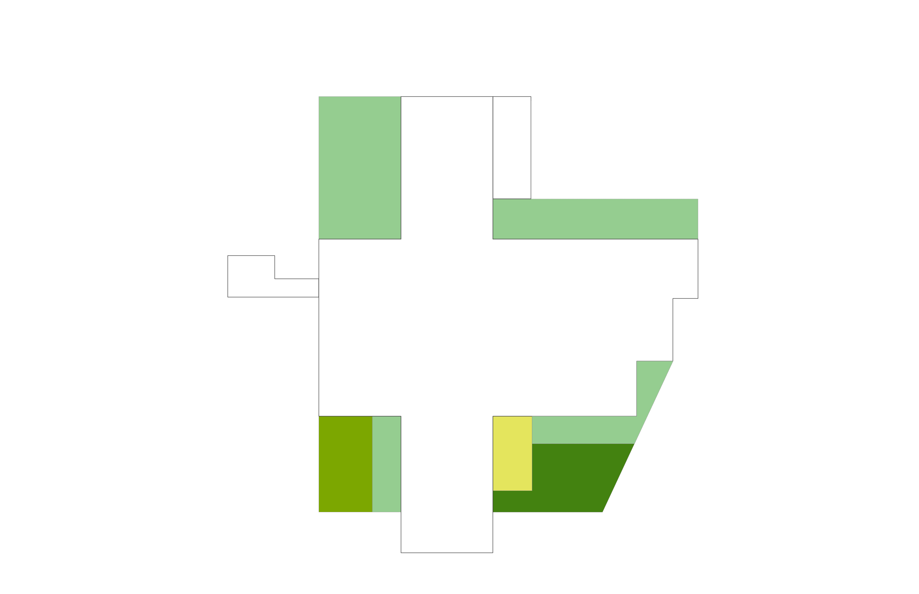
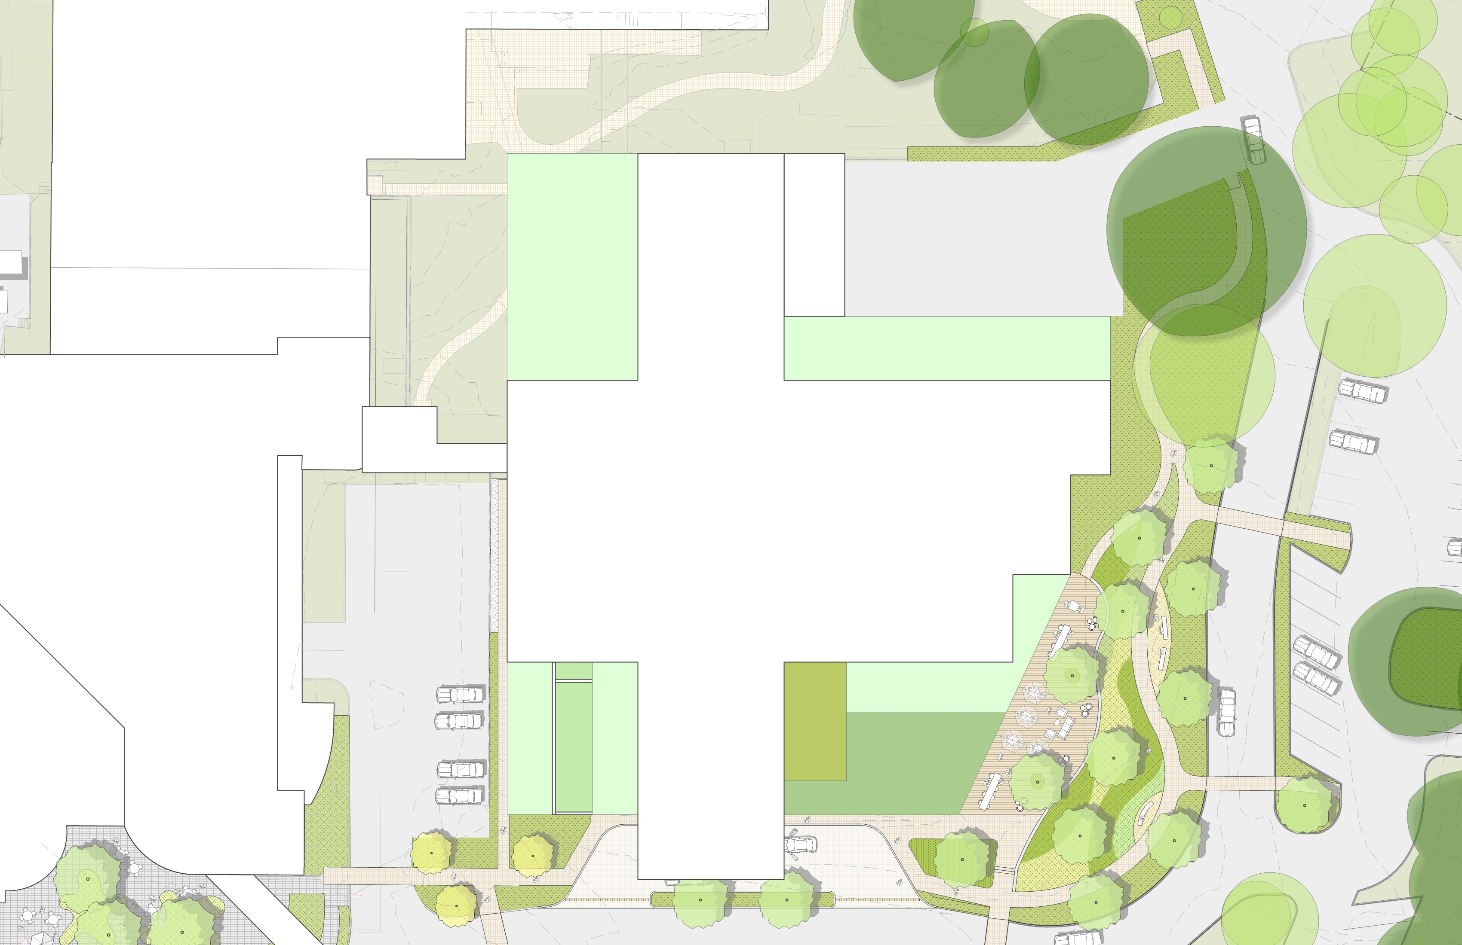
Rooftop Strategies
Level 4 – Viewing Garden
Level 2 – Viewing Garden
Level 4-7 – Accessible Therapy Terraces
Level 2 – Viewing + Accessible Garden
Level 3 – Accessible Therapy Garden
Level 4 – Viewing Garden
Courtyard
Total Area: 11,740 sf
N

Slide 37
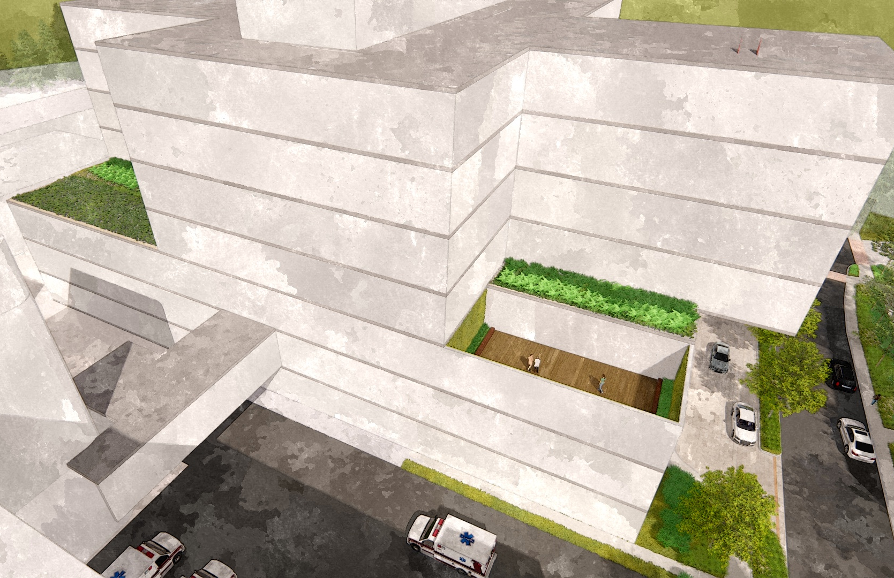
Rooftop Strategies
Viewing Garden
Viewing Garden
Accessible Outdoor Therapy Space
Emergency Department

Slide 38
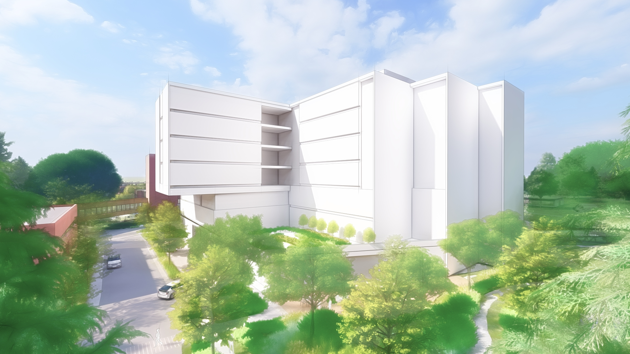
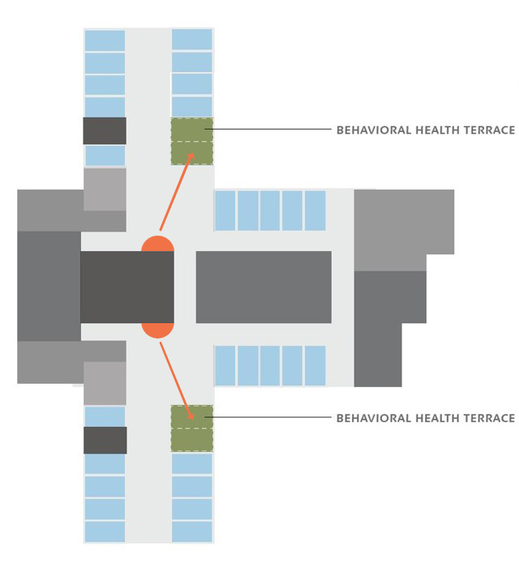
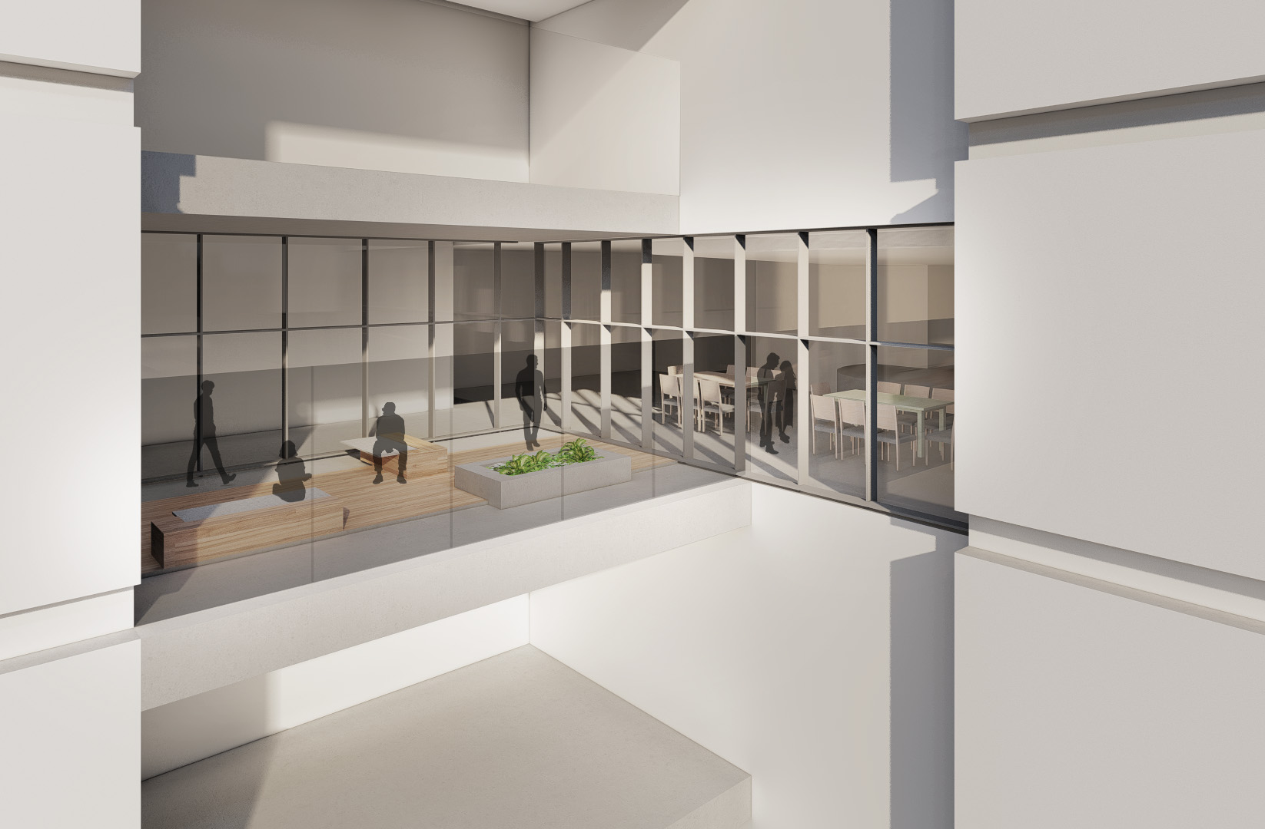
On-Unit Outdoor Terraces

Slide 39
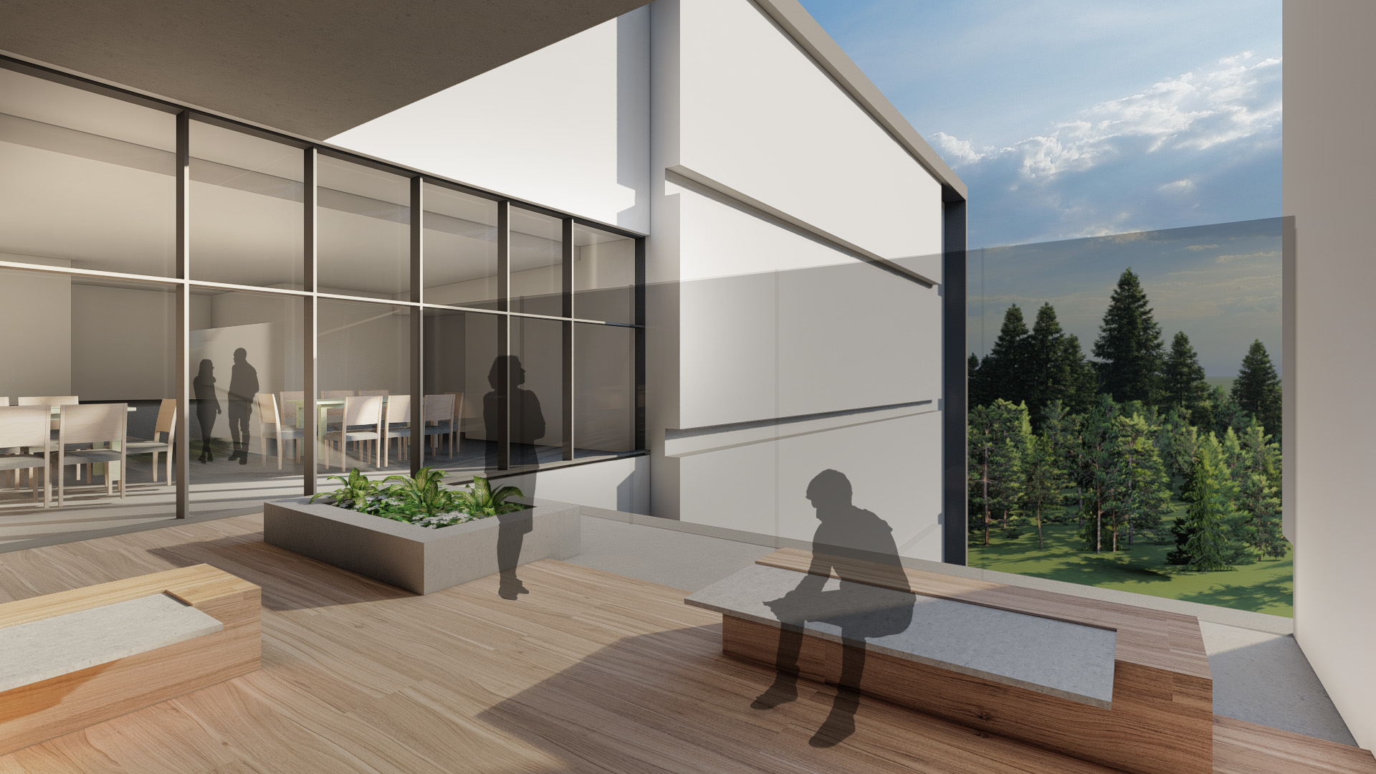
On-Unit Outdoor Terraces

Slide 40
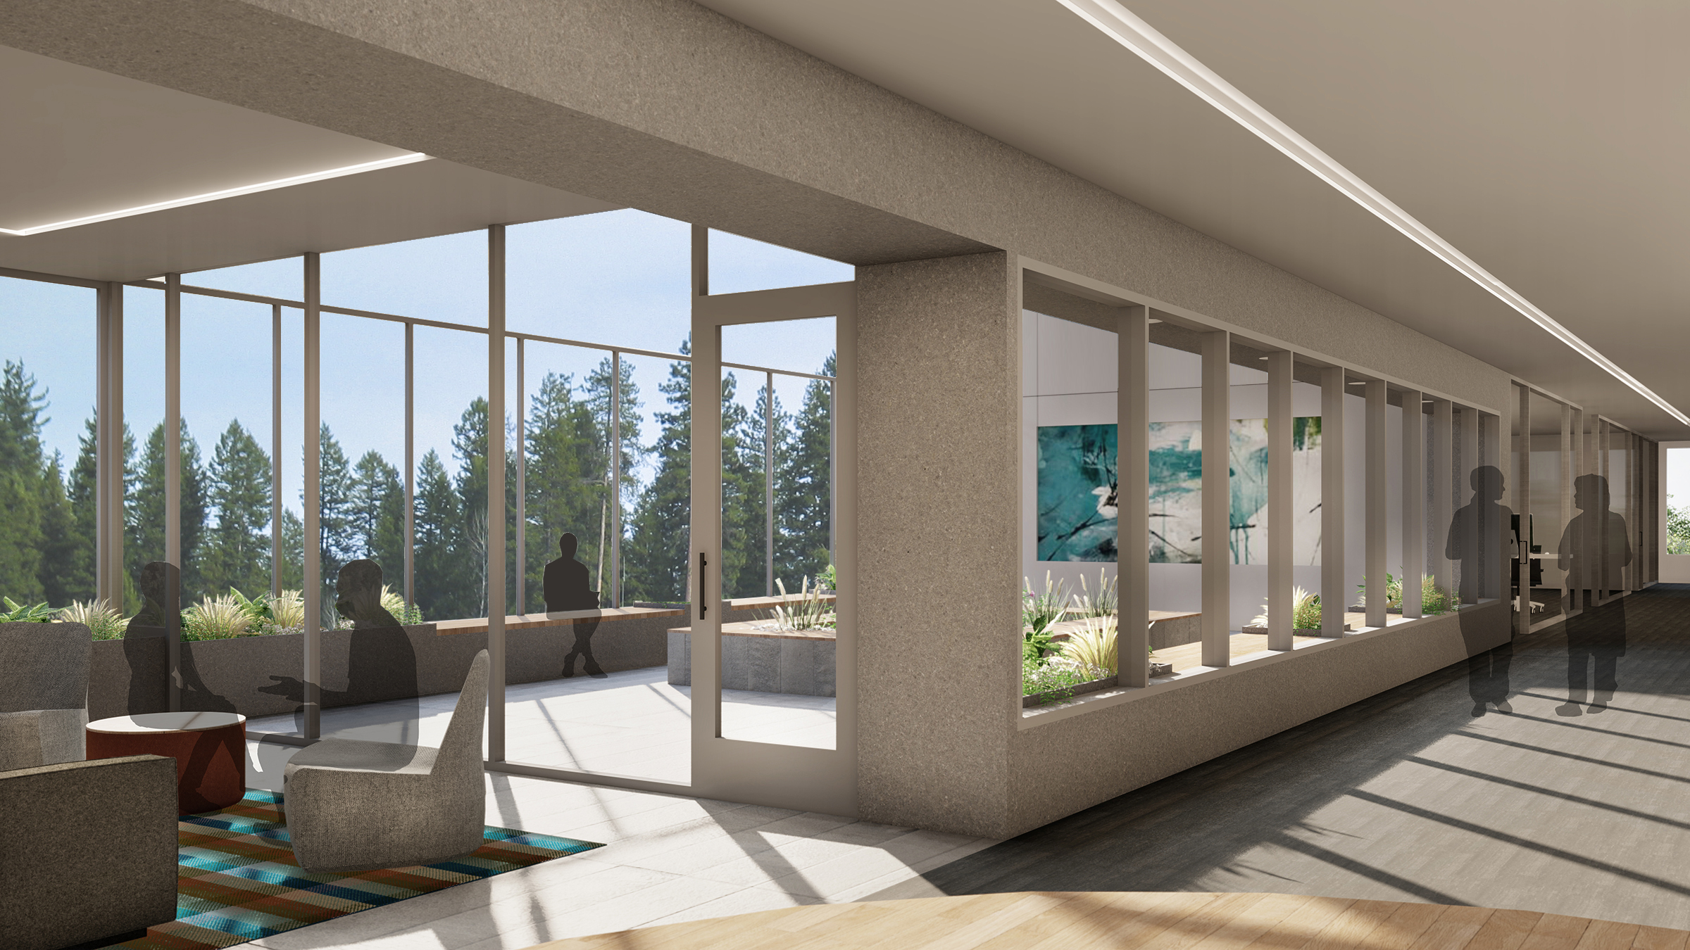
On-Unit Outdoor Terraces

Slide 41
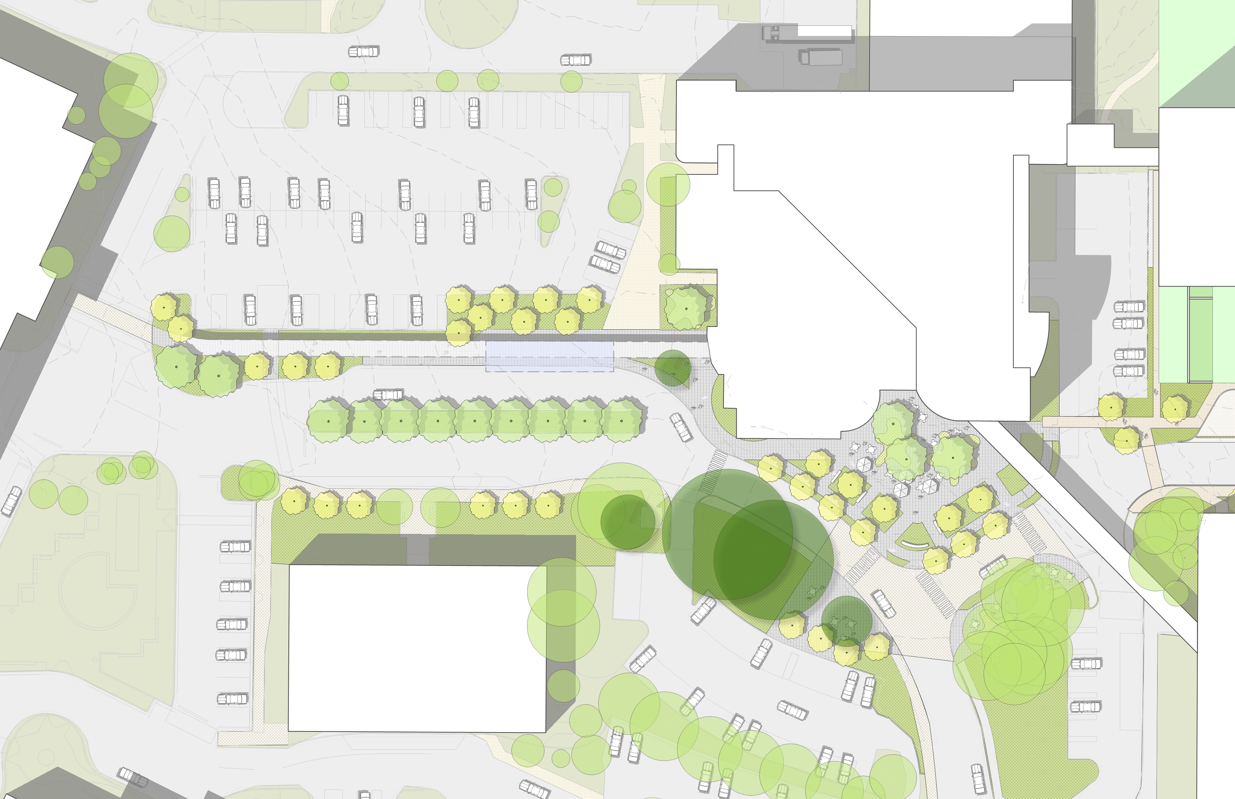
Green Heart and Green Spine
Parking
Ornamental Planting
A-Wing
Green Heart
Green Spine
Planted Median
Crosswalk
Pedestrian Bridge
Ornamental Planting
Crosswalk
Crosswalk
Seating Terrace
Seating Terrace
Special Paving
N

Slide 42
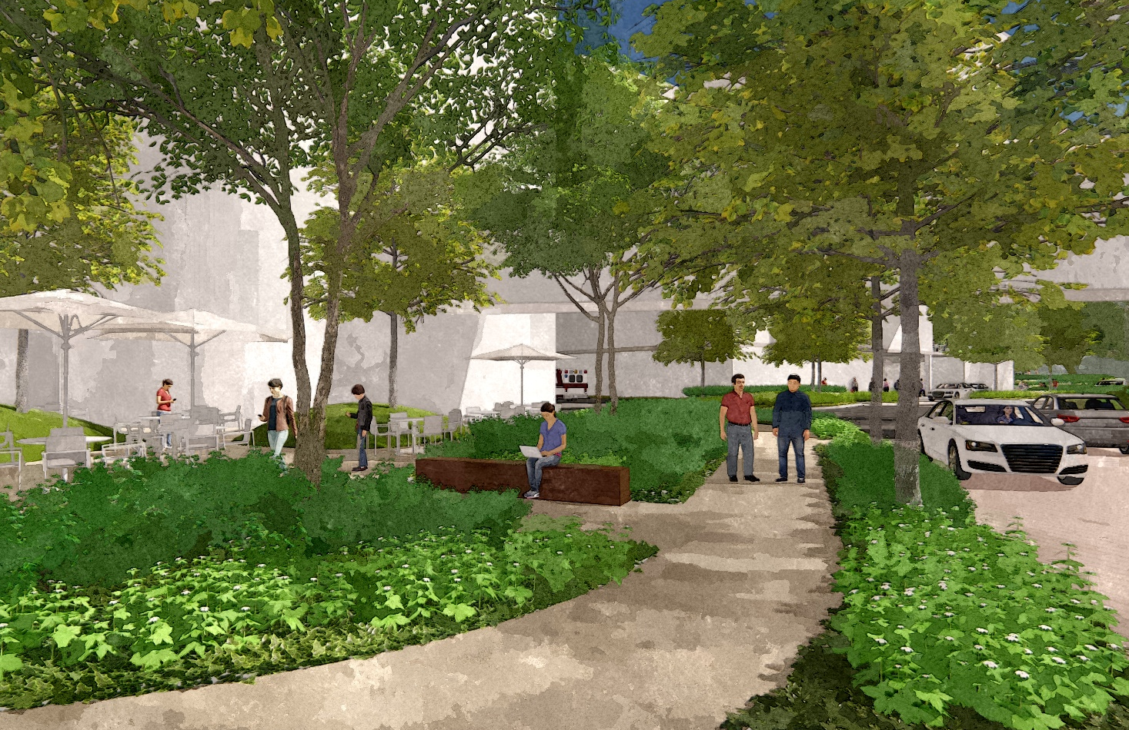
Green Heart and Green Spine
Street Trees
A-Wing
Behavioral Health
Flexible Seating Terrace
Special
Vehicular
Paving
Ornamental Planting
Planting
Buffer
Pedestrian Path

Slide 43
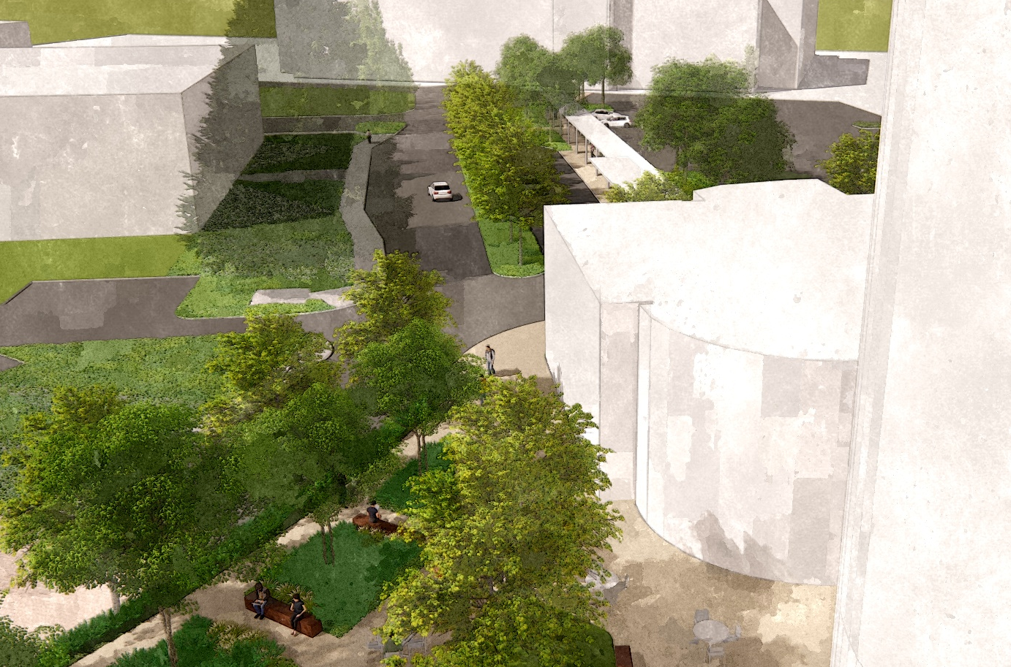
Green Heart and Green Spine
Parking Garage
Green Spine
A-Wing
Green Heart
Main Entry Plaza

Slide 44
Animation, Questions and Feedback

