Slide 1
Husky Village Redevelopment
Design Guidelines
UW Bothell
PRESENTATION // 16 December 2019

Slide 2
Husky Village Redevelopment Program
300,000 GSF maximum (not including parking)
~600 Traditional Beds/181-277 Apartment Beds
20,000 SF Office Space
15,000 SF Dining & Kitchen
9,000 Student Activity Space
225-250 parking stalls minimum

Slide 3
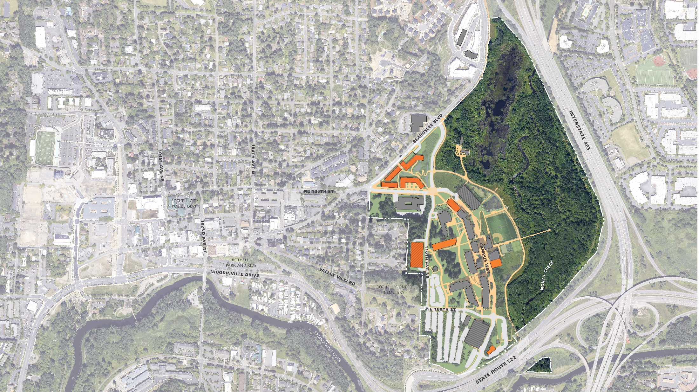
Near-Term Development Plan
Husky Village Site 4.4 Acres

Slide 4
Residence Hall
Apartments
Residence Hall
Apartments
CC 5
STEM 4

Slide 5
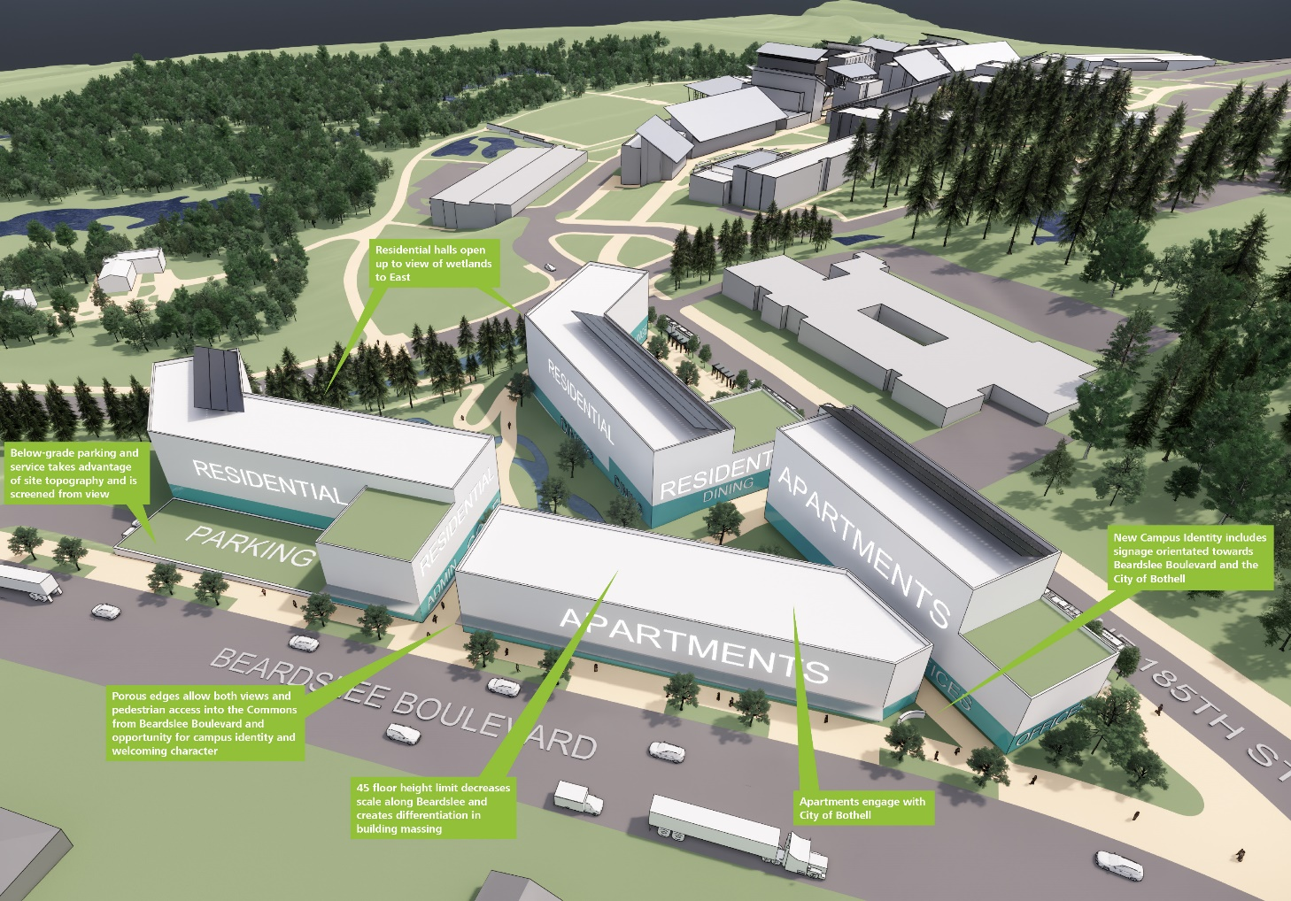
View from Beardslee Boulevard looking SE

Slide 6
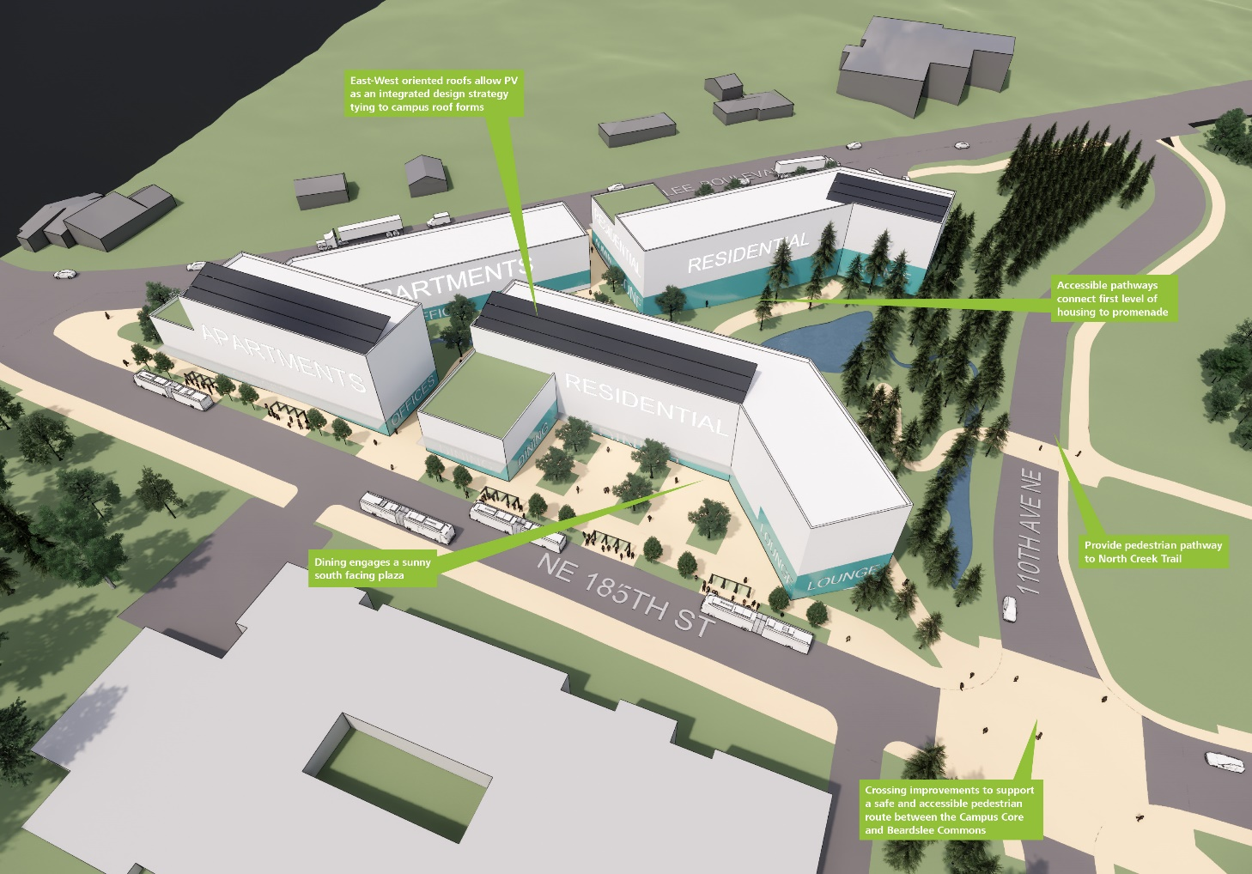
View from NE 185th Street looking NW

Slide 7
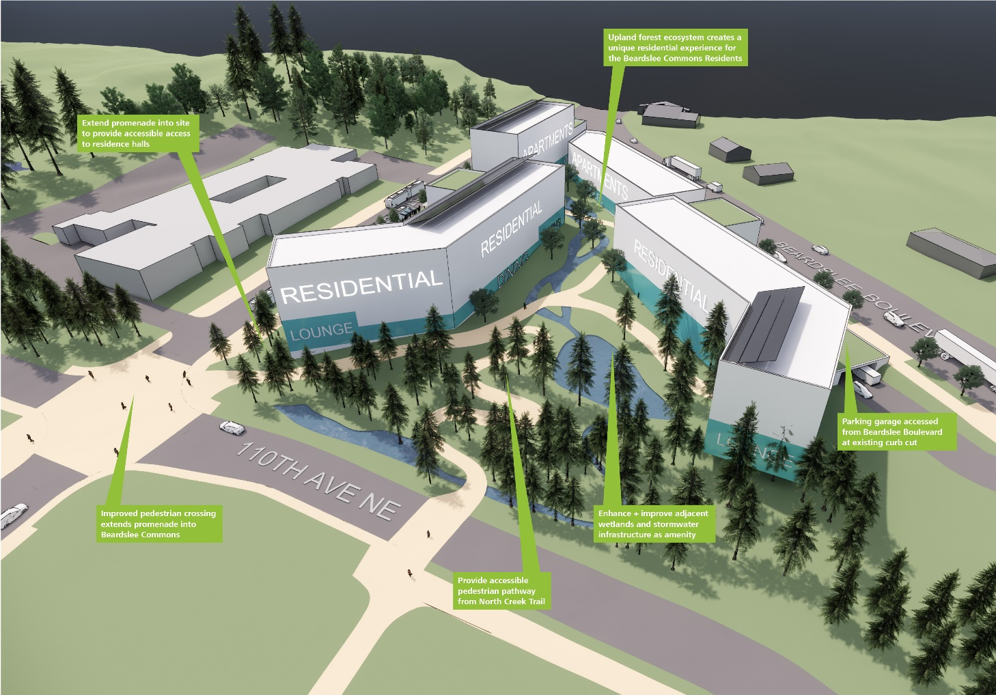
View from 110th Ave NE looking W

Slide 8
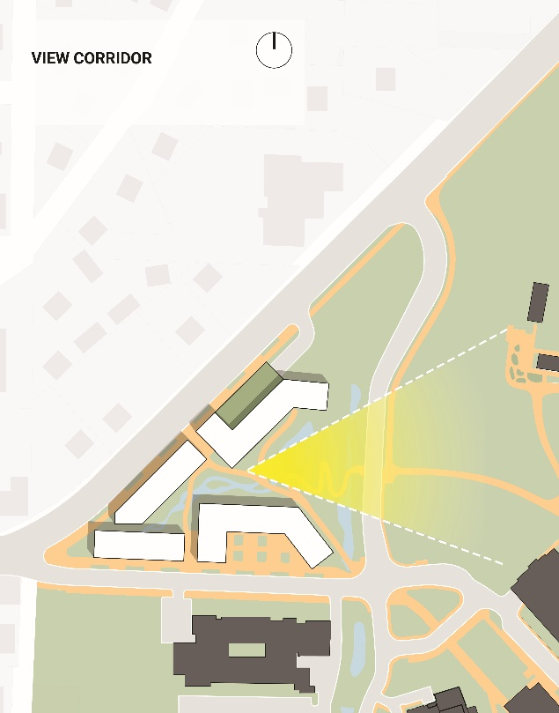
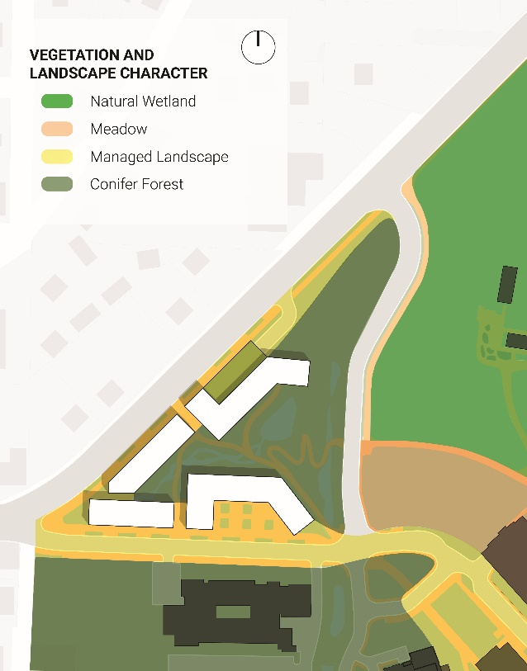
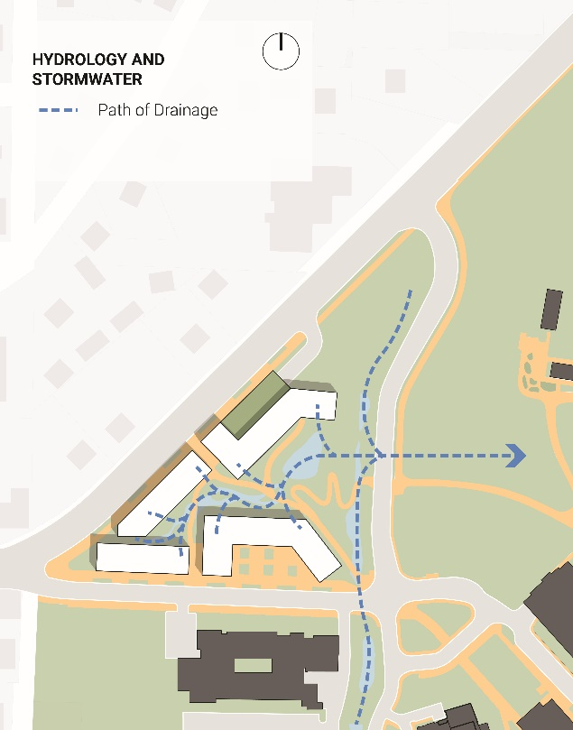
Open Space Framework

Slide 9
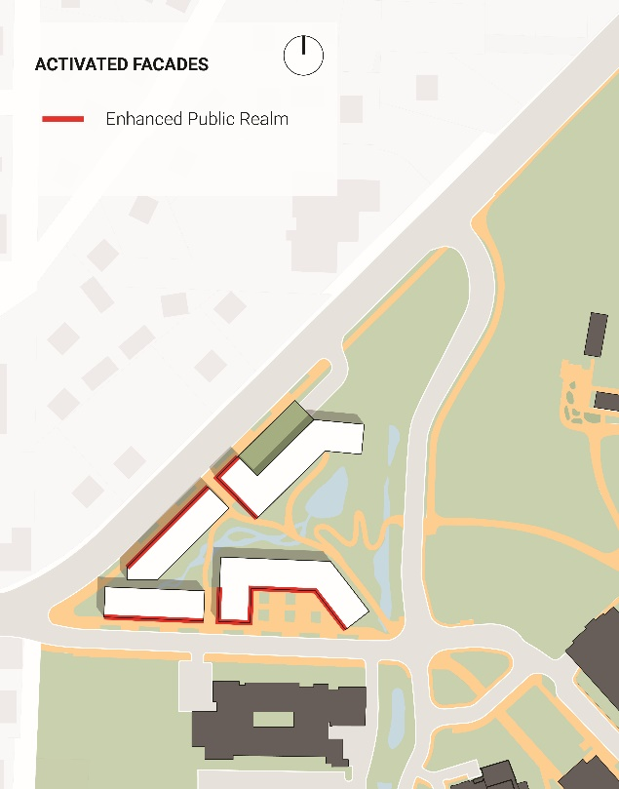
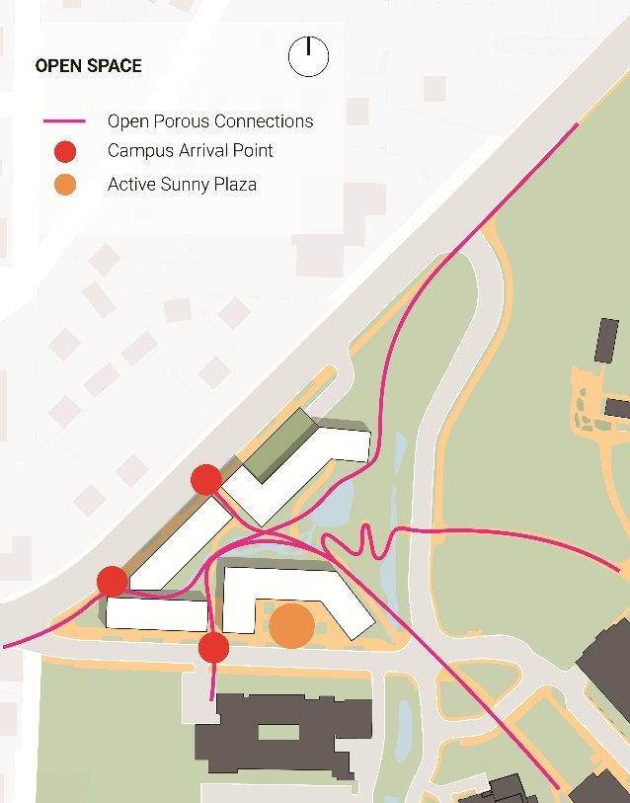
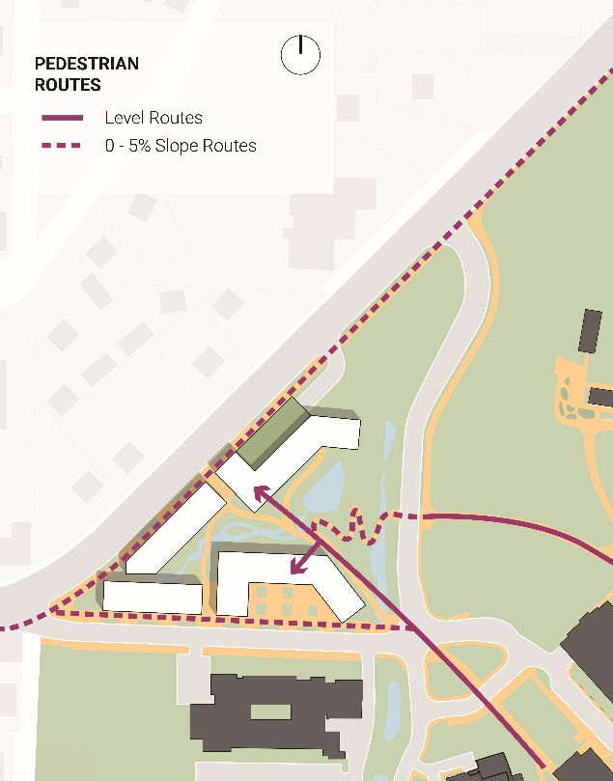
Built Environment Framework

Slide 10
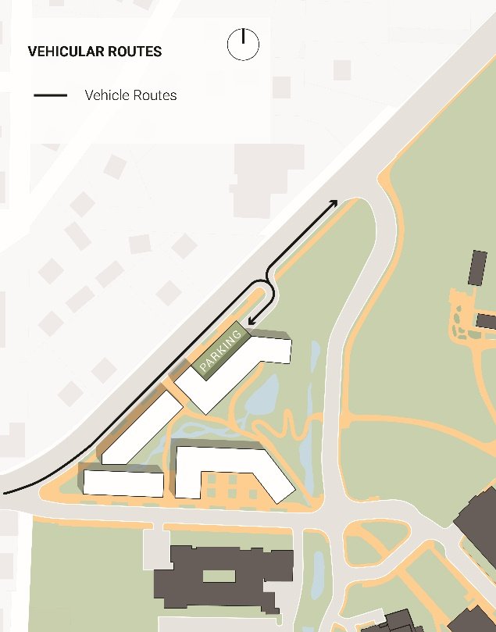
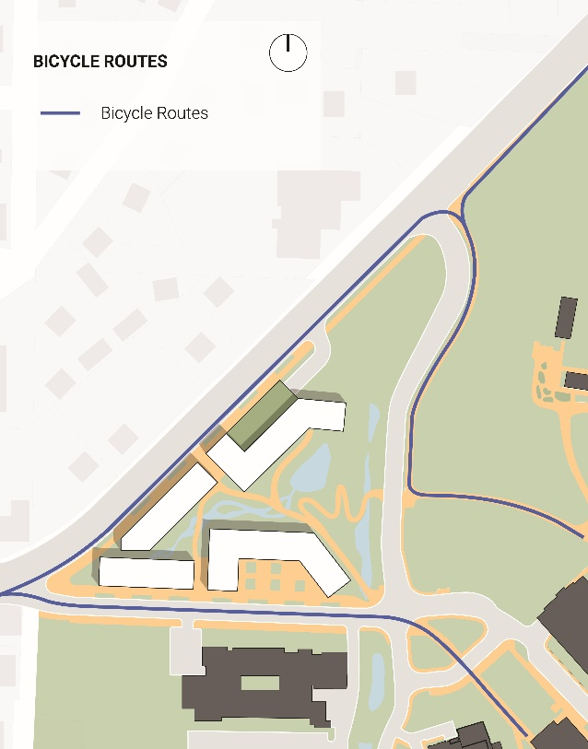
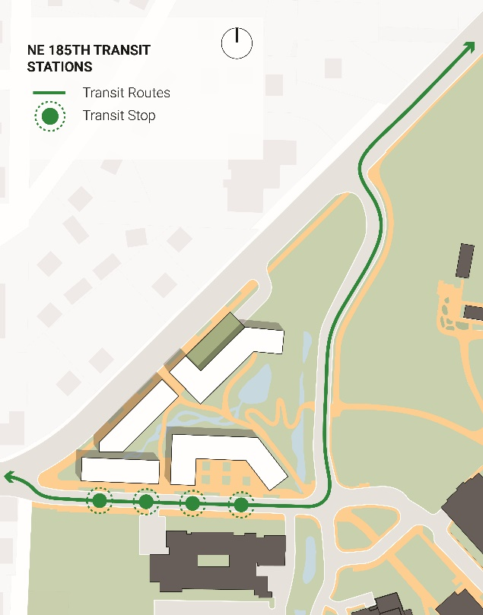
Mobility Framework

Slide 11
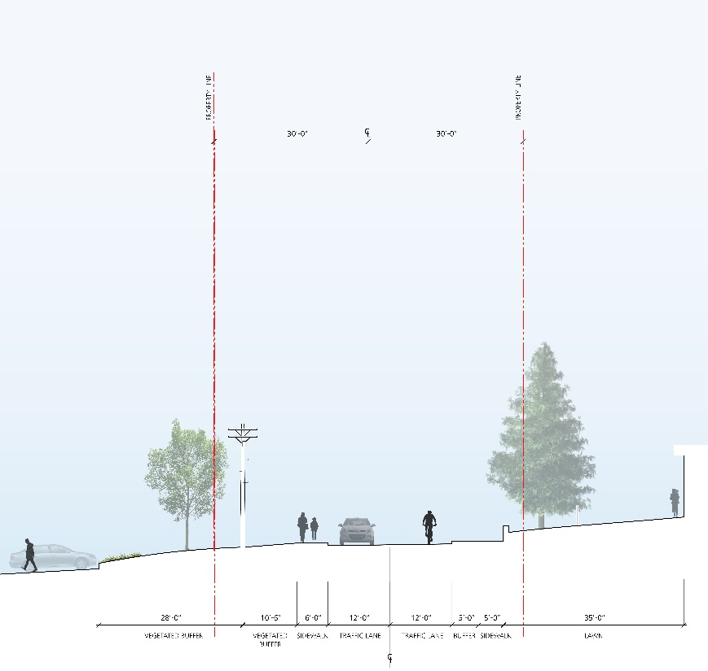
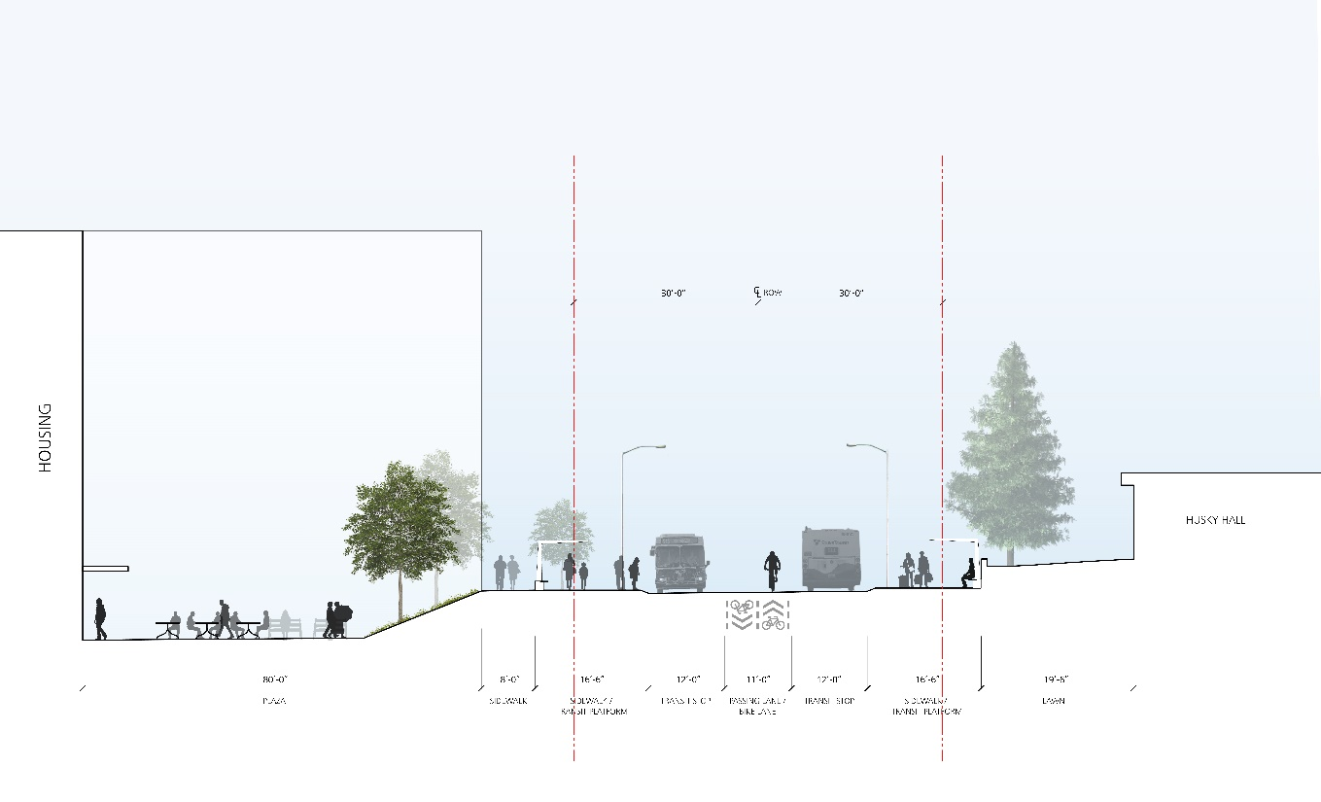
NE 185th Street – Transit Center
Existing A-A
Proposed B-B

Slide 12
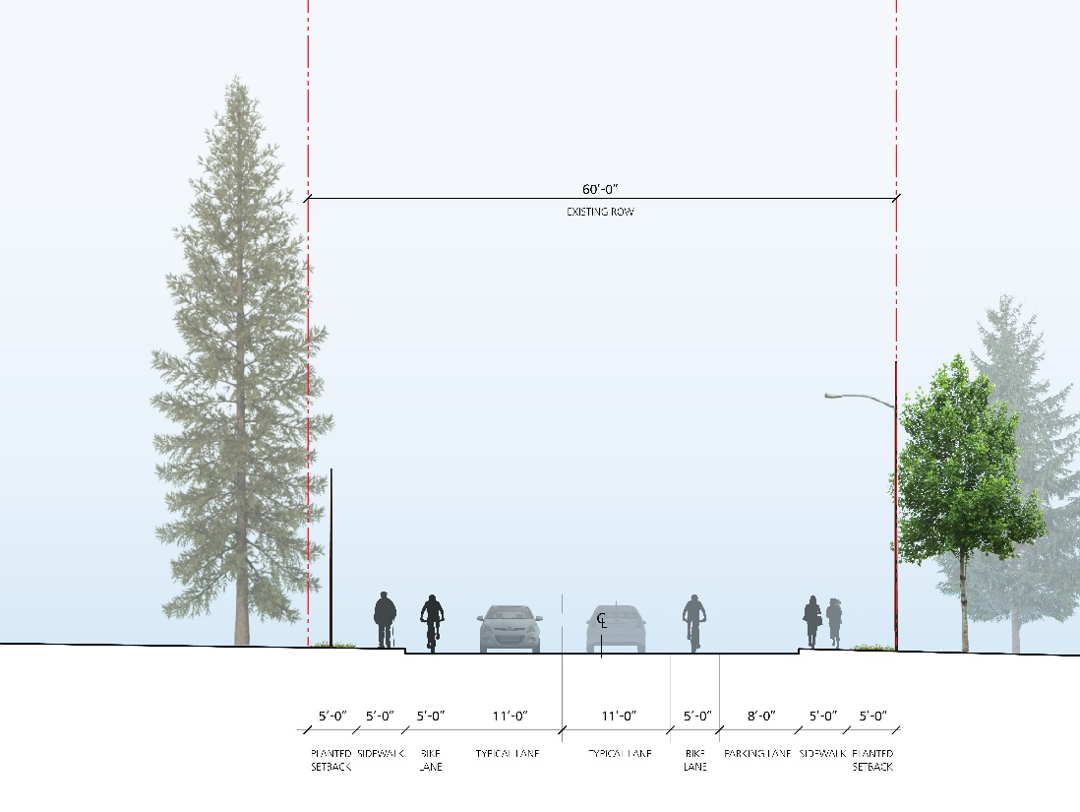
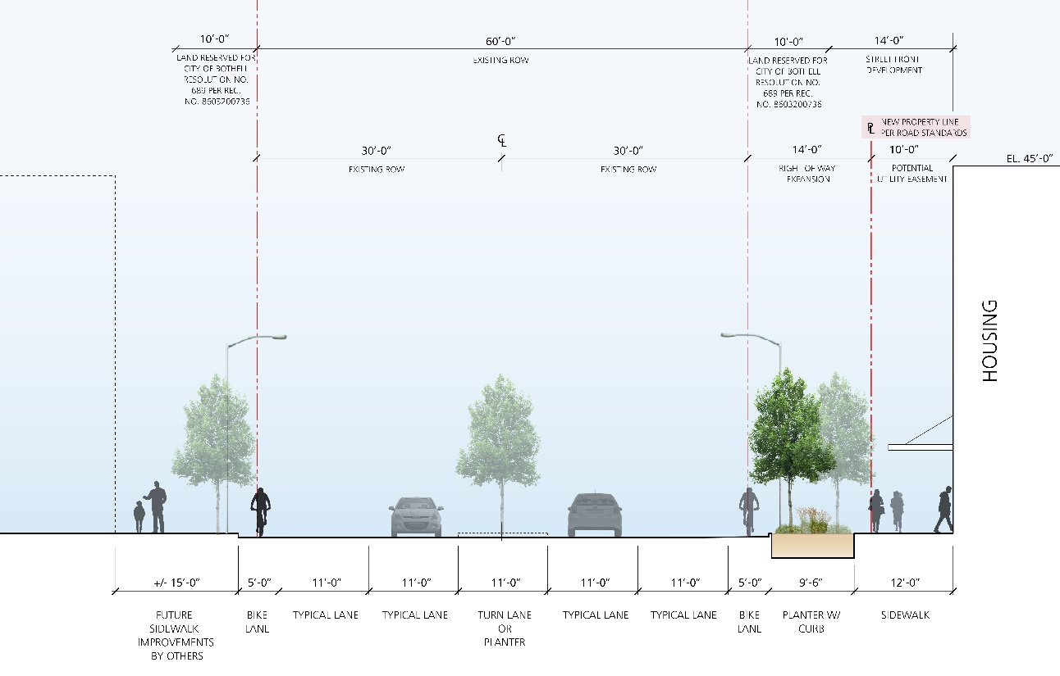
Beardslee Boulevard
Existing D-D
Proposed E-E

Slide 13
Questions & Answers

