Slide 1
UW Tacoma Milgard Hall
UW Architectural Commission
April 27th, 2020

Slide 2
Overview
Project Goals
Program
Siting Considerations
Slating Process

Slide 3
Project Goals
Offer local students more high-demand engineering degrees so students can earn degrees locally. There is clear demand for additional engineering degrees, specifically in Mechanical Engineering and Civil Engineering. UW Tacoma has support from UW to add these programs to this campus.
Meet student and employer demand for business degrees. Business degrees are among the top requested degrees in the University.
Close the job gap, fulfilling unmet industry demand for graduates in engineering and business so industries can hire locally. There are not enough engineering graduates produced by the Washington higher education system to fill local job openings in the field.
Connect local University students with local jobs in Engineering and Business. The new building will improve social and economic mobility of students within Pierce County and help keep UW Tacoma’s promise to drive economic development in the South Sound community.
Provide a high return on investment for the state, driving local economic prosperity for the South Sound and the State of Washington. UW Tacoma’s economic impact to the state of Washington is $211.7 million.
Notes:
Lightly review these, not a read through

Slide 4
Interdisciplinary Innovation
Milgard School of Business (MSB)
School of Engineering & Technology (SET)
Global Innovation & Design Lab
Notes:
GIDL is the connector between these two schools and provides a space for the entire campus to come into this building

Slide 5
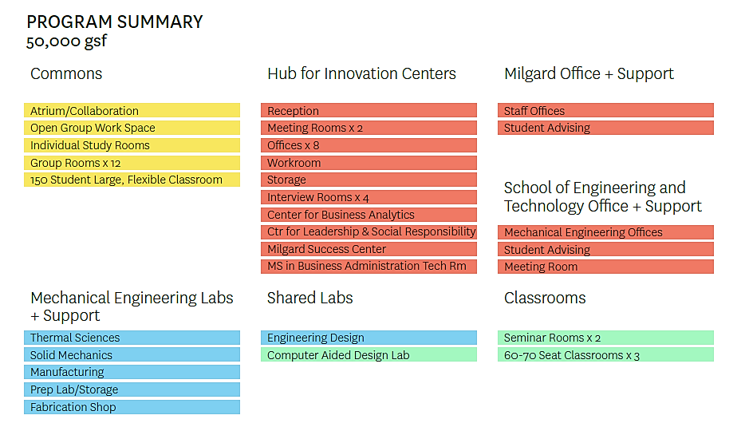
Project Program
Notes:
Mechanical and Civil Engineering lab and support spaces, breakout spaces, large classroom for campus, faculty offices and community facing centers and the GIDL

Slide 6
Siting Considerations
Notes:
As we shared last time we were reexamining the siting of this building to align with our budget allocation and Campus Development Plan, update to our Master Plan as a 10 year outlook for UWT,

Slide 7
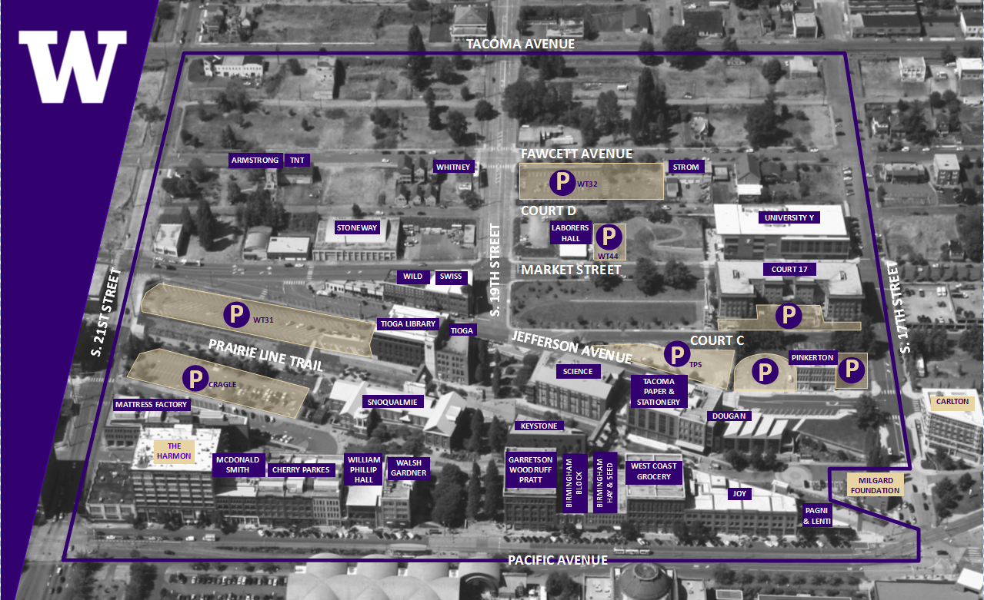
Campus Footprint

Slide 8
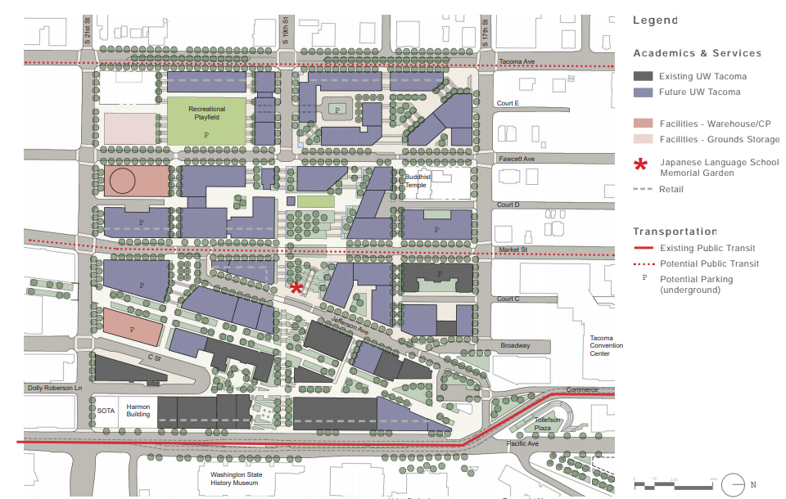
2008 Campus Master Plan
Notes:
Mithun’s full plan here

Slide 9
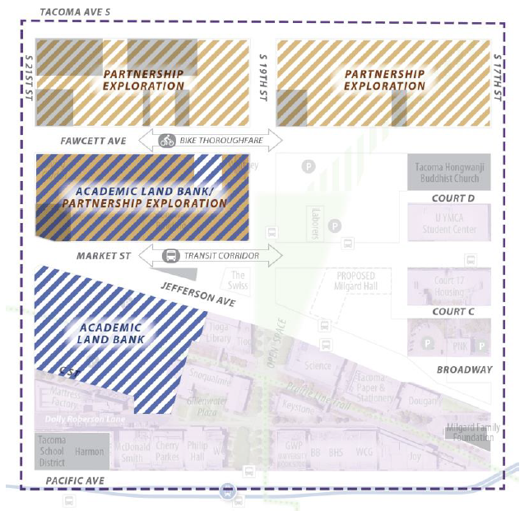
2020 Campus Development Plan
Notes:
Gensler & Heartland took the Master Plan along with current market trends to determine how the University can best focus their future development. Part of this was identifying the academic land bank to capitalize on the pedestrian patterns and concentration of engery

Slide 10
Site Options
Notes:
With this in mind we looked at these two additional sites and will work with the selected team to finalize Milgard Hall’s new home

Slide 11
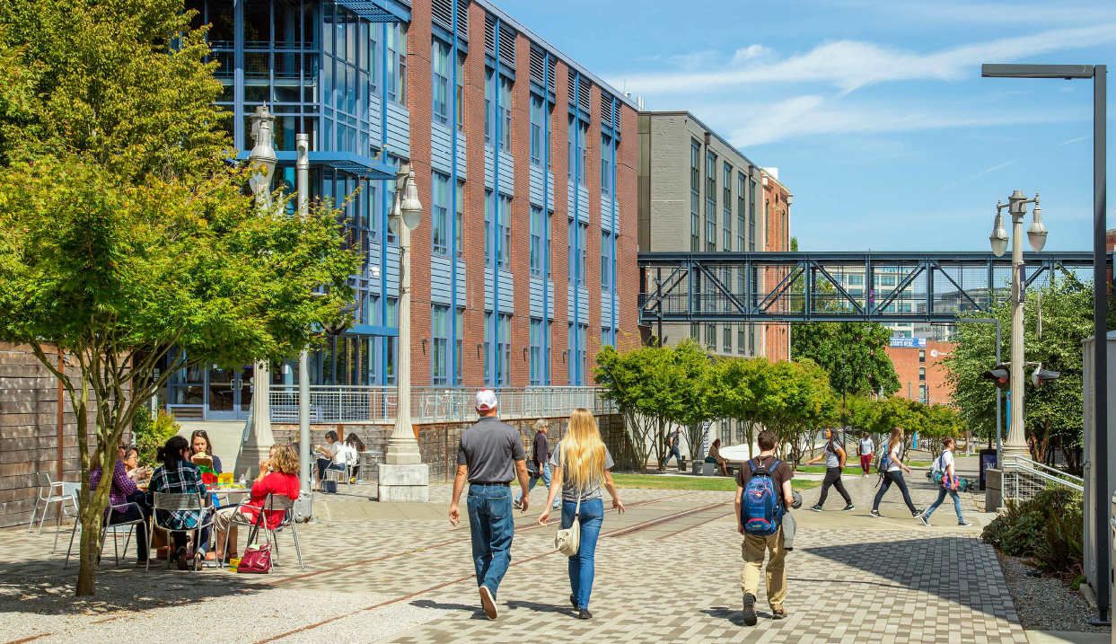
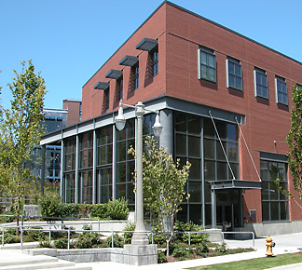
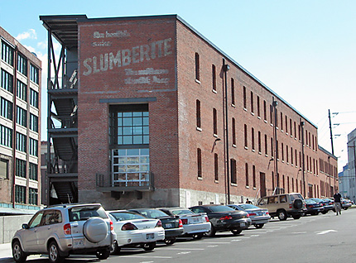
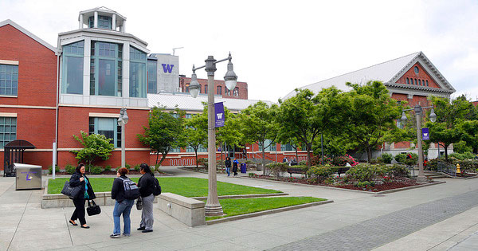
Context
Notes:
We’ve looked at several map views of UWT so we wanted to include some contextual pictures as a reminder of the scale and fabric of the campus as we move into the Interviews

Slide 12
Slating Process

Slide 13
Letters of Interest & Recommendations (31)
ARO
Hoist
Miller Hull
B&H Architects
Hultz| BHU Engineers
Payette
Bohlin Cywinski Jackson
Integrus
Perkins + Will
BORA
John Ronan Architects
Shigeru Ban + Atelierjones
DLR Group
Lever
Skidmore Ownings & Merrill
EHDD
LMN
Skylab
Gensler
Mahlum
Smith Group
Hacker
Marlon Blackwell
Studio Meng Strazzara
Henneberry Eddy Architects
McGranahan Architects
William Rawn Associates
HLW
Mithun
WRNS Studio
Miller Hayashi
Notes:
We received interest from or recommendations to reach out to the 31 firms you see here-such a wonderful list and we’d have a successful project from any of these firms
As you can imagine this required a significant amount of time to review websites, trim down from 31- 15/16 based on what’s available to research.
Also anecdotal information and it was based on that info alone that we were able to determine the most closely aligned firms to the needs of this project

Slide 14
Portfolio Review & RFQ offered (16)
ARO
Hoist
Miller Hull
B&H Architects
Hultz| BHU Engineers
Payette
Bohlin Cywinski Jackson
Integrus
Perkins + Will
BORA
John Ronan Architects
Shigeru Ban + Atelierjones
DLR Group
Lever
Skidmore Ownings & Merrill
EHDD
LMN
Skylab
Gensler
Mahlum
Smith Group
Hacker
Marlon Blackwell
Studio Meng Strazzara
Henneberry Eddy Architects
McGranahan Architects
William Rawn Associates
HLW
Mithun
WRNS Studio
Miller Hayashi
Notes:
We offered to these 16

Slide 15
SOQ Submitted (14)
ARO
Hoist
Miller Hull
B&H Architects
Hultz| BHU Engineers
Payette
Bohlin Cywinski Jackson
Integrus
Perkins + Will
BORA
John Ronan Architects
Shigeru Ban + Atelierjones
DLR Group
Lever
Skidmore Ownings & Merrill
EHDD
LMN
Skylab
Gensler
Mahlum
Smith Group
Hacker
Marlon Blackwell
Studio Meng Strazzara
Henneberry Eddy Architects
McGranahan Architects
William Rawn Associates
HLW
Mithun
WRNS Studio
Miller Hayashi
Notes:
Two firms chose not to submit

Slide 16
Office Visits (5)
ARO
Hoist
Miller Hull
B&H Architects
Hultz| BHU Engineers
Payette
Bohlin Cywinski Jackson
Integrus
Perkins + Will
BORA
John Ronan Architects
Shigeru Ban + Atelierjones
DLR Group
Lever
Skidmore Ownings & Merrill
EHDD
LMN
Skylab
Gensler
Mahlum
Smith Group
Hacker
Marlon Blackwell
Studio Meng Strazzara
Henneberry Eddy Architects
McGranahan Architects
William Rawn Associates
HLW
Mithun
WRNS Studio
Miller Hayashi
Notes:
Through scoring process number (individually) and explanation, then adjusted, objective, along with personal experience
Didn’t agree allowed for all comments to be heard, reevaluate
Closely overlaid with RFQ questions, letter grade criteria (a,b,c)
Strong baseline 31 gave us great foundation
Excited about all 5 then started clean slate on interaction
Ban/Jones- (We were particularly excited about JV ban jones their higher ed experience was lacking, art piece, budget concerns, it was about them)
Perkins Will- (lackluster presentation, fell short of design excellence, leardership MN)

Slide 17
Recommendation for Award (3)
ARO
Hoist
Miller Hull
B&H Architects
Hultz| BHU Engineers
Payette
Bohlin Cywinski Jackson
Integrus
Perkins + Will
BORA
John Ronan Architects
Shigeru Ban + Atelierjones
DLR Group
Lever
Skidmore Ownings & Merrill
EHDD
LMN
Skylab
Gensler
Mahlum
Smith Group
Hacker
Marlon Blackwell
Studio Meng Strazzara
Henneberry Eddy Architects
McGranahan Architects
William Rawn Associates
HLW
Mithun
WRNS Studio
Miller Hayashi
Notes:
Office visits informed team interaction, and emphasized SOQ content
Two top teams unanimous and clear, discussion (extra) on who was the next best fit
Three things we were looking for Higher Ed (HE) success, Mass Timber (MT), Team interaction (TI)
BORA (104/135) – HE, MT, TI active collaboration (programming including successful collaborative space)
Lever (102/135) – MT, TI (*HE)
ARO (89/135)- HE (*MT, TI)

Slide 18
Thank you

